Slide 1
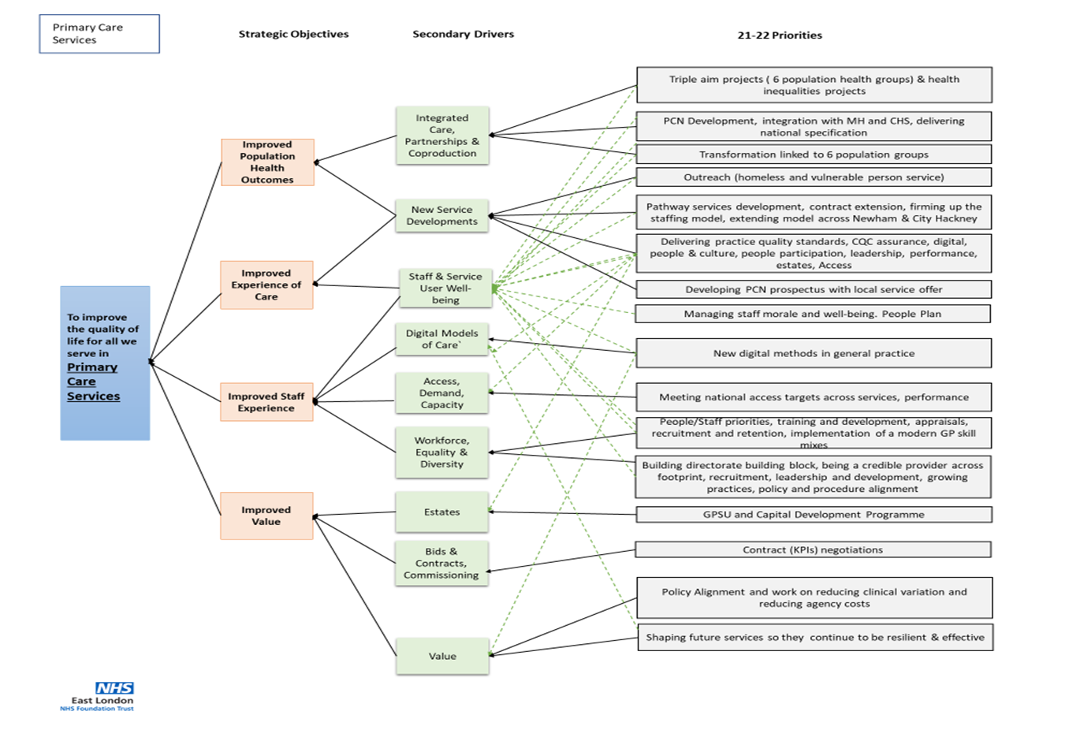
Primary Care Directorate 2021/22 Annual Plan Implementation
Outstanding General Practice at ELFT
JUNE UPDATE
Last updated on 12 July 2021 by Marina Muirhead

Slide 2
Our mission - Improve the quality of life for all that we serve
Aim 1 – Improved Population Health, pages 4 to 11
Aim 2 – Improve experience of care, pages 12 to 14
Aim 3 – Improve staff experience, pages 15 to 17
Aim 4 – Improve Value pages, 18 to 20
This implementation plan will be owned and monitored via the DMT.

Slide 3
PC Directorate: Our 21/22 Annual Plan
Building and transforming

Slide 4
Strategic Objective | Driver | Lead / SRO | Start Month | End Month
Improved population health outcomes | Integrated Care, Partnerships & Coproduction | Practice Leads | Summer 2021
21/22 Priority | Projects / Actions to deliver the priority | Others involved and any corporate support | Status update / | RAG
CQC 6 population health groups – defining the offer | each service to develop engagement plans with the 6 population groups following the audit in April | N/A | CQC handbook issued to all services to help them develop their offer for each of the pop groups
 | Development of 2 population level specific focus groups a BLMK and E/L to develop the offerings
 | The Dialog+ project LD is running at LRS has started to work initially with young families and children attending the childhood imms clinic | LRS PPG Project

Slide 5
Strategic Objective | Driver | Lead / SRO | Start Month | End Month
Improved population health outcomes | Integrated Care, Partnerships & Coproduction | Service Director | April 2021 1st Version and November 2nd version | Ongoing
21/22 Priority | Projects / Actions to deliver the priority | Others involved and any corporate support | Status update / | RAG
ARRS roles and links with the PCNs | PCN prospectus and integration offer Feedback from practices Further refining | BDU and all services across the trust
Second PCN prospectus of offers | The pipeline projects | BDU and all services across the trust | Not starting until late 2021

Slide 6
Strategic Objective | Driver | Lead / SRO | Start Month | End Month
Improved population health outcomes | Integrated Care, Partnerships & Coproduction | Practice leads, OD Lead and Service Director | April 2021 | Ongoing
21/22 Priority | Projects / Actions to deliver the priority | Others involved and any corporate support | Status update / | RAG
Greenhouse population health integrated health, care and housing provider partnership | A project group has been established and lead by Greenhouse which includes ELFT MH ARRS roles PCN leadership Housing LA VCSE Groundswell | Multi Agency Partnership Group | Second workshop undertaken. Service pulling together the offer to the Greenhouses population ahead of the next workshop

Slide 7
Strategic Objective | Driver | Lead / SRO | Start Month | End Month
Improved population health outcomes | Integrated Care, Partnerships & Coproduction | Practice Leads, Comms Manager and PPL | June | March 2022
21/22 Priority | Projects / Actions to deliver the priority | Others involved and any corporate support | Status update / | RAG
Reducing health inequalities | The project manager for patient and community engagement will be doing work to help understand the inequalities faced but our patients better. | Practice Leads | Adverts out
 | SPR in Public health to be assigned to primary care from May via the ELFT PH team to do some specific work on health inequalities | SPR and Leads when identified | Kick off meeting with Liz and Marina taken place
 | Health and housing project at the Greenhouse practice | Greenhouse Leads | In train
 | Work on increasing update around breast, bowel and cervical screening with some tweaking for different populations | Comms Manager with Practice Leads
 | Community screening champions – linked
 | Work on increasing imms and vaccinations learning from the covid-19 programme about how to deliver vaccination campaigns in differing settings | Lead Nurses

Slide 8
Strategic Objective | Driver | Lead / SRO | Start Month | End Month
Improved population health outcomes | Integrated Care, Partnerships & Coproduction | Practice Leads | April 2021 | Ongoing
21/22 Priority | Projects / Actions to deliver the priority | Others involved and any corporate support | Status update / | RAG
PCN Development and delivering national specifications including IIF | As per the contractual guidance | PCN meetings and ELFT PCN programme board
 | Developing PCN prospectus with local service offer BDU and Service Areas / Leads | Service Director

Slide 9
Strategic Objective | Driver | Lead / SRO | Start Month | End Month
Improved population health outcomes | Integrated Care, Partnerships & Coproduction | Practice Leads | April 2021 | Ongoing
21/22 Priority | Projects / Actions to deliver the priority | Others involved and any corporate support | Status update / | RAG
New Service Developments | Outreach (homeless and vulnerable person service ELFT Homeless and Vulnerably House Integrated Care Model | Service Director BDU and Service Areas / Leads | Inclusion health spec progressing plans to issue to the CCG
 | Change Bus Project | Service Director BDU and Service Areas / Leads | As per above
 | Pathway services development, contract extension, firming up the staffing model, extending model across Newham & City Hackney | Service Director BDU and Service Areas / Leads | C&H Service approved Adverts being drawn up by the MD
 | Delivering practice quality standards and CQC assurance CQC readiness workshop we ran with the outputs from this CQC Handbook Pop quiz | Medical Director / Service Director Service Areas / Leads | Weekly CQC newsletter issued Handbook issued Services being trained in peer inspection
 | People participation Building our people participation strategy Building a carers strategy Back out to advert for two half time people | Medical Director / Service Director Service Areas / Leads | Not yet commenced

Slide 10
Strategic Objective | Driver | Lead / SRO | Start Month | End Month
Improved population health outcomes | Integrated Care, Partnerships & Coproduction | Medical Director & Service Leads | April 2021 | Ongoing
21/22 Priority | Projects / Actions to deliver the priority | Others involved and any corporate support | Status update / | RAG
New Service Developments | Improving Access Demand and capacity QI project at CMC should help deliver learning we can spread across the other services LRS to start the work Publishing case studies and comms materials on the different roles in general practice and who will see you for what – posters have developed | Medical director and Comms Manager | Comms materials developed and need to be discussed, agreed and advertised at a practice level Demand and capacity project at CMC progresses well.

Slide 11
Strategic Objective | Driver | Lead / SRO | Start Month | End Month
Improved population health outcomes | Integrated Care, Partnerships & Coproduction | Service Director, Medical Director & Head of Nursing | April 2021 | Ongoing
21/22 Priority | Projects / Actions to deliver the priority | Others involved and any corporate support | Status update / | RAG
New Service Developments | PC Leadership Development ELFT Lead Lead GP programme Lead Nurse Programme Practice Manager Programme |  | ELFT lead underway In development other leadership programmes Skilling up line managers in transactional HR

Slide 12
Strategic Objective | Driver | Lead / SRO | Start Month | End Month
Improved experience of care | Service User engagement | Medical Director | September
Projects / Actions to deliver the priority | Others involved and any corporate support | Status update / | RAG
Development of PPGs Via PM for patient and community engagement Good stuff form coverage | Medical director with oversight via QAG | Not yet commenced
PREM Survey Up and running OR service to design and implement a survey Roll out of you said, we did boards Outreach PREM - | Medical director with oversight via QAG
National GP survey National survey results published in July 2021 an action plan will be needed and you said we did process | Medical director with oversight via QAG | Results published and practice teams working up action plans

Slide 13
Strategic Objective | Driver | Lead / SRO | Start Month | End Month
Improved experience of care | Service User engagement | Comms Manager / DDM and Practice Leads | April
20/21 priority | Projects / Actions to deliver the priority | Others involved and any corporate support | Status update / | RAG
Comms and engagement | new practice leaflets Include the offer for different populations. Getting info from sites and building a template Printing and online versions / accurux Available in various languages | Medical director / Service Leads with oversight via QAG | First draft for LRS seen Further work required on the elements that are missing
 | comms on the new roles in general practice Campaign on our people and their roles | Medical director / Service Leads with oversight via QAG | Materials produced and need to be discussed with service areas
 | Practice and Partner Newsletters | Medical director / Service Leads with oversight via QAG | Not yet started

Slide 14
Strategic Objective | Driver | Lead / SRO | Start Month | End Month
Improved experience of care | Improving access and going digital first | DDM and Practice Leads | April
Projects / Actions to deliver the priority | Others involved and any corporate support | Status update / | RAG
Roll out of the new GPA contractual requirement Access programme at CMC and LRS | Practice team steering group | Practices have commenced apt mapping work
New digital methods in general practice | Practice Leads

Slide 15
Strategic Objective | Driver | Lead / SRO | Start Month | End Month
Improved staff experience | Managing staff morale and well-being | PC team, service, and medical director | April & December | Ongoing
Projects / Actions to deliver the priority | Others involved and any corporate support | Status update / | RAG
Staff survey working group Staff summer party Staff survey to undertake MV visiting each team re wellbeing Wellbeing team sessions | PC team, service, and medical director
Development of a PC People Plan and Talent Management Strategy | P&C BP | Not commencing until December
Implementation of the primary care directorate Staff and mandatory training mapping KSF Development of a brochure of KSF events Souring of a training provider or development of inhouse training schemes | LD Officer | Awaiting the interviews for the LD lead
AFC consultations in BMLK and Greenhouse Delivering the staffs request a move to agenda for change and aligning the model | PC BP | In train

Slide 16
Strategic Objective | Driver | Lead / SRO | Start Month | End Month
Improved staff experience | Managing staff morale and well-being | PC team, service, and medical director | April & December | Ongoing
Projects / Actions to deliver the priority | Others involved and any corporate support | Status update / | RAG
Appraisals delivery recruitment and retention, Links to the people plan and career development | Whole team
Staff Survey Improvements | Steering group with action plan | See previous
Workforce, Equality & Diversity Race and privilege sessions | Whole team | Sessions currently cancelled
Policy and procedure alignment The primary care webspace All aligned policies and procedures Structured clinical and non-clinical induction packs Embedded within the services | Clinical and non-clinical policy review group | May website Clinical ongoing 70% Non clinical finished

Slide 17
Strategic Objective | Driver | Lead / SRO | Start Month | End Month
Improved staff experience | Improved staff experience | DDM | April | Ongoing
Projects / Actions to deliver the priority | Others involved and any corporate support | Status update / | RAG
Standardised induction programmes Practice / Service Managers Bands 3 and 4 E/ London GPSU HCA and Nursing teams Locum Doctors Outreach Service | Service Leads | Various ones issued. Ones outstanding Nursing packs GPSU Locum doctors Outreach teams
GPSU implementation Implementing the model and all logistics Meetings with leads on each area Whole team meeting on 12/5 Clinicians to help scope the interface between the GPSU and practices | Steering Group / Project Implementation Steering Group | Project group progresses however there are some key risks around capital.

Slide 18
Strategic Objective | Driver | Lead / SRO | Start Month | End Month
Improved value | Value | Medical Director | April | Ongoing
Projects / Actions to deliver the priority | Others involved and any corporate support | Status update / | RAG
work on reducing clinical variation Policies work Implementation of QAG Developing directorate meds safety audits Developing equity across the clinical team Looking at clinical rotas to standardise where necessary | Medical Director overseen by QAG
Rotas and forward planning Roll out health roster across the primary care directorate | All leads
reducing agency costs Ongoing recruitment for clinical staff Piece around developing the PC bank | Practice Leads
Reduction in non-pay costs Efficiency programme to be designed and developed | Practice Managers Finance BP and Data and Income Manager
Increasing practice use of ARRS Ensuring the right roles are recruited to Ensuring there is correct knowledge / systems and processes in place to ensure ARRS roles are fully utilised and booked into | Practice Leads DDM and D&ICM

Slide 19
Strategic Objective | Driver | Lead / SRO | Start Month | End Month
Improved value | Value | Practice Leads | April | Ongoing
Projects / Actions to deliver the priority | Others involved and any corporate support | Status update / | RAG
Increasing practice resilience By building the foundations of the right systems and processes, getting staffing models right with understanding of demand and capacity and with good leadership. Daily work done by MM and LD GPSU is key in that | Service director and medical director
Bids & Contracts, Commissioning Reviewing contract (KPIs) negotiations | All leads

Slide 20
Strategic Objective | Driver | Lead / SRO | Start Month | End Month
Improved value | Estate improvement | Service Director | April | Ongoing
Projects / Actions to deliver the priority | Others involved and any corporate support | Status update / | RAG
GPSU and capital bid Deliver the transformation of the LRS site | Trust capital, digital and estates teams | In development

Slide 21
References
NHS Digital: General practice data hub a collection of interactive dashboards relating to general practice in England
https://digital.nhs.uk/data-and-information/data-tools-and-services/data-services/general-practice-data-hub
NHS Digital: Payments to General Practice - England, 2019/20
https://digital.nhs.uk/data-and-information/publications/statistical/nhs-payments-to-general-practice/england-2019-20
NHS England and the BMA: Investment and evolution: A five-year framework for GP contract reform to implement The NHS Long Term Plan
https://www.england.nhs.uk/wp-content/uploads/2019/01/gp-contract-2019.pdf
The Long Term Plan
https://www.longtermplan.nhs.uk/
NHS England, 10 high impact actions to release time to care in General Practice
https://www.england.nhs.uk/gp/gpfv/redesign/gpdp/
NHS England, Releasing time to care in General Practice
https://www.england.nhs.uk/gp/gpfv/redesign/gpdp/releasing-time/
NHS England, Building capability for improvement in General Practice, the national offer to General Practice
https://www.england.nhs.uk/gp/gpfv/redesign/gpdp/capability/

