Slide 1
Digital Transformation Plan

Slide 2
What we do
Data and Reporting services
RiO, EMIS, SystmOne
Computer and network

Slide 3
Digital Planning

Slide 4
What we’ll do
Digital agenda
Objective
Activities
Transform the experience of care through the utilisation of digital tools
Video consultations
Patient portal
Shared record
Population health data
Efficient workflows
Digital experience – Service users and carers
Transform the experience of work though adoption of digital tools and processes
Mobile working
Digital dictation
eObservations
ePrescribing
Model digital ward
Data visualisation
Digital experience - staff

Slide 5
Digital ambition– three domains of Digital First
Fast
Digital First solutions available at point of need
Frictionless
Systems and processes digitally optimised
Fun
Staff confident in using the solutions effectively

Slide 6
Digital Evolution – Journey to Digital First
We provide a modern Toolkit that supports:
delivery of high quality patient care
staff wellbeing
Information at your fingertips
Access from anywhere/anytime
Simple to use
Interoperability – can share information with any clinician anywhere
Fast
Digital First solutions available at point of need
Frictionless
Systems and processes digitally optimised
Fun
Staff confident in using the solutions effectively

Slide 7
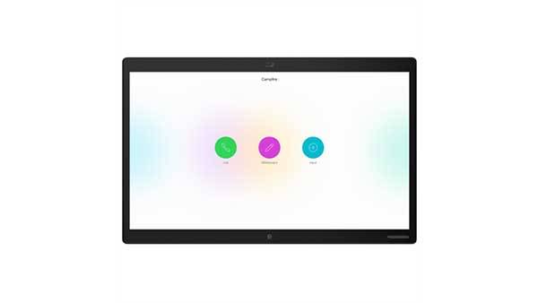
Improved staff experience - Mobile
Office 365
NHSMail
EMIS Mobile
RiO Mobile
Operational apps
Remote access
UK cloud
4G/WiFi
Mobile workforce
Internet
Internet
Home workers
Hotdesk facilities

Slide 8
Improved staff experience - Ward
East London Patient Record
Acute GP
Social Care
Single sign on – smartcard enabled
ePrescribing
eCorrespondance & hybrid mail
eObs
CMC
SCR
ICE

Slide 9
Improved value - Data
Performance
Executive
Teams
Analytics portal
Financials
ESR
Discovery
Cloud based data warehouse
Commissioner reports
National/statutory reports

Slide 10
2018-19 Achievements
300 EMIS mobile iPads deployed in all District Nursing services, over 80% utilisation
5th of 200 Trusts in deploying win10
70% of desktop estate on windows 10
700 Office 2016/365 users
1st mental health ward to gain national funding for ePMA rollout
Patient safety benefits realised
eCorrespondance deployed Trustwide
Cyber security improvements through NHS cyber accelerators
Bedfordshire community services and SPOA live 800 community staff

Slide 11
Patient admitted with manic relapse after stopping lithium
AFTER DIGITAL TRANSFORMATION
BEFORE DIGITAL TRANSFORMATION
GP for meds and allergies
SCR
Clinician accesses SCR from RiO in context hyperlink
Radiology dept for kidney scan result
Multiple calls and faxes
Doctor
A&E for details of recent attendance
Single login
eLPR
RiO
Doctor
Renal dept for last outpatient letter
Clinician accesses integrated East London Patient Record
Pathology lab for blood results
Clinician prescribes and records drug administration electronically
Write drug chart on ward
Restart lithium
JAC

Slide 12
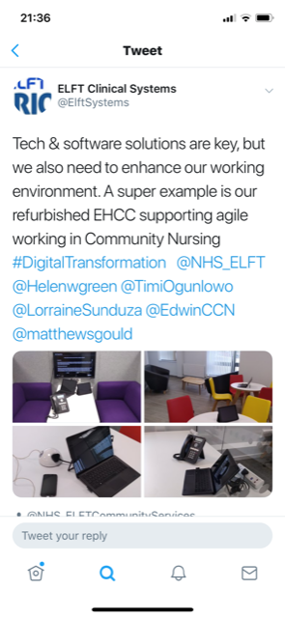
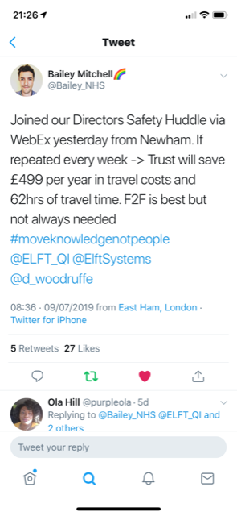
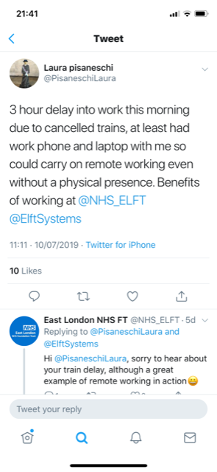
The impact of our Digital Programme

Slide 13
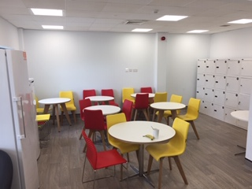
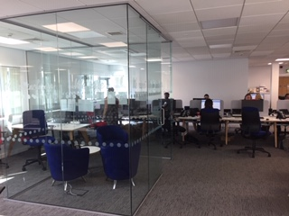
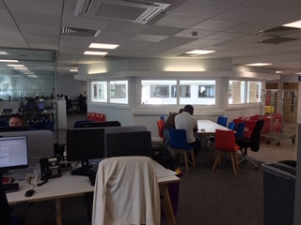
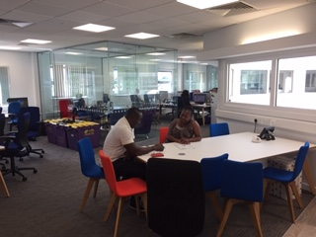
Improved staff experience - environment

