Slide 1
HP Planet Partners program Ordering process - Bulk collections
June 2016

Slide 2
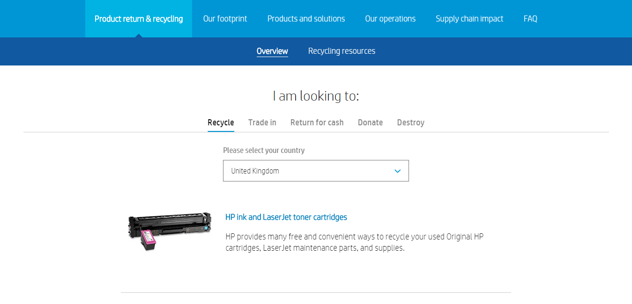
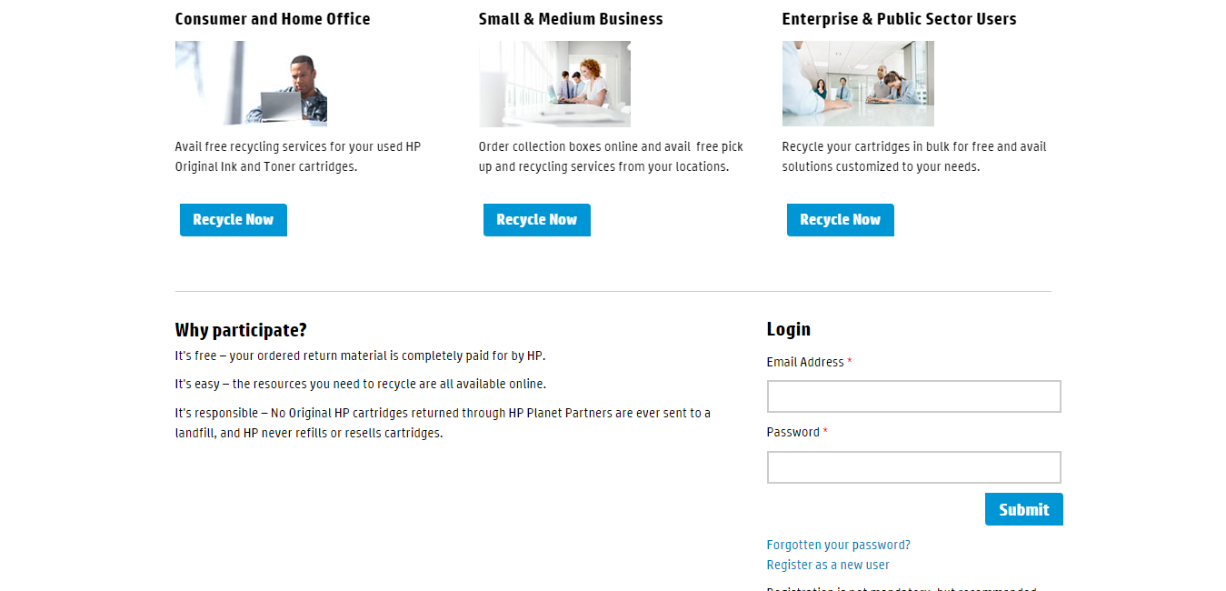
Step 1. Go to hp.com/recycle, select your country and click on “HP ink and LaserJet toner cartridges”.
Step 2. Login if you are a registered user. Registration is not mandatory, but recommended.

Slide 3
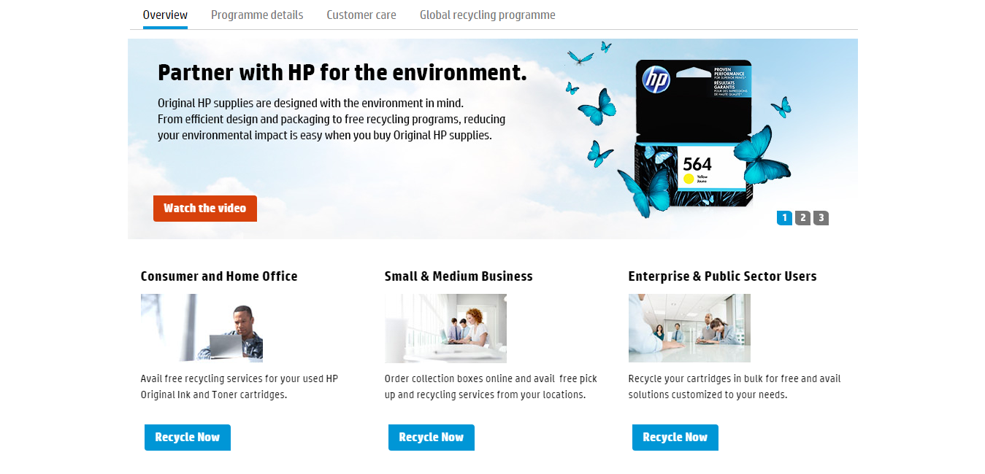
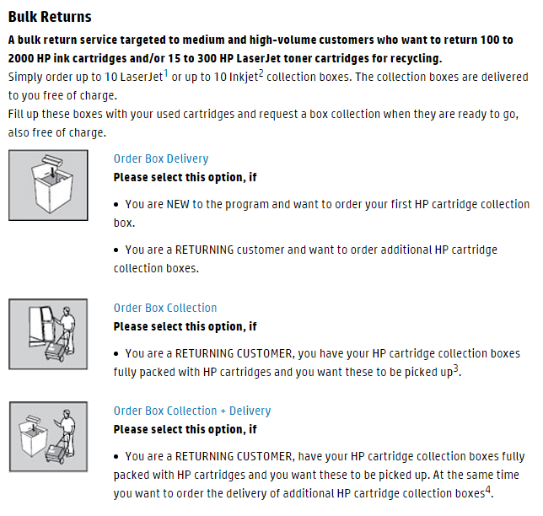
Step 3. Click on “Recycle Now” under the business segment that matches your profile (SMB or Enterprise / Public Sector for business customers).
Step 4. In the “Bulk Returns” section, select the appropriate service option based on your needs (box delivery, box collection or box collection + delivery).

Slide 4
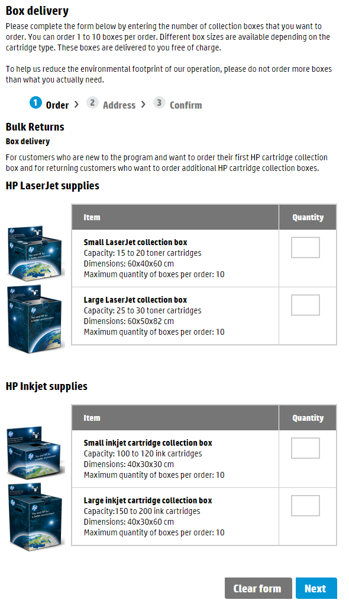
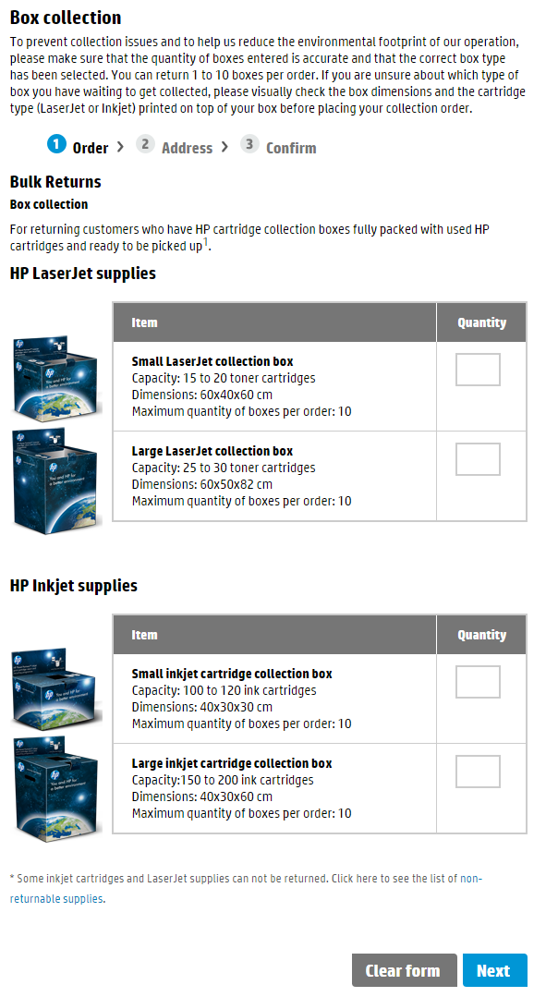
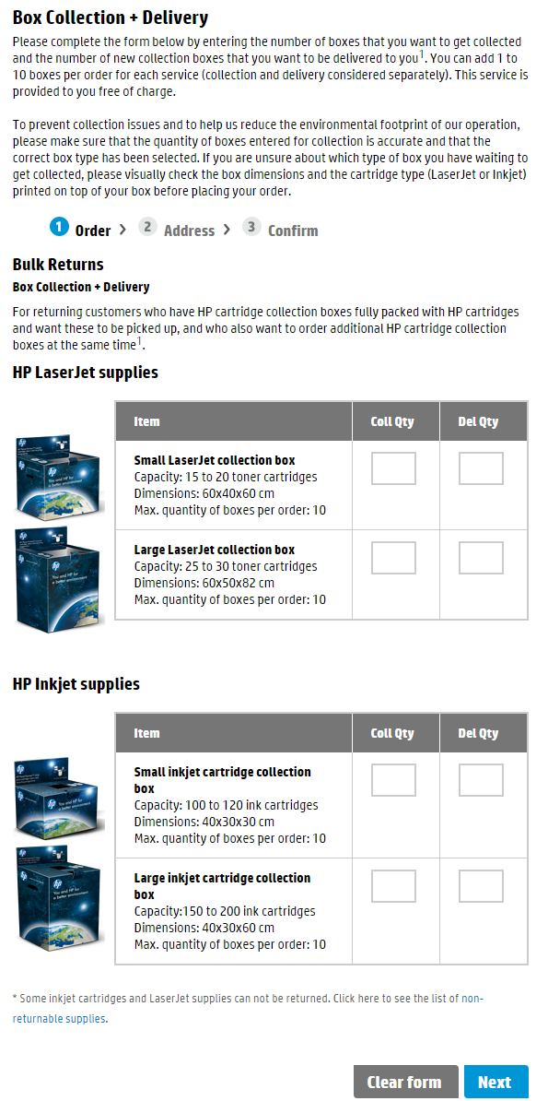
Step 5. Based on your previous selection, define the type and quantity of boxes to be delivered to your premises, and/or the type and quantity of boxes to be collected from your premises.

Slide 5
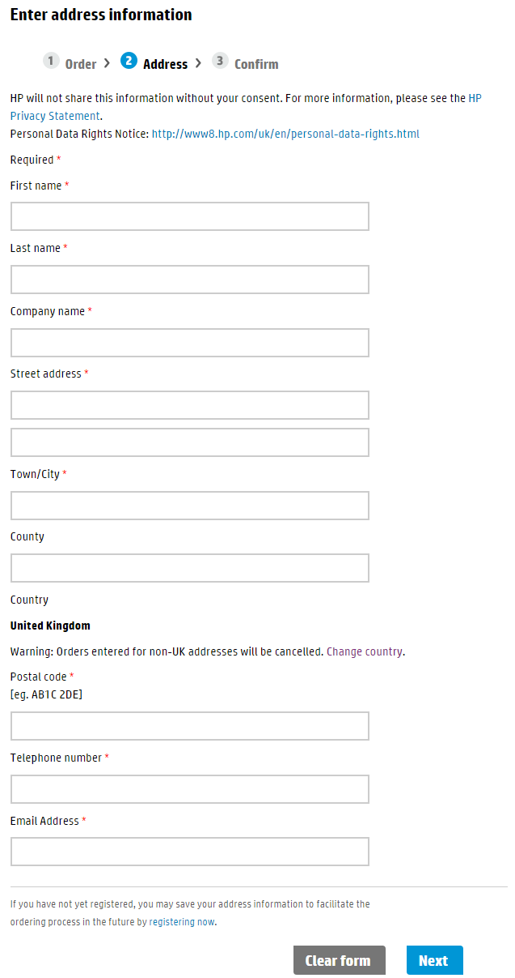
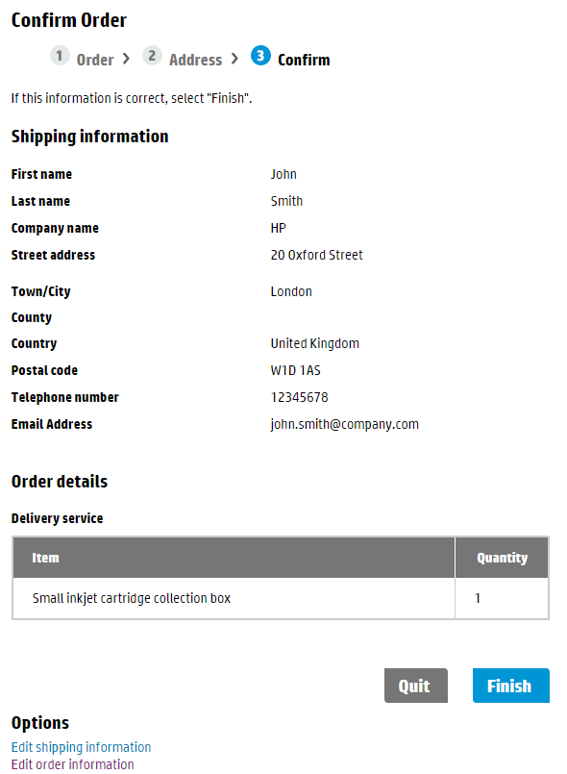
Step 6. Enter your contact and address details (not necessary if you are a registered user and have logged in).
Step 7. Review and confirm the details of your order.

Slide 6
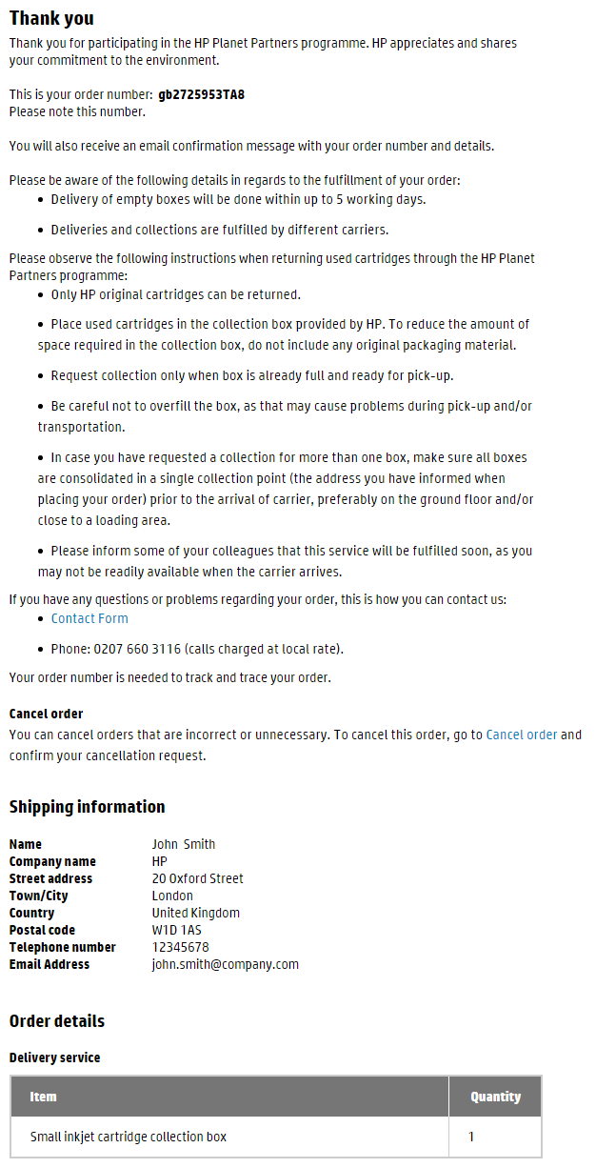
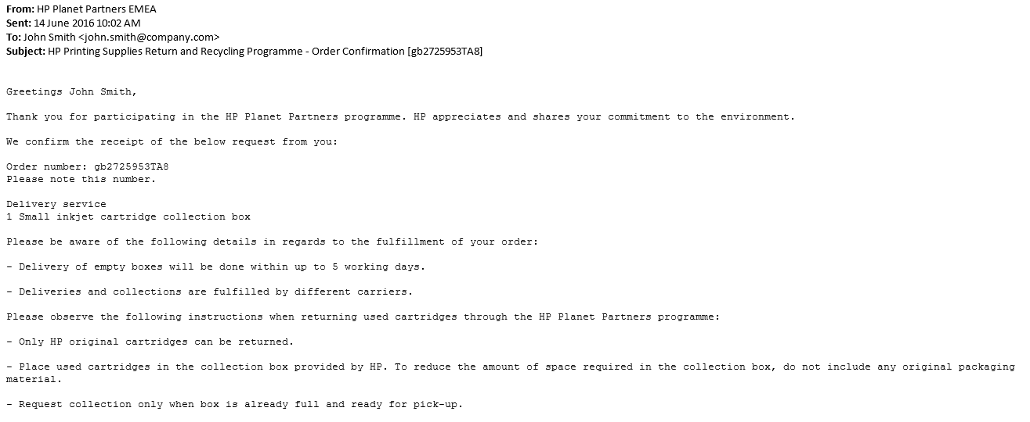
Step 8. Review the key user instructions in the order confirmation page.
A message with the same content is also sent to your email address.

Slide 7
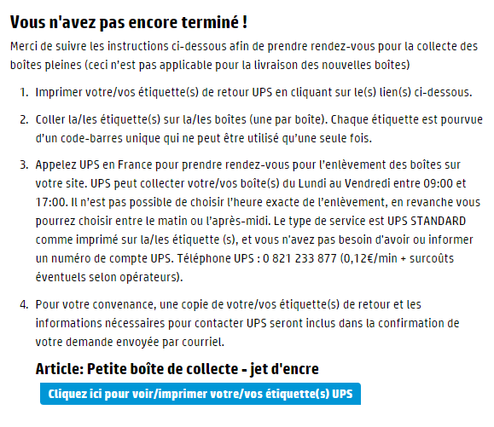
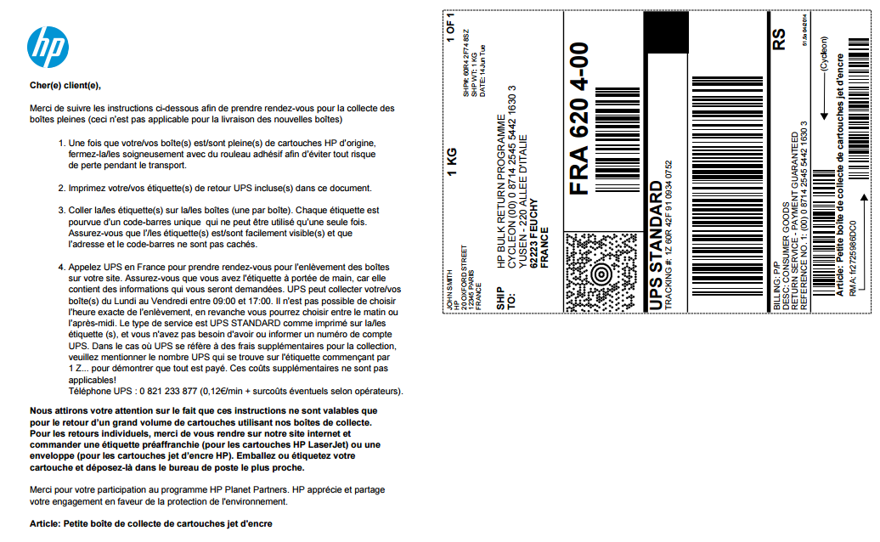
APPLICABLE TO CUSTOMERS IN FRANCE AND SPAIN ONLY
Step 8. For box collection orders, follow the instructions in the order confirmation page/email and call UPS to schedule your collection. Review the key user instructions in the order confirmation page (also included in your order confirmation email).
Step 9. Print your UPS collection label and affix it to your box prior to the arrival of the courier.

