Slide 1
Communications Annual Plan 2022-23
March 2022

Slide 2
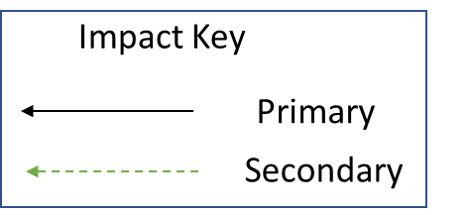
Strategic Objectives
Secondary Drivers
22-23 Priorities
Trust Rebrand
Improved Population Health Outcomes
Integrated Care, Partnerships & Coproduction
Bedford Health Village Engagement
New Improved channels – e.g. YouTube, Interactive Trust Talks, ELFT Podcasts
New Service Developments
Improved Experience of Care
New Website/Intranet
To improve the quality of life for all we serve
Dedicated support for Primary Care
Improved Staff Experience
Staff & Service User Wellbeing
Service User Accreditation
Improved Value
Digital Improvements
Dedicated support for Digital First Strategy

