Slide 1
People and Culture Annual Plan 2022-23
March 2022

Slide 2
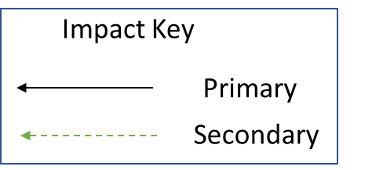
Strategic Objectives
Secondary Drivers
22-23 Priorities
Getting the basics right – internet & intranet presence, transactional processes improve
Future of work programme and work life balance project
Embedding technology – the LMS and Healthroster
New ways of working
Continued improvement on WRES & WDES plan and metrics
Belonging in the NHS
To improve the quality of life for all we serve
Introduction of EDI lead role
Improved Staff Experience
Transition of mass vacc lead employer to business as usual
Looking after our people
Adapt wellbeing offer and policies to support trauma informed approaches
Respectful Resolution project launches
Embed workforce planning project manager service
Growing and developing for the future
A centralised temporary staffing function that facilitates reduction in agency spend
Delivery of recruitment and retention strategy group action plan

