Slide 1
Respect and Dignity @ Work
(Including Covid, Race and Privilege)

Slide 2
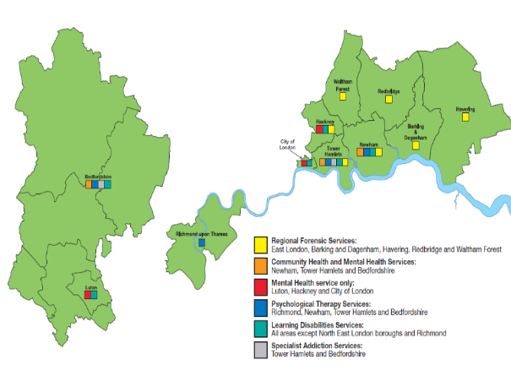
A Mile in My Shoes

Slide 3
Respect and Dignity @ Work Campaign
Phase 2
Phase 3
Phase 4
Phase 1

Slide 4
Through My Eyes
50 staff stories and illustrations
7 Themes:
The Administrator stories;
The Black Women’s stories;
Stories from those with mental health problems;
The Bradford score stories
Stories following an incident of violence or suicide;
I love my job;
One person can make all the difference.

Slide 5
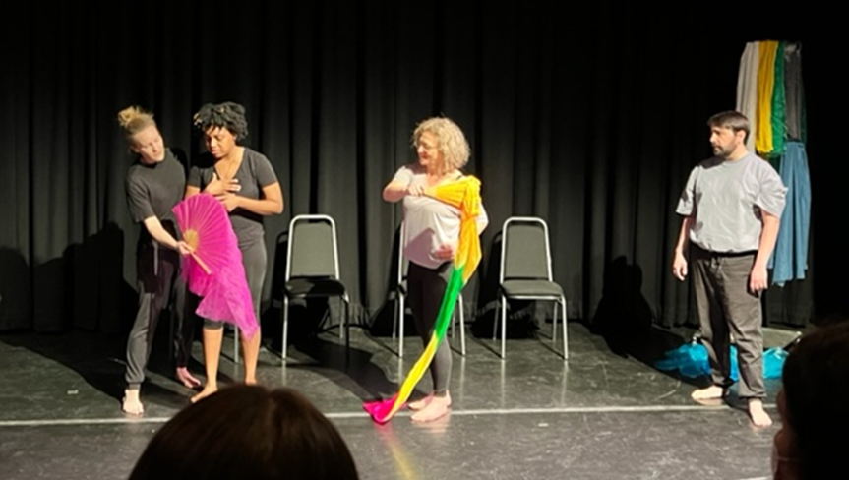
Creating Change

Slide 6
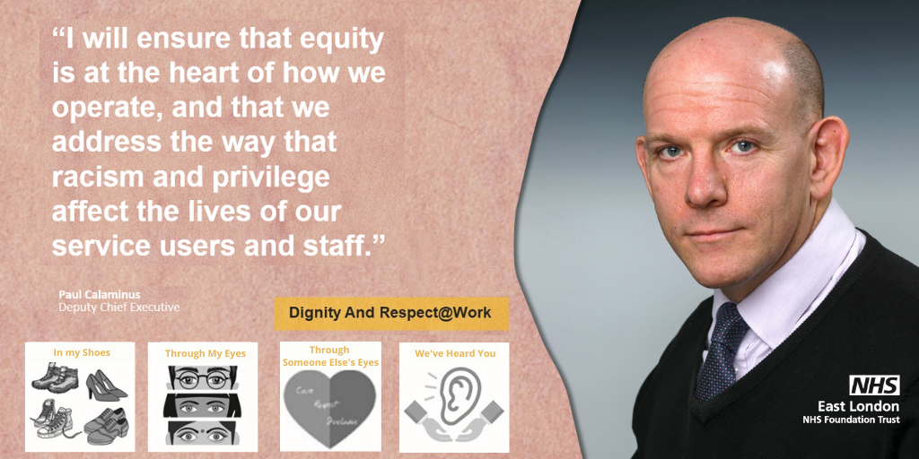
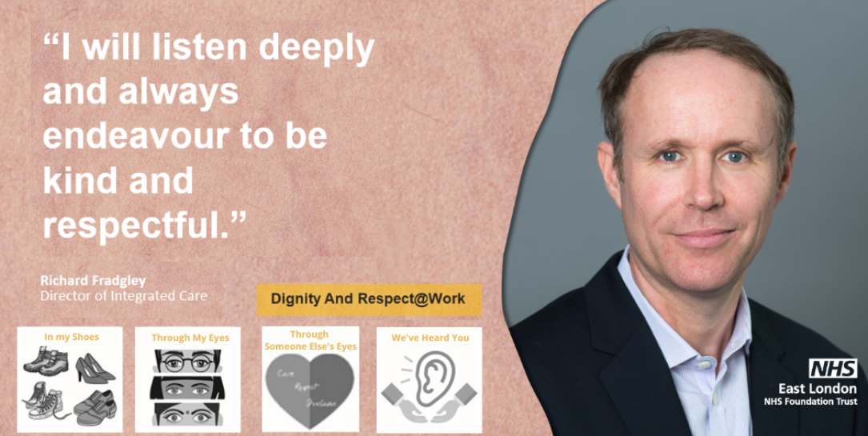
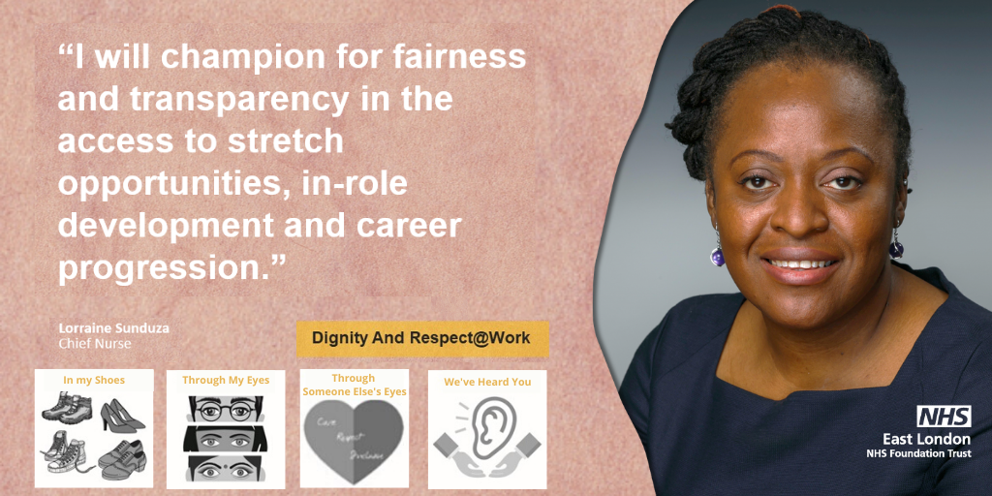
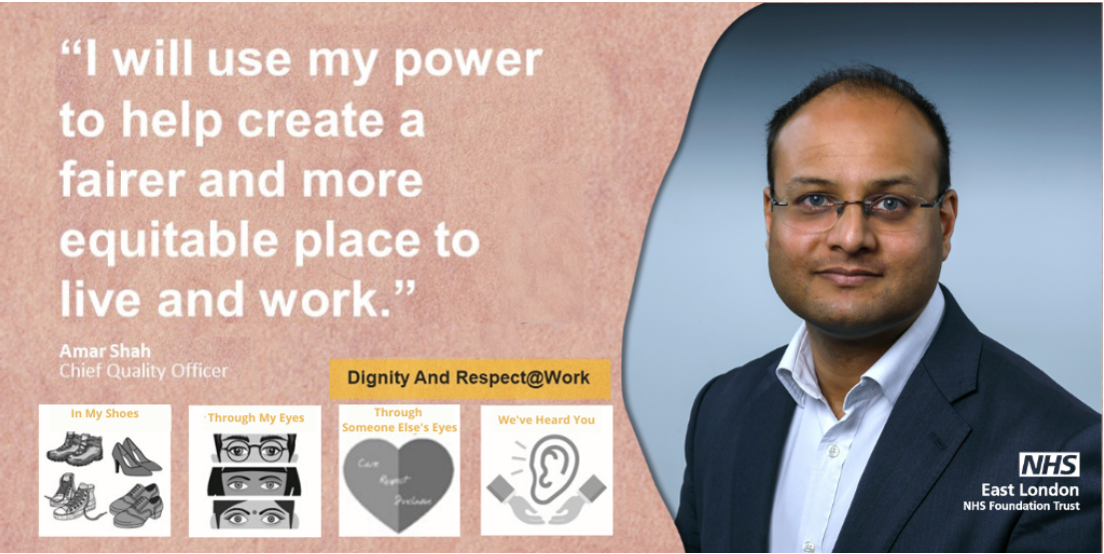
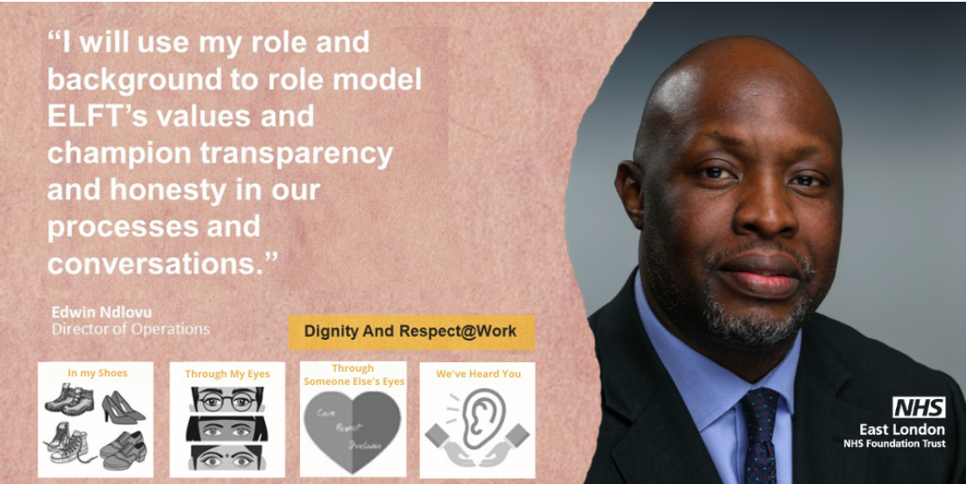
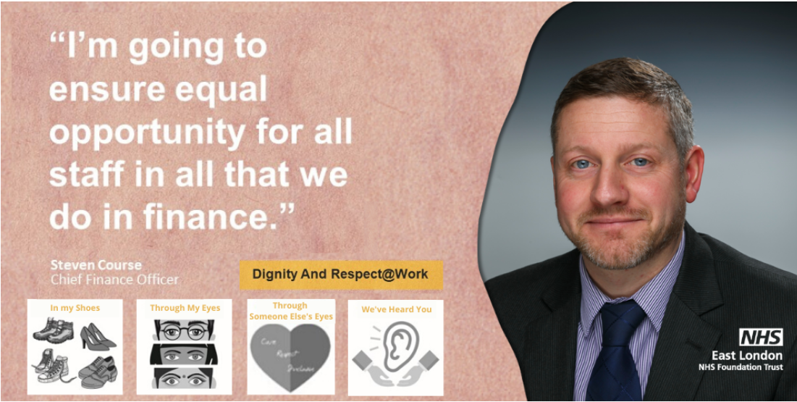
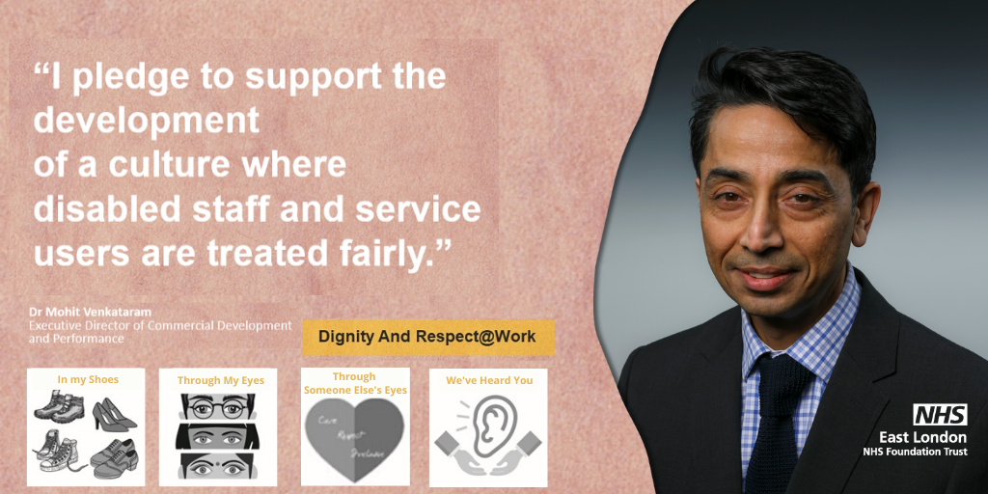
Executive Pledges 2020/2021

Slide 7
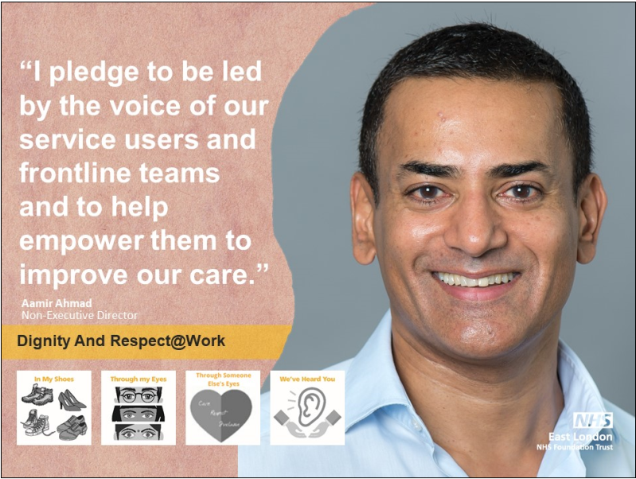
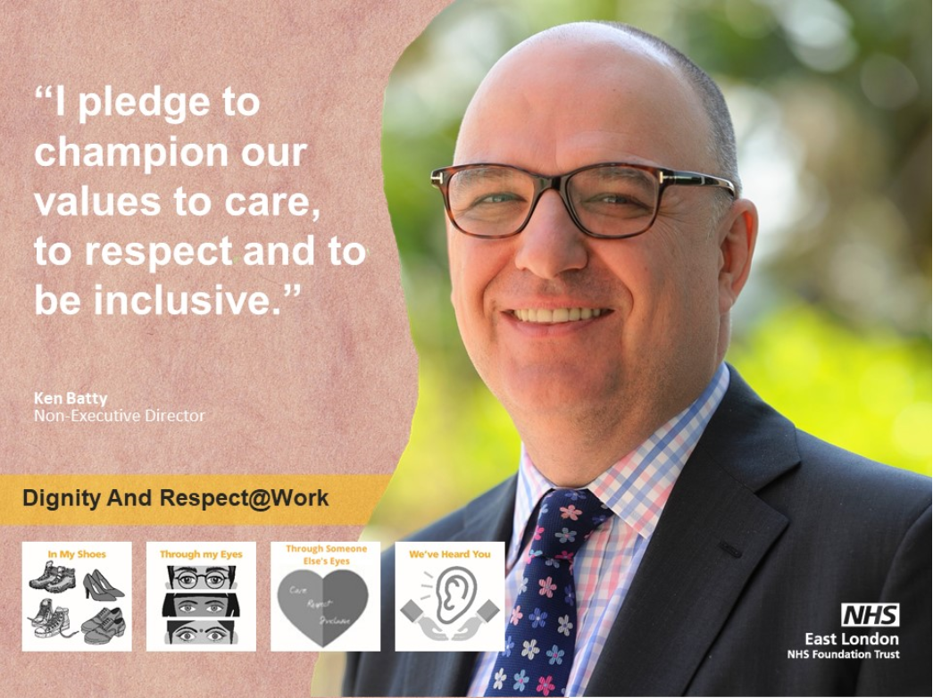
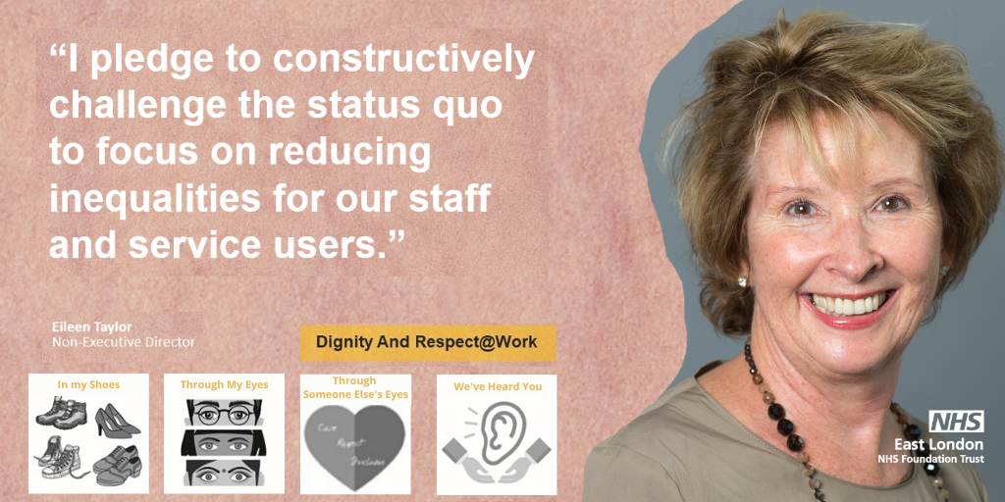
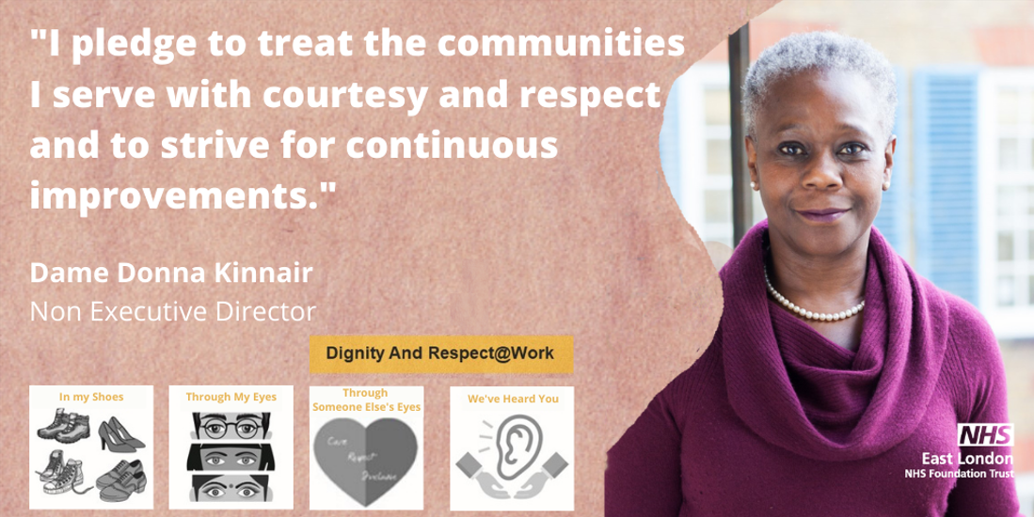
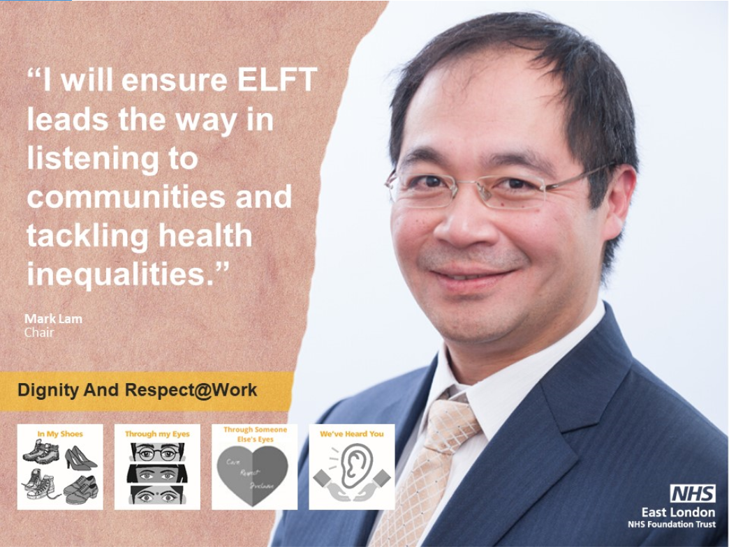
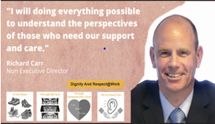
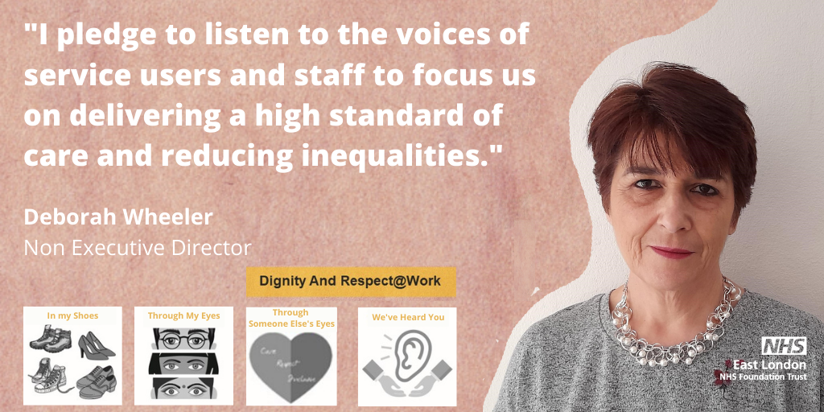
NED Pledges 2020/21

Slide 8
Covid, Race and Privilege
2 hour sessions opened up by the CEO or Deputy CEO to explain the context;
Zoom breakout rooms 20-30 people.
Each group facilitated by an Executive Director.
Volunteer storytellers sharing a story - Living and Working while BAME, followed by discussion, reflections Q&A;
Back into plenary and the Executive Director summarises the discussions;
More discussions in the plenary group.
Attend by around 600 staff

Slide 9
Outputs from the first two sessions: Two words to describe how you are feeling?

Slide 10
CEO Discussion Groups
5 monthly sessions with the Trust’s most senior leaders exploring:
Understanding White Privilege
What it means to be White?
White Fragility
Whiteness
What is White Privilege John Amaechi
https://www.bbc.co.uk/bitesize/articles/zrvkbqt

Slide 11
CEO Discussion Groups

Slide 12
#MyNameReallyIs….Twitter Campaign
22,000 Impressions
Over 8,000 Views
The second most popular Tweet in 2020.
https://twitter.com/nhs_elft/status/1290645413469585416?s=12
Carmen’s Video https://twitter.com/NHS_ELFT/status/1306879782525767680
Caroline’s Video
https://twitter.com/NHS_ELFT/status/1305423531832942593

Slide 13
Our Disciplinary Data
We’ve reduced the disparity in the proportion of colleagues from Black, Asian Minority backgrounds compared to White staff facing formal disciplinary action. Although in 2021 the likelihood increased

Slide 14
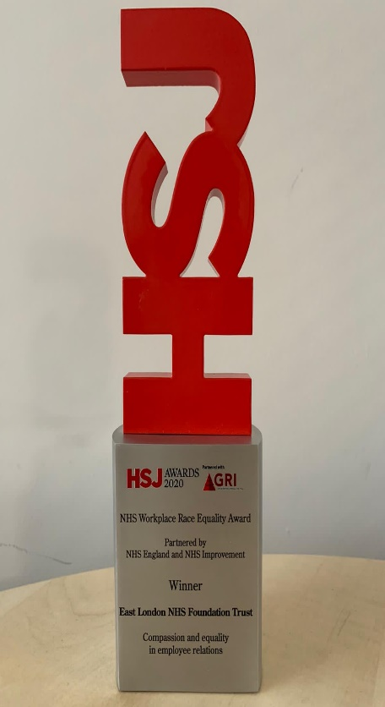
Our Progress
ELFT won the Health Service Journal (HSJ) Award in the Workforce Race Equality Standards (WRES) category for Compassion and Equality in Employee Relations, in recognition for what we have done using QI methodology and Co-production
Recognising Racism: Using QI to Help Take Action: East India ward
Session on Islamophobia Awareness
Regular place based locality meetings - Making Equality Work
Employed a new Head of EDI
Equality Delivery System 2 (EDS 2) Assessment

Slide 15
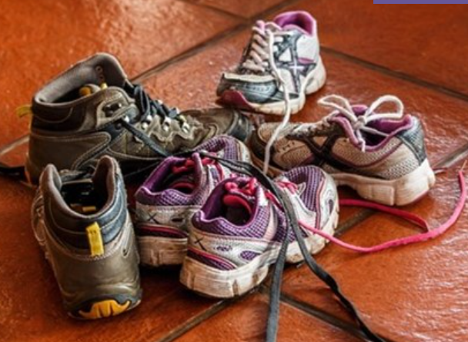
Non Violence Resistance (NVR) Classes
We know that around 25% of our staff live in the boroughs that we provided services in.
Over 50% of staff affected are from BAME communities;
Those same boroughs have a prevalence on of Knife Crime, Gangs and County Lines;
We have run our first cohort of Non Violence Resistance (NVR) which are parenting classes for staff to help to prevent their children from getting caught up.
We have seen 9 parents go through this programme. The second cohort is already underway. We have run a second cohort and are about to run a third.

Slide 16
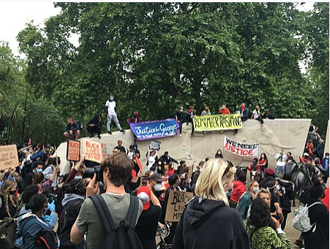
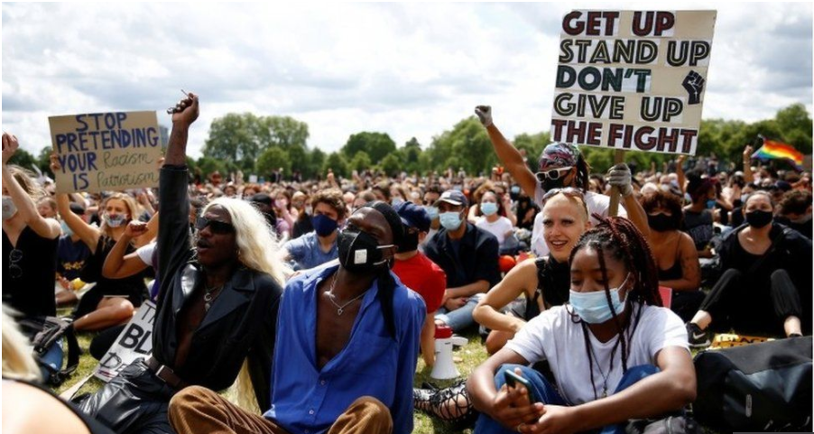
Our Progress 1 Year on….

Slide 17
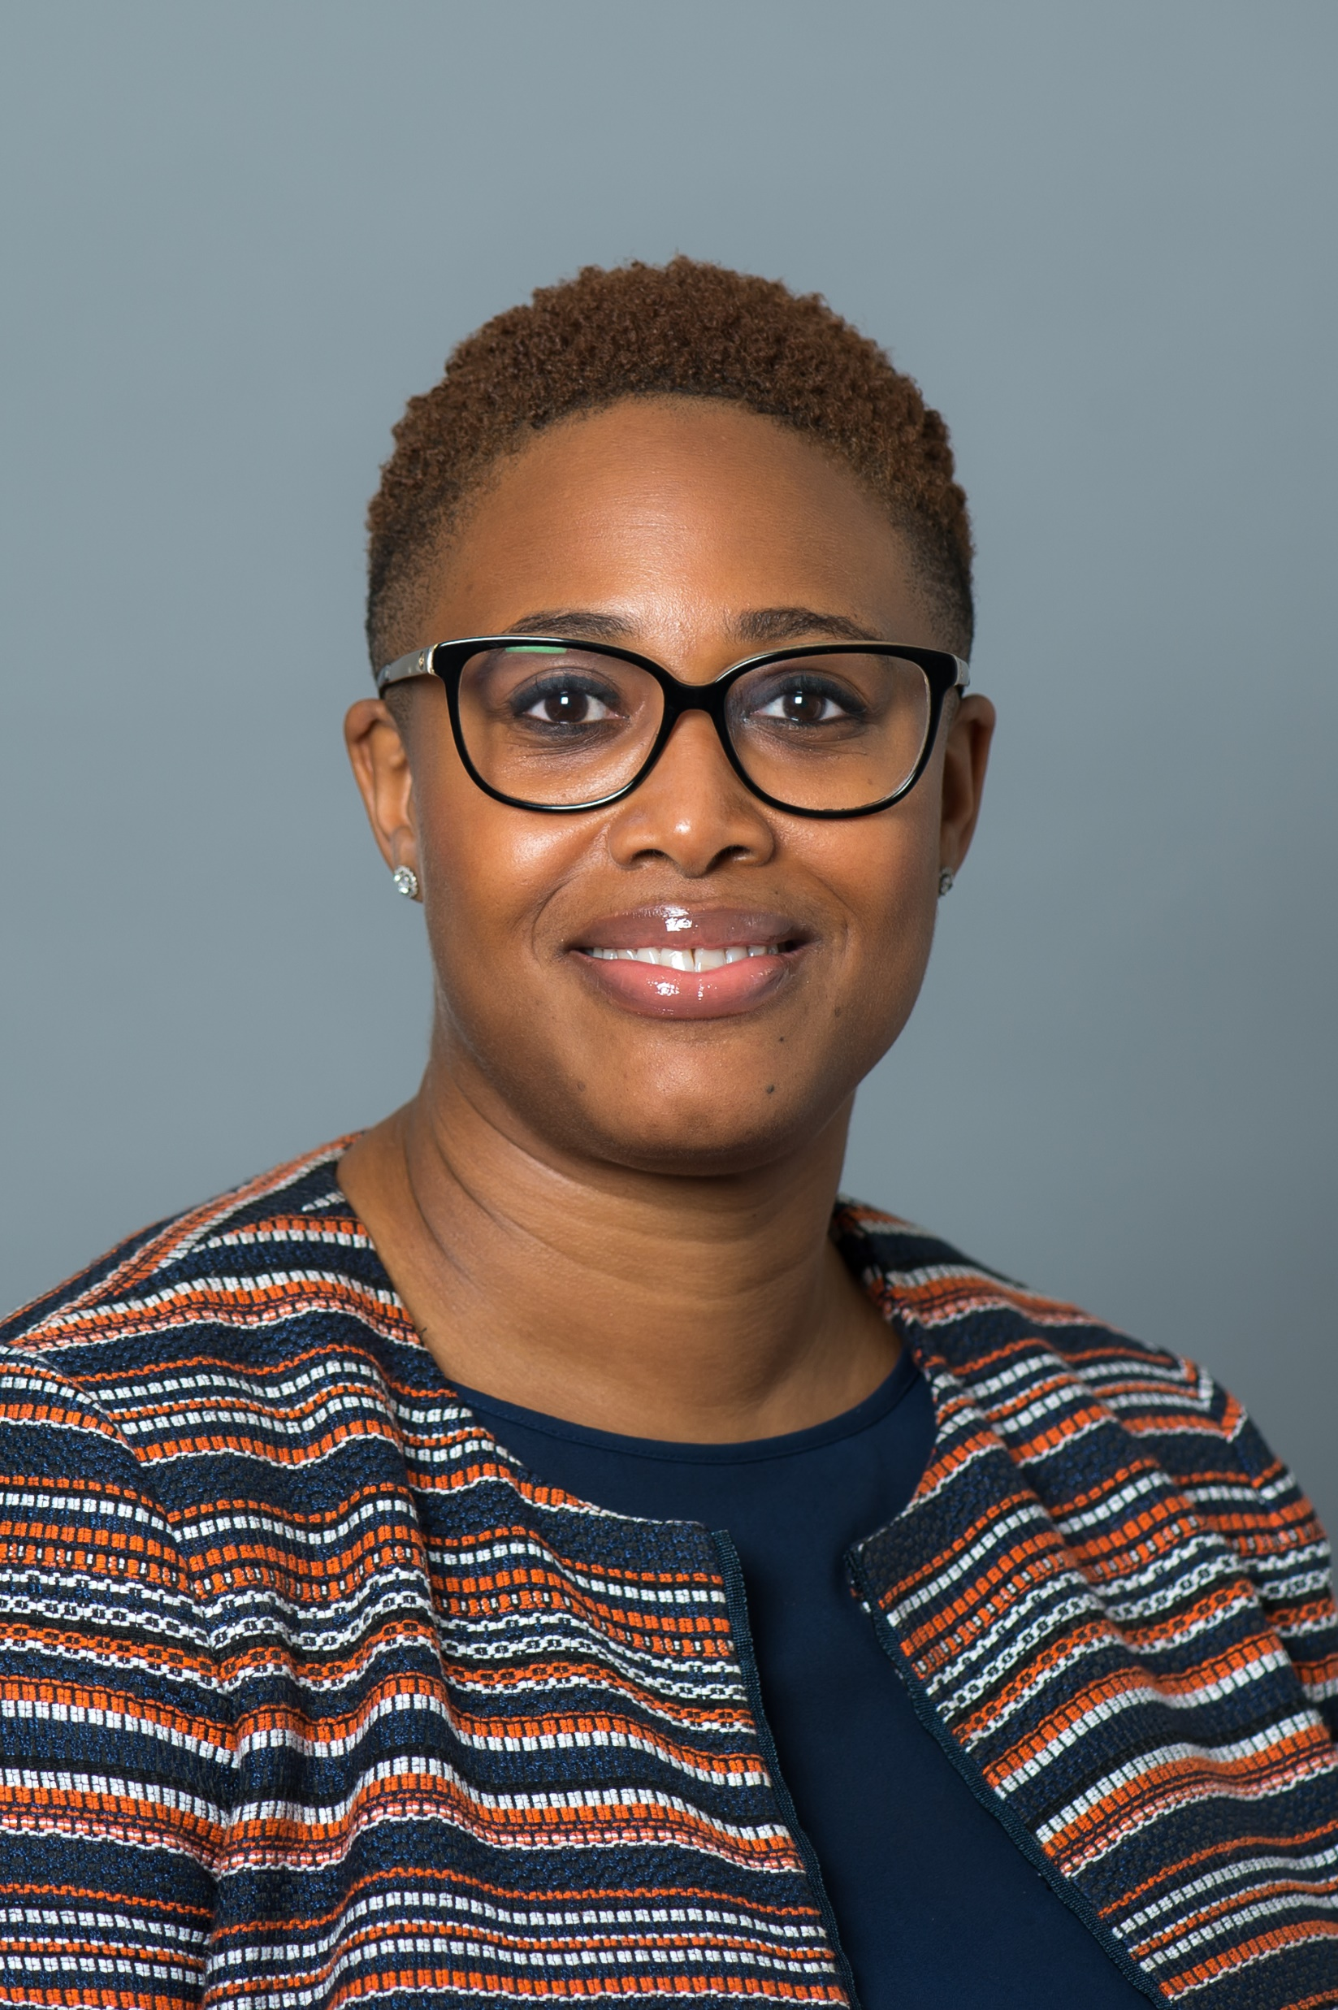
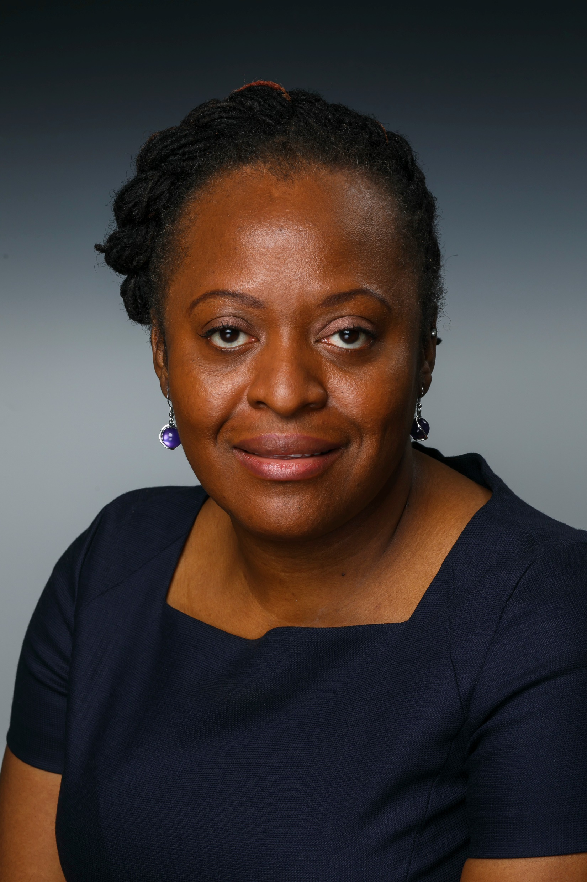
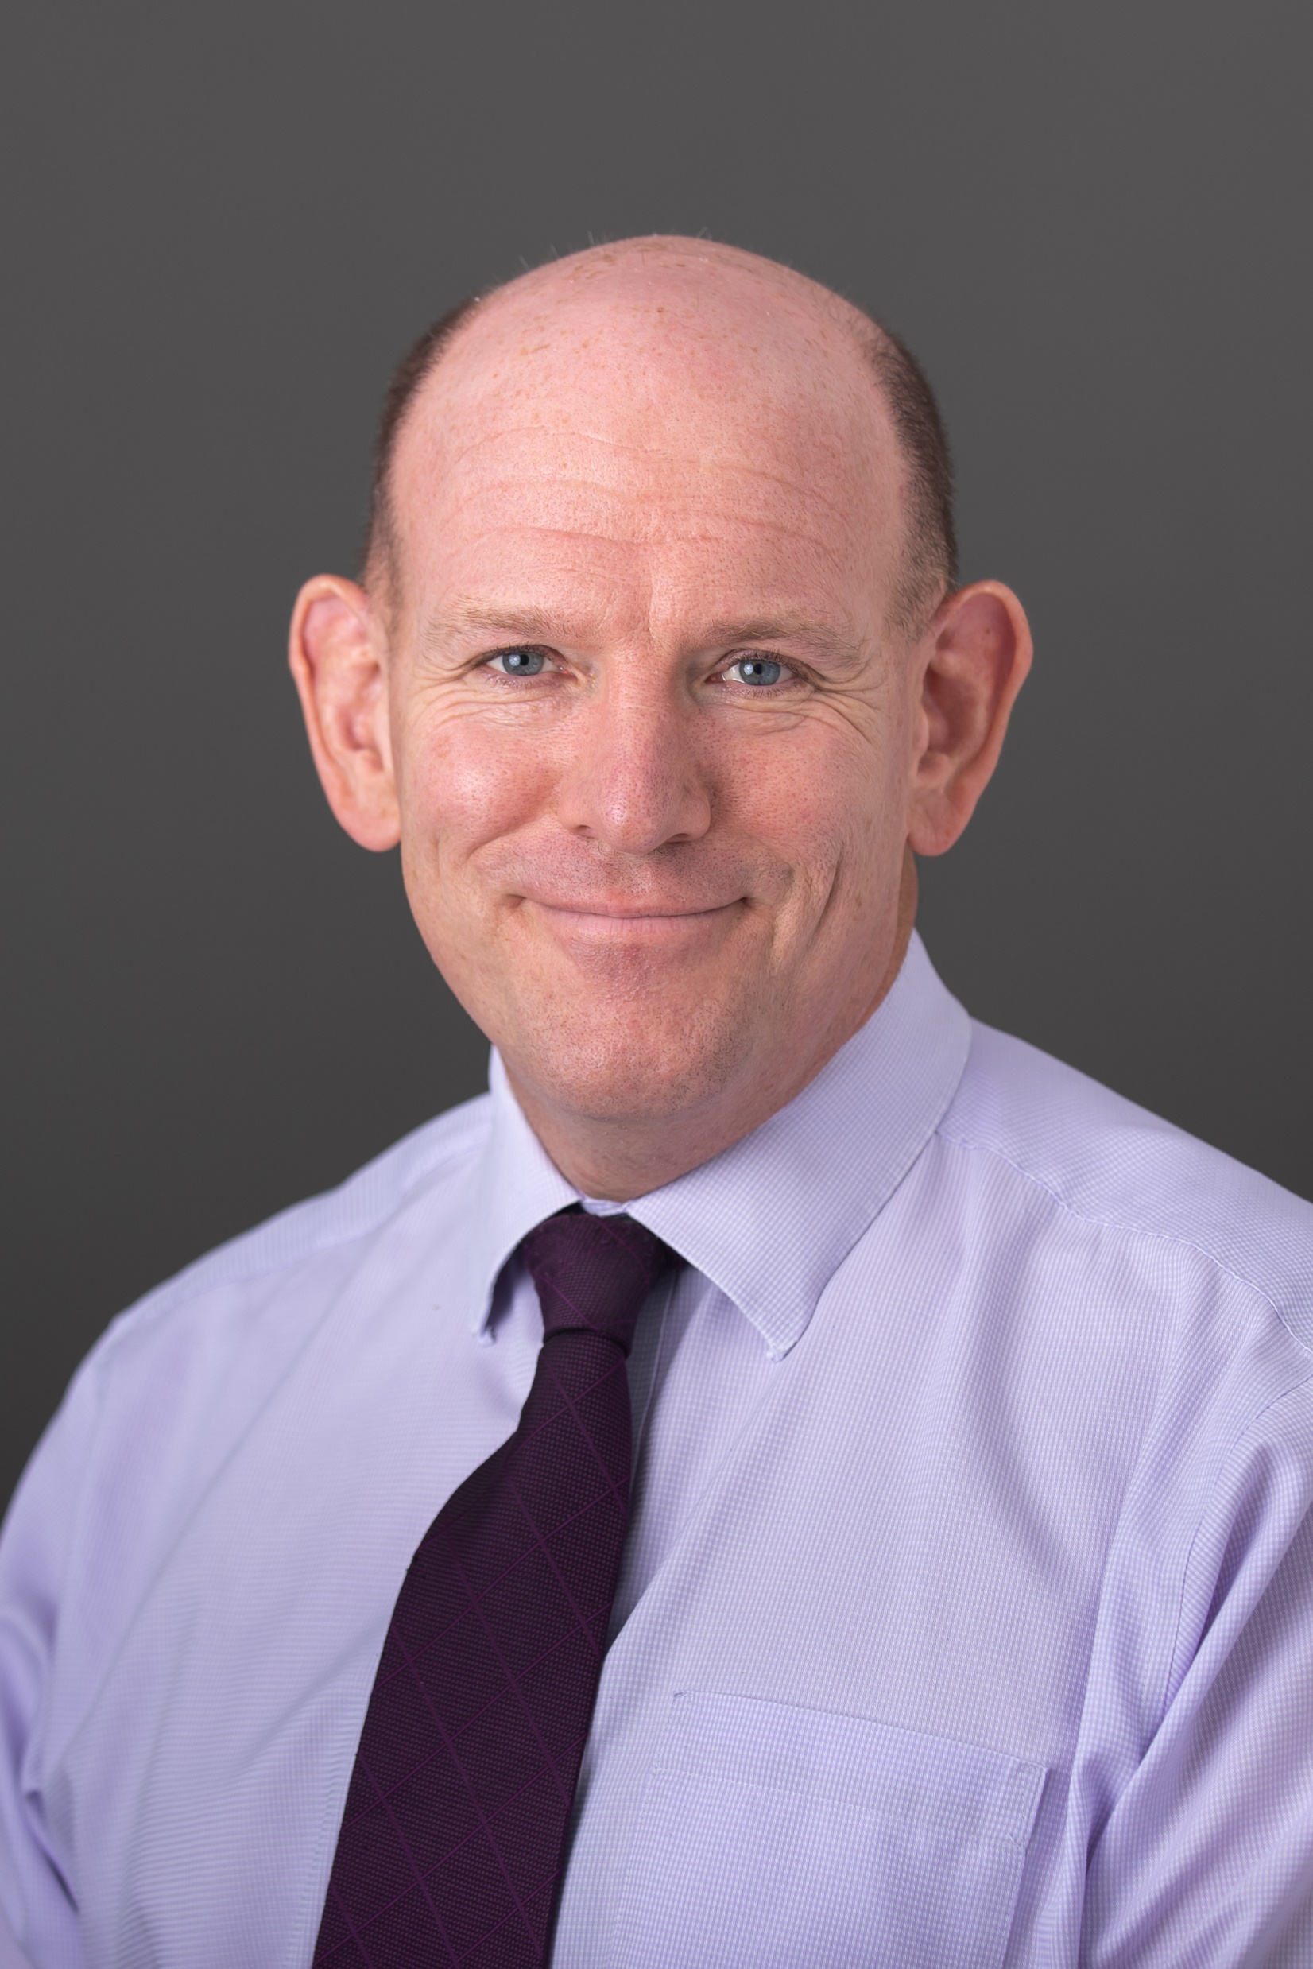
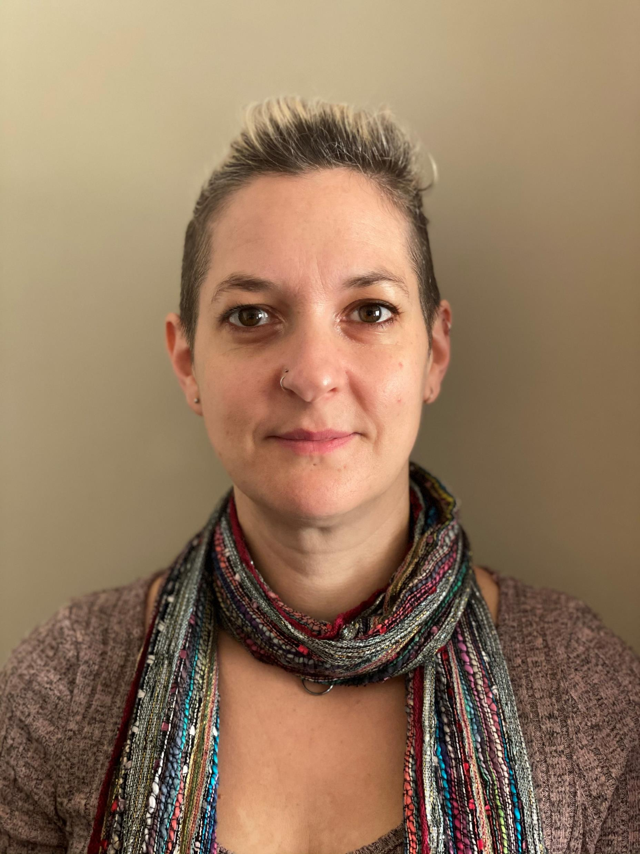
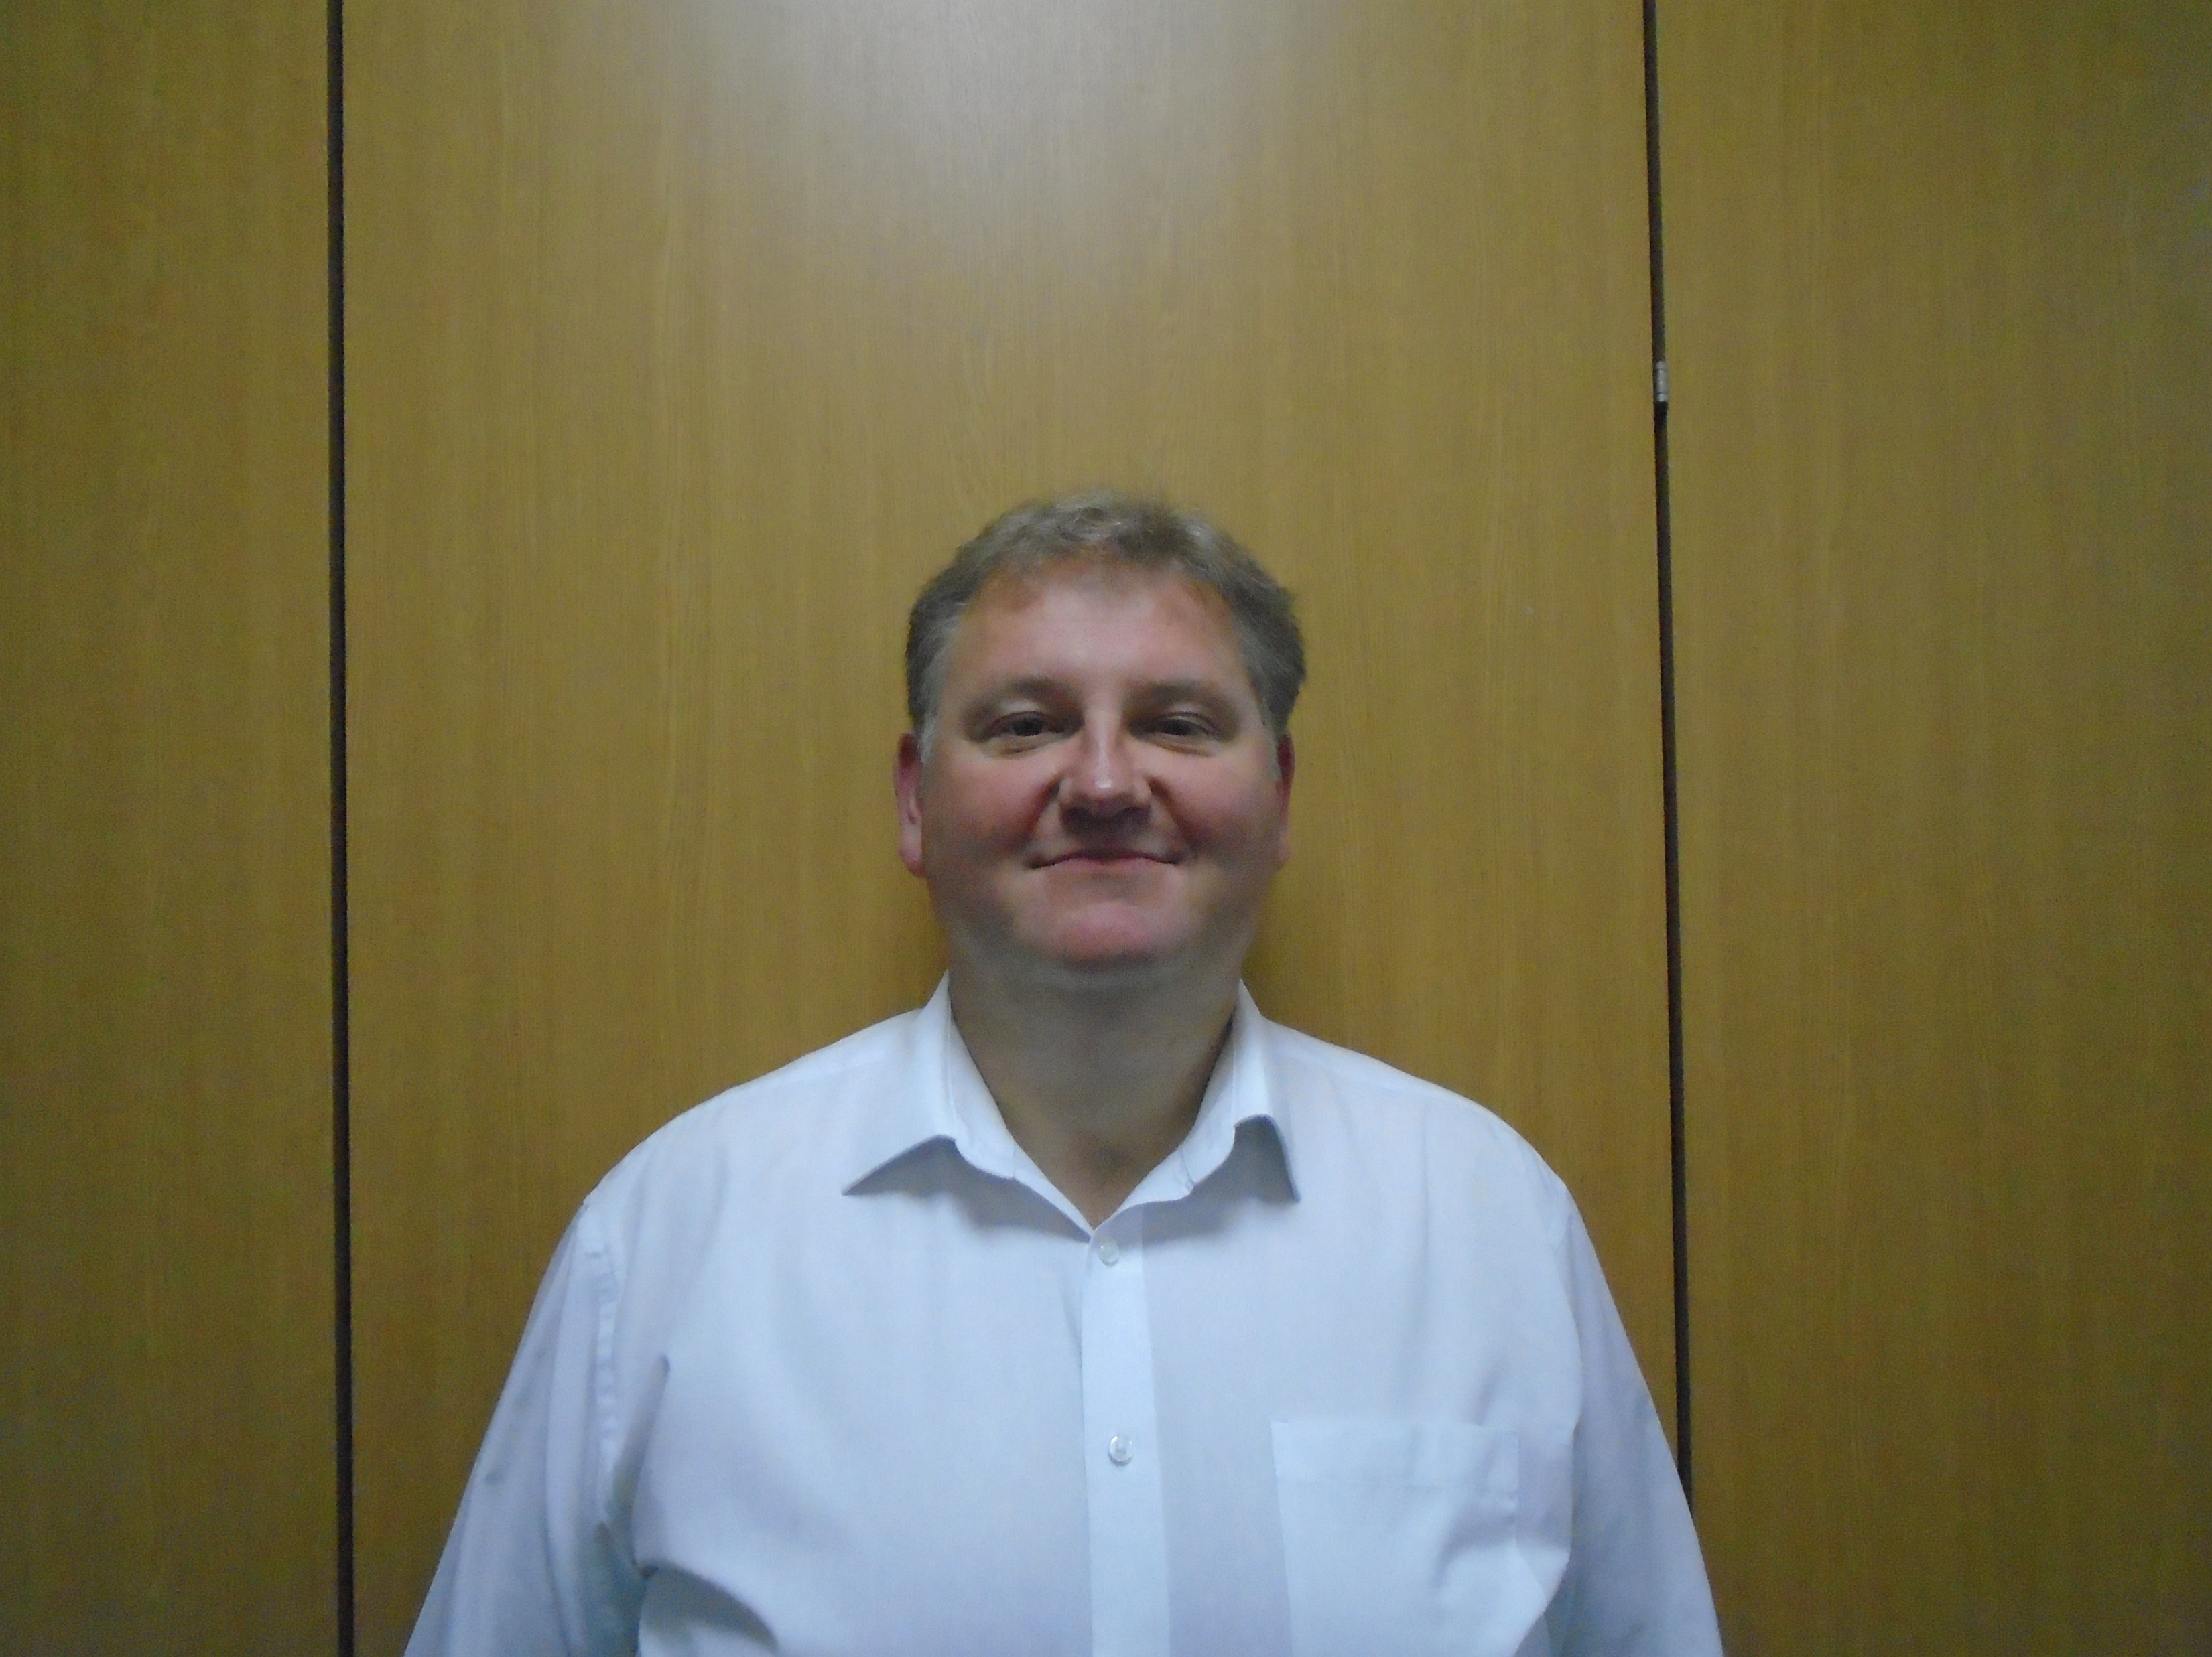
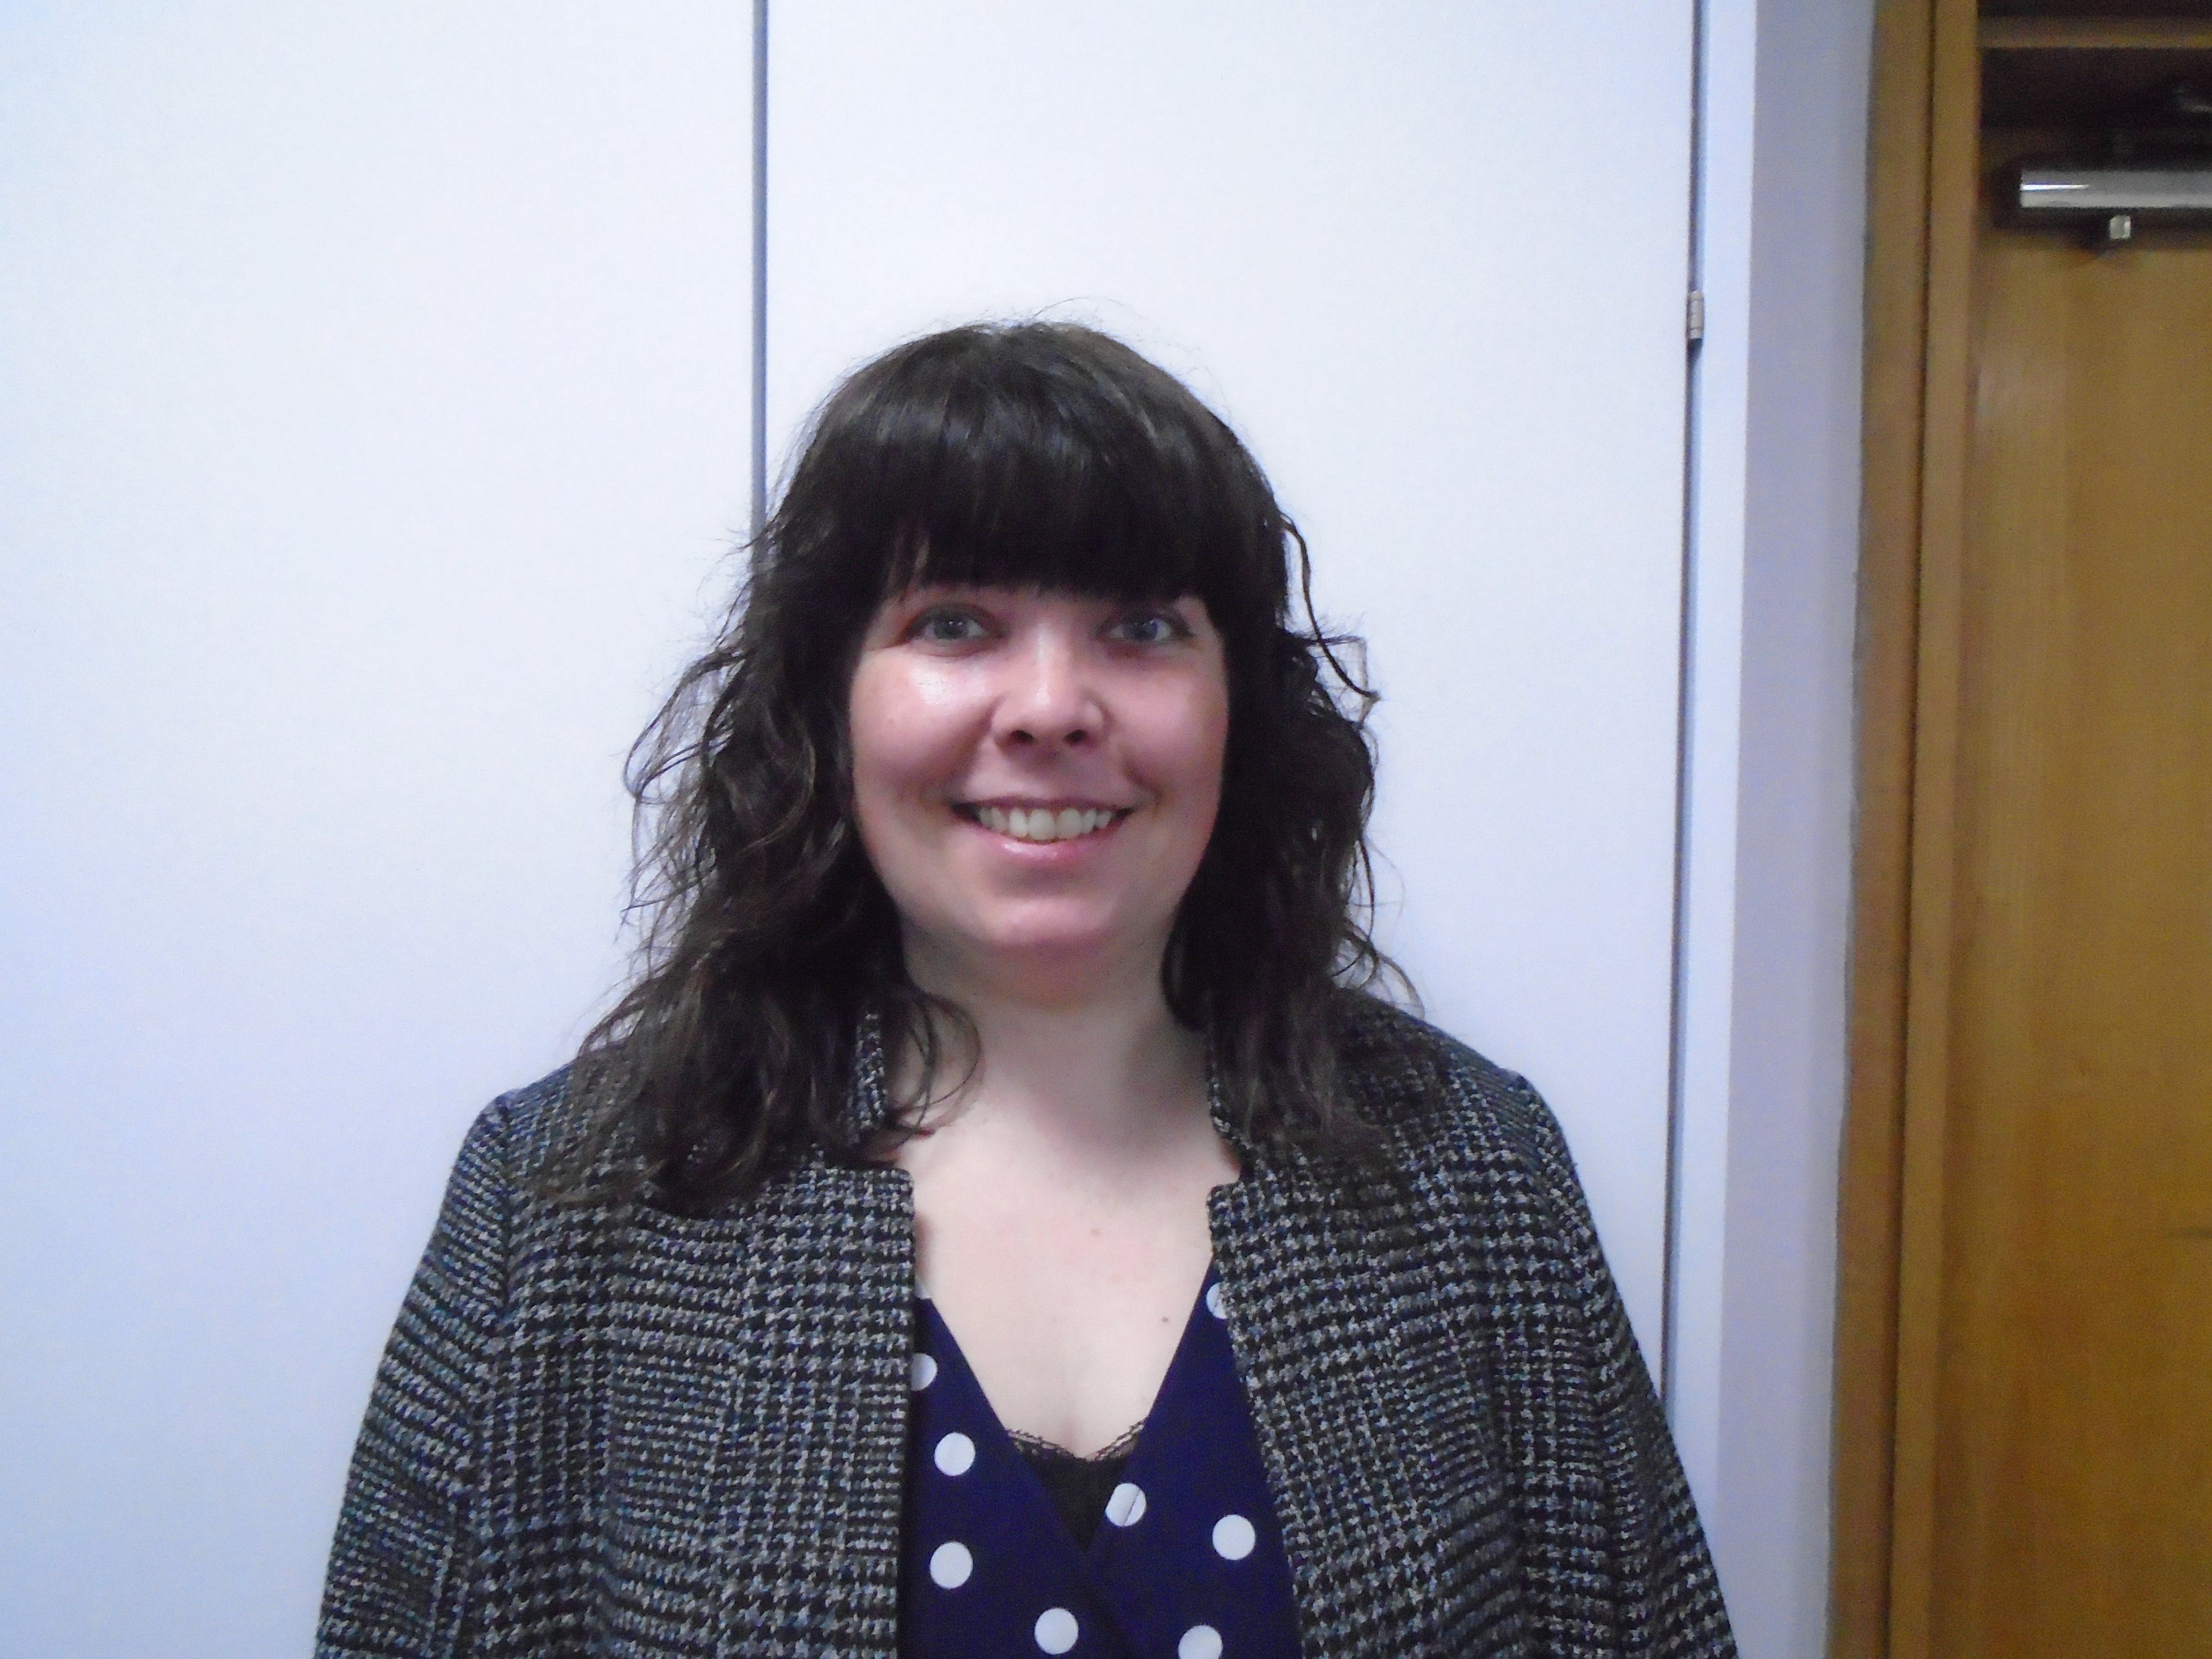
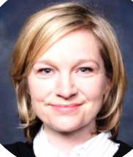
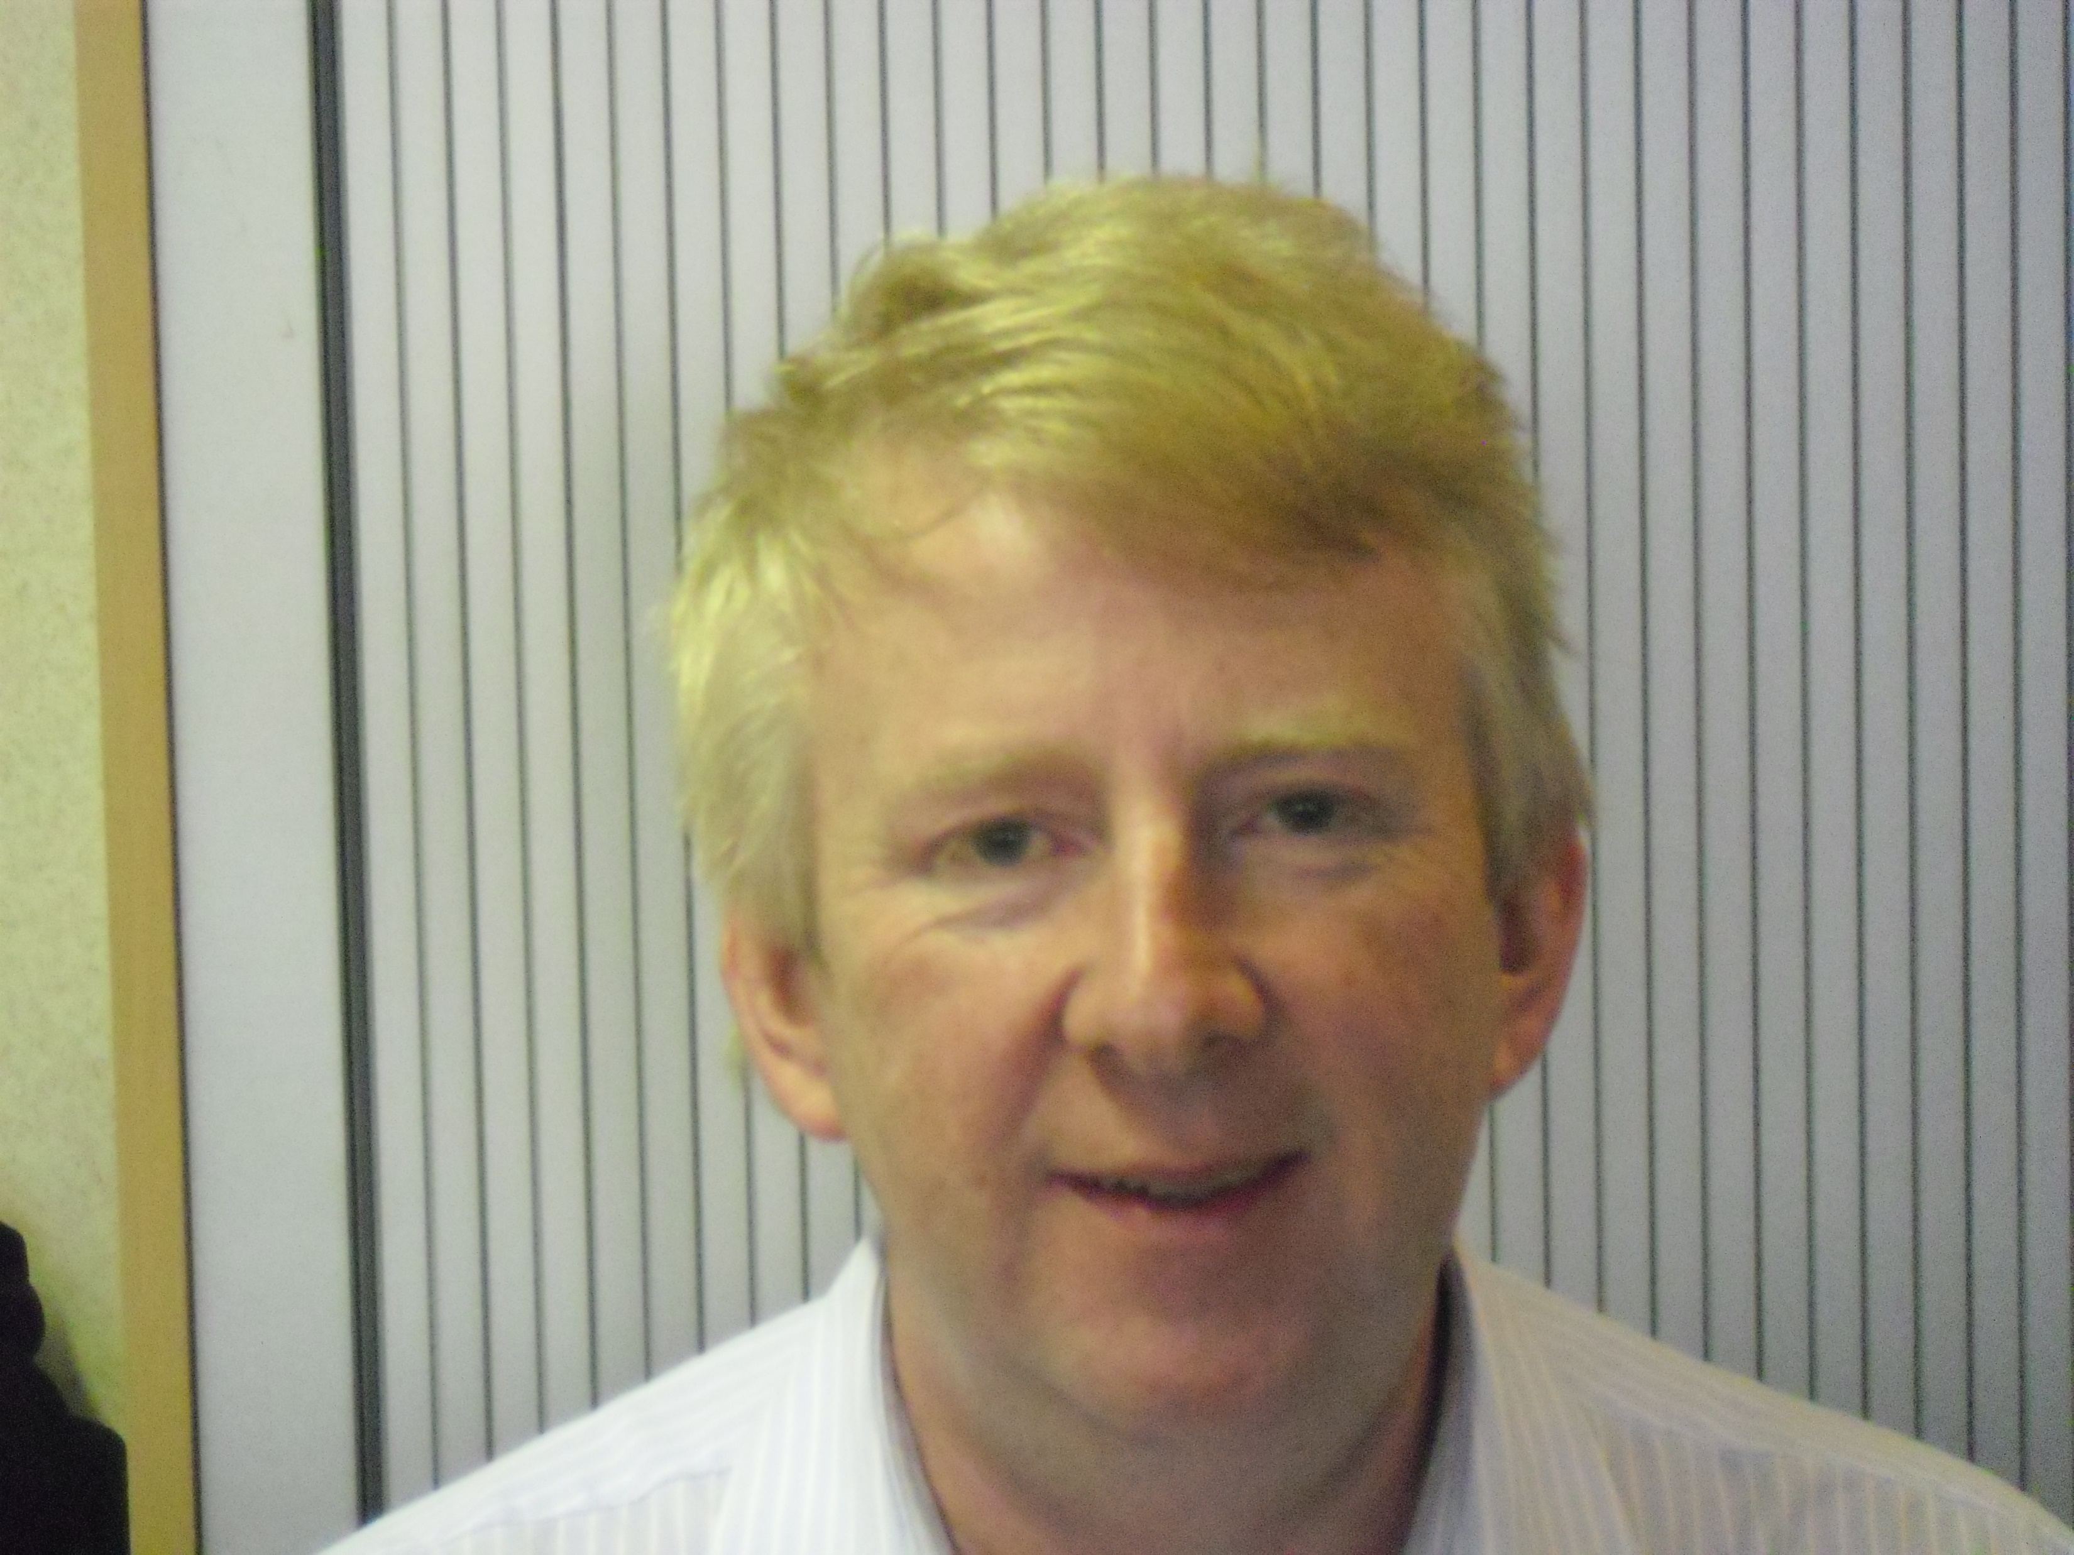
WRES Experts and White Allies
Paul Calaminus
Chief Executive Officer
Steve Palmer
Associate Director of People & Culture
Lorraine Sunduza
Chief Nurse & Deputy Chief Executive
Tanya Carter
Chief People Officer
Laura Fitzpatrick
People Business Partner
Katherine Brittan
Deputy Director of QI
Anita Hynes
Freedom to Speak up
Guardian
Eugene Jones
Director of Transformation

Slide 18
Actions to date…
Respect and Dignity @ Work Project
May 2019
Exec discussions regarding Covid 19 Impact on BAME Communities
Risk Assessment process for vulnerable Staff (including BAME)
Risk Assessment Webinars for vulnerable staff and Managers
Extraordinary BAME network meetings
Rolled out Vitamin D supplements for staff
CEO All staff letter on Racism and Inequalities
Deputy CEO Video
Race & Privilege
8 sessions of Covid 19, Race and Privilege staff
Inequalities workstream set up
Board and Governors sessions on Race & Privilege
Reverse Mentoring for the Board
6 nominees undertaking the White Allies programme
2 Executives undertaking the WRES Experts programme
Board Development session on Power Privilege and Micro- Aggressions

Slide 19
Work in progress/Next Steps
Ukraine Humanitarian Support Sessions
NEL ICS Equality Leads
Flair Pilot
Q2 2022
Revised Equalities Plan 2022-2026
Recruited a Head of EDI
Return of ‘A Mile in My Shoes’
Emotional Impact of VCOD Sessions
Vaccination as a Condition of Deployment
Rolled out Vitamin D for a second year
Another Cohort of White Allies
Another Cohort of WRES Experts
Refreshed ELFT People Plan

Slide 20
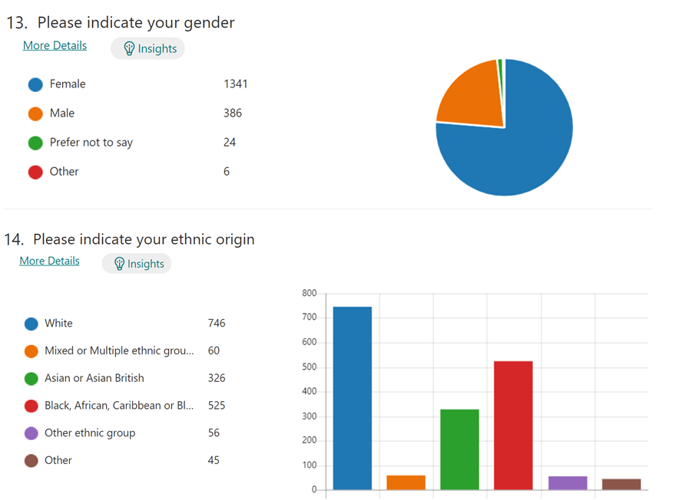
BAME Network outputs
#SunshineInYourPocket
#MoreSunshineInYourPocket

Slide 21
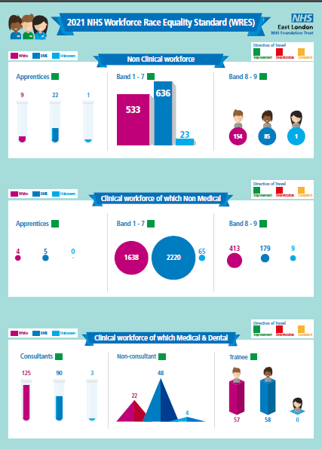
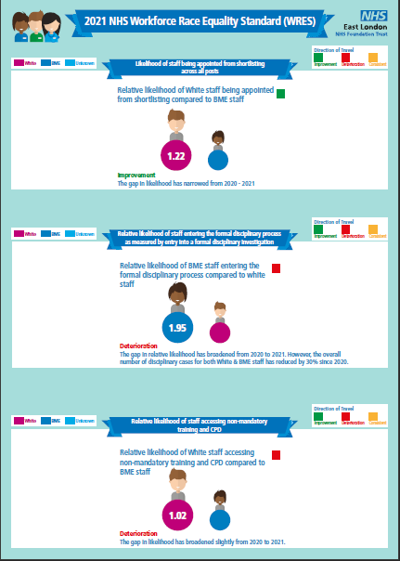
Some Improved Workforce Race Equality Standard (WRES) Metrics

Slide 22
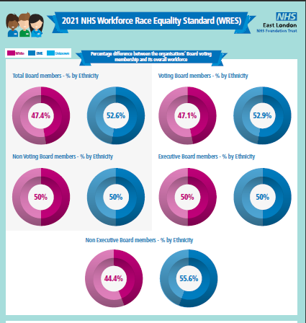
ELFT has the most diverse Board & Executive Team

Slide 23
Refreshed Trust Strategy

Slide 24
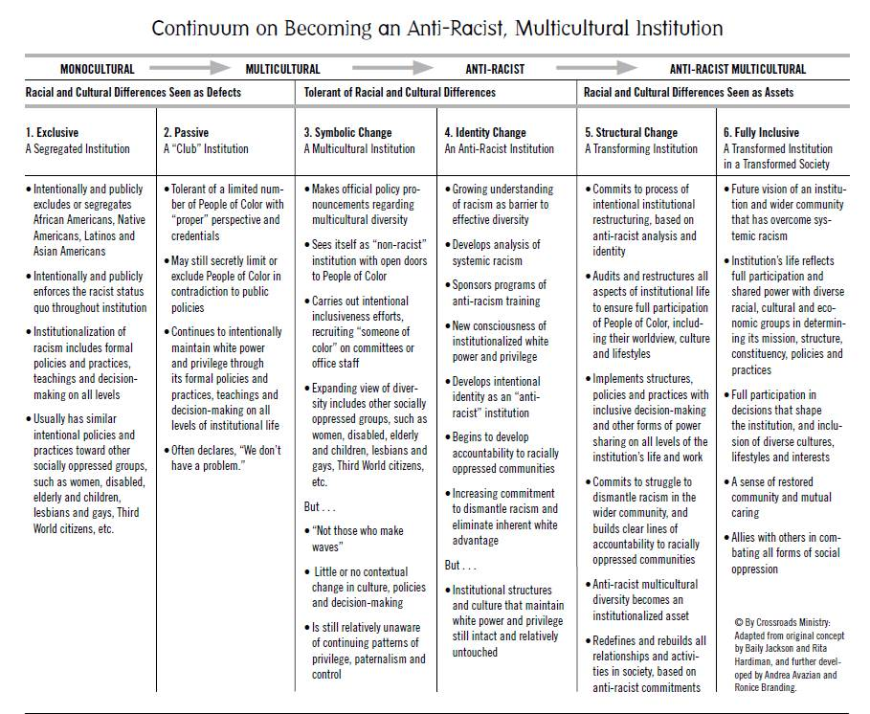
Becoming and anti-racist and multicultural organisation
DMT Away Days
Board Development Session
Exec Session
Governor Session
Network meetings
All staff sessions by Directorates

Slide 25
What’s next?
We continue to work on becoming an anti- racist organisation and will co-design an anti racist statement.
The DMT Away day took place in October 2021 focusing on how the Trust can achieve this.
Launched a coaching programme with a focus on colleagues from Black, Asian Minority backgrounds
We also ran an interview skills workshops
Respectful Resolution is being rolled out to support staff to reduce Bullying & Harassment
Conversations about Anti Semitism and Islamophobia
WRES Report Feedback session
Partnering with Flair to be a case study – using the situational Judgement tool in Summer 2022.

