Slide 1
Use of Force Act

Slide 2
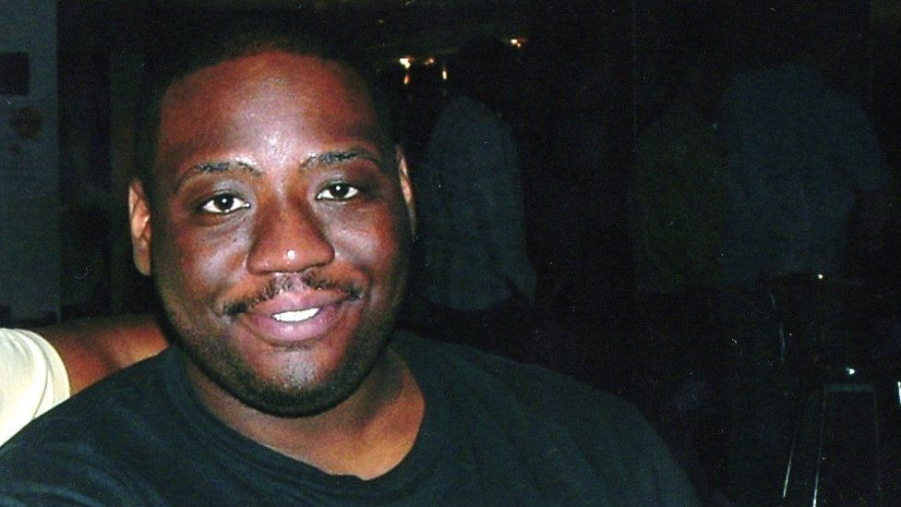
What is the Use of Force Act?
The Use of Force Act was enacted on 1st November 2018 having been introduced via a Private Members Bill following the death of Olaseni Lewis.
Olaseni (‘Seni’) Lewis was a 23-year-old Black man who died at a mental health facility after being restrained by 11 police officers.
It took seven years before there was an inquest, which ruled: "The excessive force, pain compliance techniques and multiple mechanical restraints were disproportionate and unreasonable”.

Slide 3
https://www.youtube.com/watch?v=V7ete08noKo&t=37s
Notes:
From 1:45 to 3:11 we can show.

Slide 4
The “Use of Force” refers to
Physical restraint: means physical contact which is intended to prevent, restrict or subdue movement of any part of a patient’s body.
Mechanical restraint: means the use of a device which is intended to prevent, restrict or subdue movement of any part of a patient’s body and which has the primary purpose of behavioural control, e.g. handcuffs.
Chemical restraint: is the use of medication which is intended to prevent, restrict or subdue movement of any part of a patient’s body, e.g. RT.
Long Term Segregation: the isolation of a patient in an area away from other patients.
Seclusion: the supervised confinement of a patient in one room.

Slide 5
Use of Force
Should be used for no longer than necessary to prevent harm to the person or to others
Should be a proportionate response to that harm
Should be the least restrictive option

Slide 6
Reduce the use of force.
Purpose of the Act
Promote human rights-based approach
Ensure accountability and transparency about the use of force
Notes:
Practices like face-down and chemical restraint can be humiliating and life-threatening and disproportionately affect black men.
The statutory guidance sets out how we expect mental health units to meet the requirements of the Act. The requirements of the Act and the statutory guidance provide a much-needed opportunity to embed a consistent approach across services nationally.

Slide 7
‘Responsible Person’
Chief Executive is responsible to the board
Responsible Person – David Bridle
Delegated responsibility to Directors of Nursing & Clinical Directors
Restrictive practices team. Kenneth, Huda and Asha

Slide 8
What is ELFT doing?
Making sure all staff are aware
Use of Force Policy – all staff should read & understand their responsibilities
Use of Force Training – all staff should attend
Notes:
Ensuring that Use of Force policy (and linked restrictive practice policies) is fully implemented within the ward environment/the team/the department that they manage.
Ensuring that Use of Force policy is readily available to all staff at all times.
Ensuring that the recording and auditing of incidents of physical intervention is completed in line with Use of Force
Responding appropriately to any concerns regarding the attitude of staff members around issues of the use of force, aggression, violence or restrictive practice.
Ensuring that there is a regular and comprehensive general risk assessment to ensure the safety of the environment
Maintaining training and equipment levels in their ward/team/department. This will include ensuring that - staff are appropriately trained to monitor physical health.

Slide 9
What is ELFT doing?
Making sure all service users are aware
Posters
Leaflets (co-produced with service users)
Notes:
Ensuring that Use of Force policy (and linked restrictive practice policies) is fully implemented within the ward environment/the team/the department that they manage.
Ensuring that Use of Force policy is readily available to all staff at all times.
Ensuring that the recording and auditing of incidents of physical intervention is completed in line with Use of Force
Responding appropriately to any concerns regarding the attitude of staff members around issues of the use of force, aggression, violence or restrictive practice.
Ensuring that there is a regular and comprehensive general risk assessment to ensure the safety of the environment
Maintaining training and equipment levels in their ward/team/department. This will include ensuring that - staff are appropriately trained to monitor physical health.

Slide 10
What is ELFT doing?
Updating other restrictive practice policies to link to Use of Force Act
Making Use of Force Act ward to board assurance and ongoing learning from implementation and practice
Notes:
Ensuring that Use of Force policy (and linked restrictive practice policies) is fully implemented within the ward environment/the team/the department that they manage.
Ensuring that Use of Force policy is readily available to all staff at all times.
Ensuring that the recording and auditing of incidents of physical intervention is completed in line with Use of Force
Responding appropriately to any concerns regarding the attitude of staff members around issues of the use of force, aggression, violence or restrictive practice.
Ensuring that there is a regular and comprehensive general risk assessment to ensure the safety of the environment
Maintaining training and equipment levels in their ward/team/department. This will include ensuring that - staff are appropriately trained to monitor physical health.

Slide 11
What is ELFT doing?
Reviewing use of force data for scrutiny, action and assurance, including analysis of impact
Ensuring service users are partners in everything we do
Notes:
Ensuring that Use of Force policy (and linked restrictive practice policies) is fully implemented within the ward environment/the team/the department that they manage.
Ensuring that Use of Force policy is readily available to all staff at all times.
Ensuring that the recording and auditing of incidents of physical intervention is completed in line with Use of Force
Responding appropriately to any concerns regarding the attitude of staff members around issues of the use of force, aggression, violence or restrictive practice.
Ensuring that there is a regular and comprehensive general risk assessment to ensure the safety of the environment
Maintaining training and equipment levels in their ward/team/department. This will include ensuring that - staff are appropriately trained to monitor physical health.

Slide 12
What is ELFT doing?
But most importantly:
Doing everything we can to reduce the use of force in all our services
Notes:
Ensuring that Use of Force policy (and linked restrictive practice policies) is fully implemented within the ward environment/the team/the department that they manage.
Ensuring that Use of Force policy is readily available to all staff at all times.
Ensuring that the recording and auditing of incidents of physical intervention is completed in line with Use of Force
Responding appropriately to any concerns regarding the attitude of staff members around issues of the use of force, aggression, violence or restrictive practice.
Ensuring that there is a regular and comprehensive general risk assessment to ensure the safety of the environment
Maintaining training and equipment levels in their ward/team/department. This will include ensuring that - staff are appropriately trained to monitor physical health.

Slide 13
Want to know more?
Please speak to your Borough Lead Nurse about getting involved in projects to reduce the use of force
Notes:
Ensuring that Use of Force policy (and linked restrictive practice policies) is fully implemented within the ward environment/the team/the department that they manage.
Ensuring that Use of Force policy is readily available to all staff at all times.
Ensuring that the recording and auditing of incidents of physical intervention is completed in line with Use of Force
Responding appropriately to any concerns regarding the attitude of staff members around issues of the use of force, aggression, violence or restrictive practice.
Ensuring that there is a regular and comprehensive general risk assessment to ensure the safety of the environment
Maintaining training and equipment levels in their ward/team/department. This will include ensuring that - staff are appropriately trained to monitor physical health.

