Slide 1
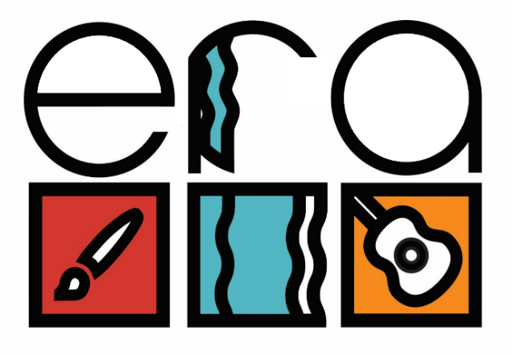
ERA Study - Effectiveness of group arts therapies compared to group counselling for diagnostically heterogeneous patients: Randomised controlled trial in mental health services.
ERA is the largest study of group arts therapies conducted in adult mental health to date
429 participants recruited to receive a 40 session group intervention in the arts therapies of their choice OR counselling
43 groups delivered – that’s over 1720 clinical sessions of which 34 groups and 1360 sessions were delivered in ELFT
46 clinical staff involved – 24 arts therapists, 9 group counsellors. 13 co-facilitators joined from local services and included
nurses, assistant psychologists, recovery college peer tutors, social therapists and community health clinicians
Partnership working with community sites including Bunyan Museum, Brady Centre and Rokeby Together Café
Clinical delivery completed, research follow up rate is at 82%. Findings expected late 2024 – watch this space!
Qualitative feedback from clients has been very positive
Chief Investigators: Catherine Carr, Stefan Priebe Trial Manager: Emma Medlicott Clinical Lead: Jennifer French
“It made me concentrate more, it’s made me trust people a little bit more… And it just made me enjoy my time again because for the last 2 years I have been a virtual prisoner but this had brought me out again”
“The people we met were extremely nice. They gelled and I gelled… and I will miss seeing them.… it was brilliant”

