Slide 1
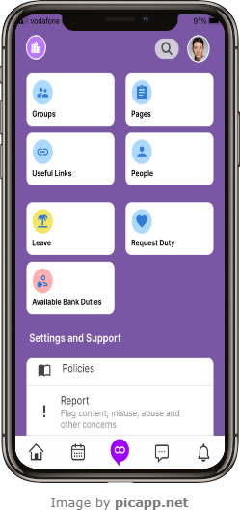
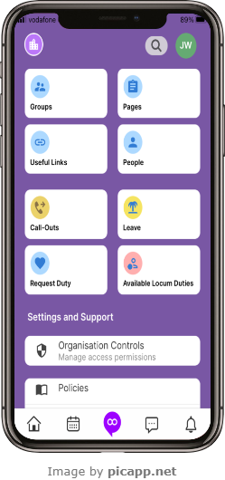
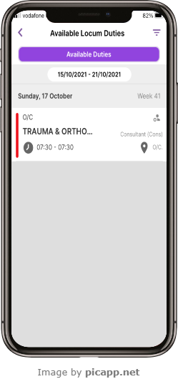
Loop – Available Locum/Bank Duties
1
Select Available Bank Duties or Available Locum Duties from the Loop main screen
2
Select an Available Duty from the list
Or
ALL1.1 April 2023

Slide 2
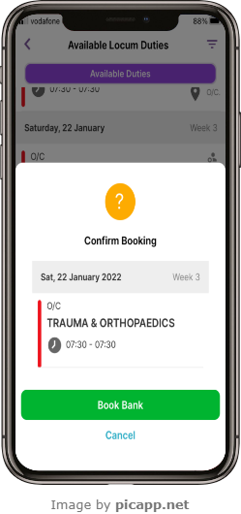
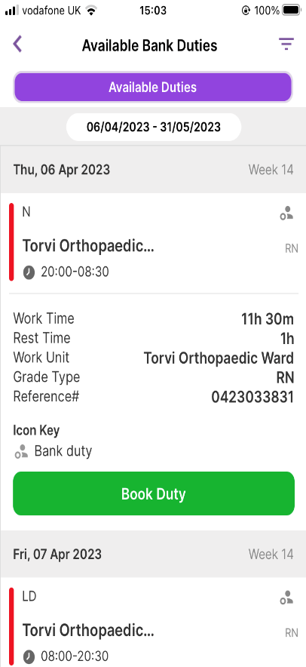
Loop – Available Locum/Bank Duties
3
Select the green Book button
4
Select Book Bank to confirm
ALL1.1 April 2023

