Slide 1
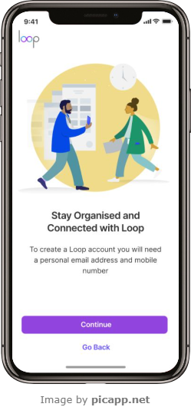
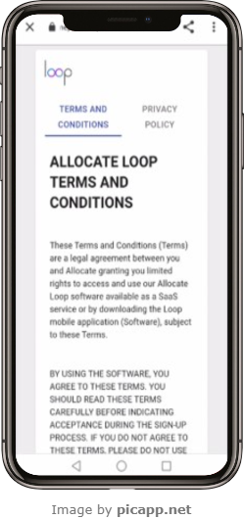
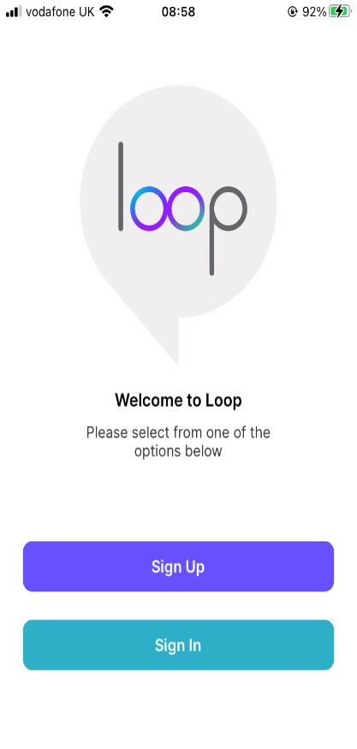
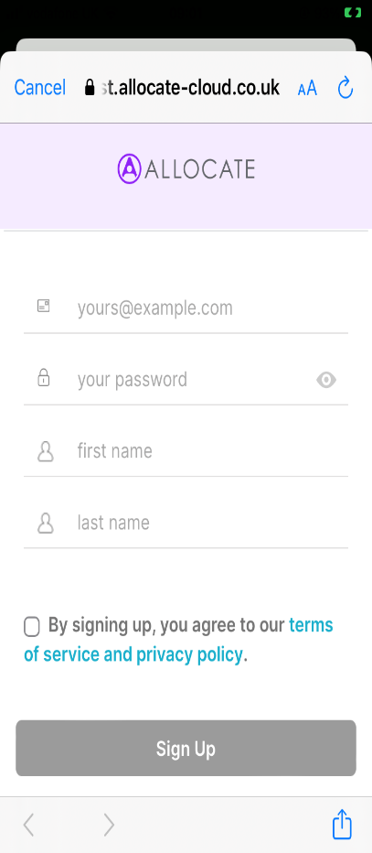
Loop – Creating your loop Account
1
Download the Loop app from the appropriate smartphone store. The landing page screen will appear.
Select Sign Up or Sign In
2
Make sure you have your personal email address and mobile number to hand and select Continue
3
Enter your Email, Password, First Name, Last Name and Phone Number. Tap the terms of service and privacy policy to view and read. Tick the box to agree. The Sign Up button will be greyed out until you agree.
4
Read the Allocate Loop Terms and Conditions
ALL1.1 April 2023

Slide 2
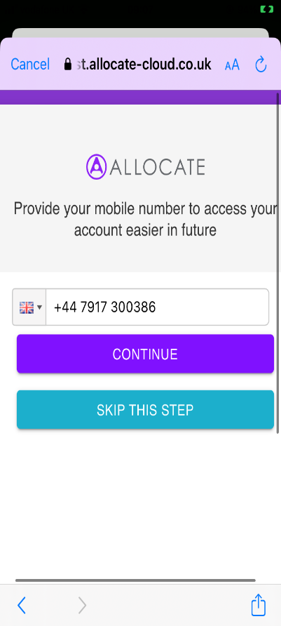
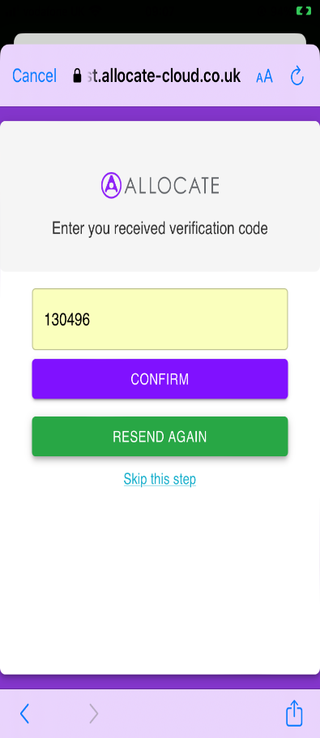
Loop – Creating your loop Account
5
Once you have agreed to the Terms and Conditions, you have the option to add a phone number for another Sign In option. Enter your phone number and press Continue or press Skip This Step
6
If entered correctly, you will get a notification with a verification code. Enter the code and press Confirm, or Resend Again if the code has not been delivered.
ALL1.1 April 2023

Slide 3
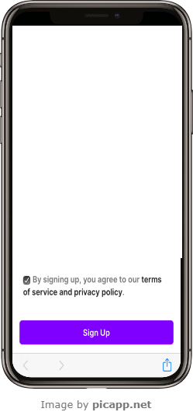
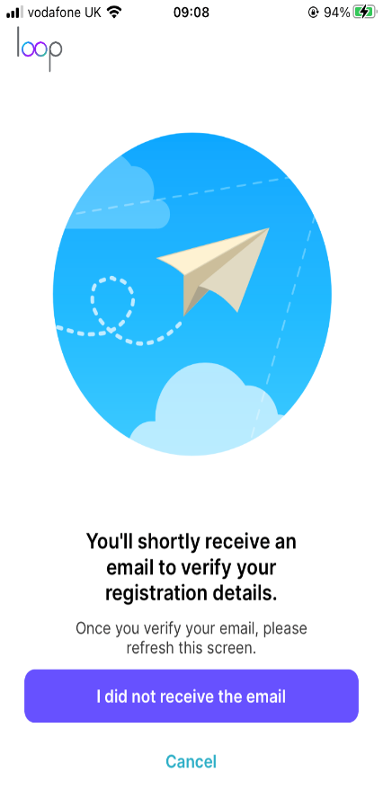
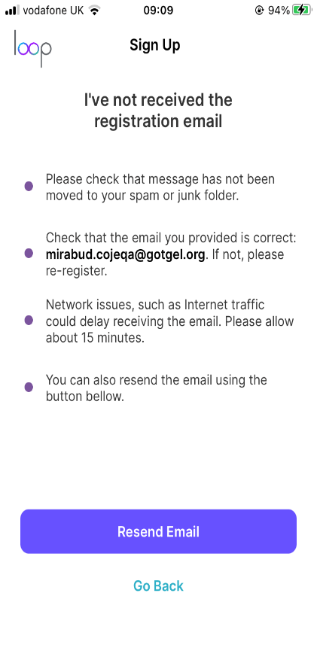
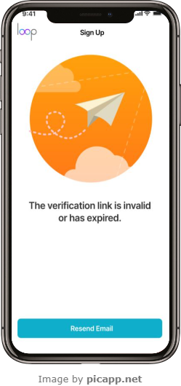
Loop – Creating your Loop Account
7
Once you have agreed to the terms, and (optionally) added a phone number, select to Sign Up
8
Check your email/Text message. Click the link in the email/text message to verify your account.
If you haven’t received the email, select the I did not receive the email link at the bottom of the screen.
9
If you have followed all of the instructions and still not received the email, select Resend Email or if it has come through, select Go Back
10
If the verification link has expired, then you will get the following message. Select Resend Email
ALL1.1 April 2023

Slide 4
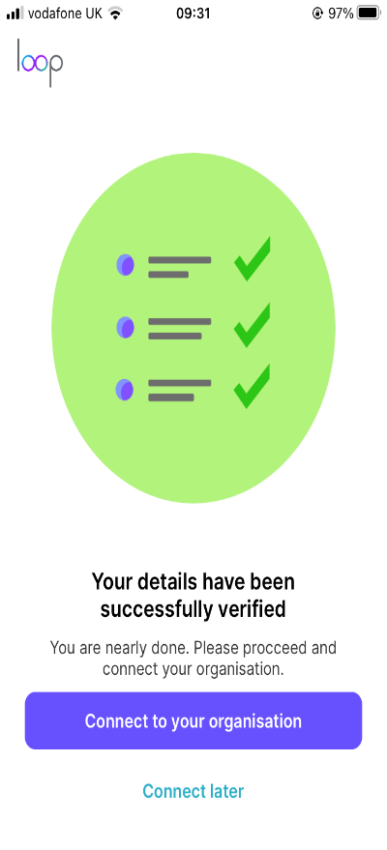
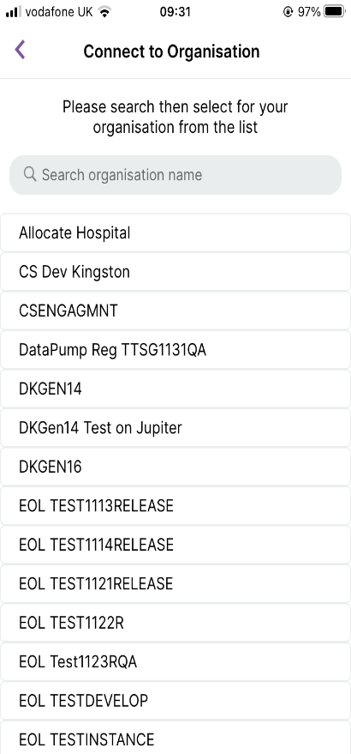
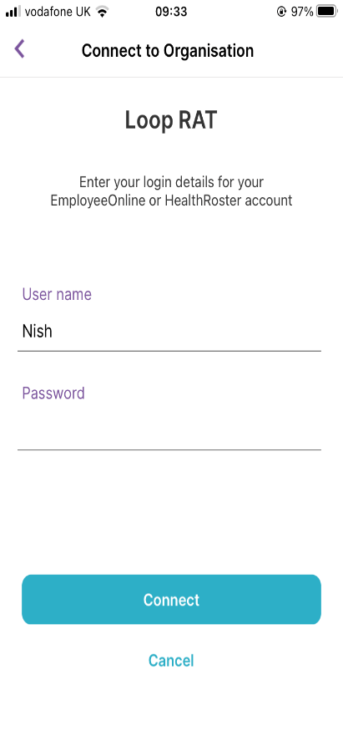
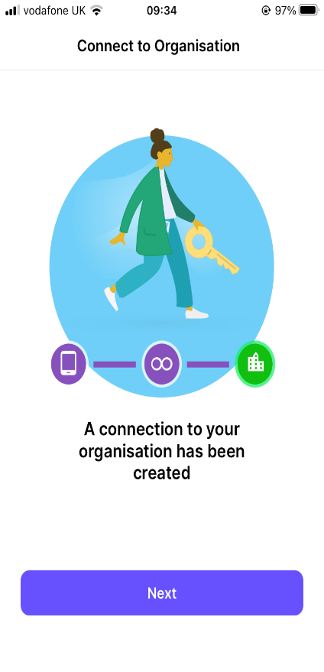
Loop – Creating your Loop Account
11
Once the email is verified, select Connect to your organisation
12
Type the name of your organisation in the search field and then select it.
13
Enter your User name and Password for EmployeeOnLine (EOL)
Select Connect or Cancel
14
You are now connected to your organisation. Select Next
ALL1.1 April 2023

