Slide 1
New National Waiting Times Standard Adults and Older Adults Training Pack

Slide 2
Background – New Waiting Times Standard
Based on NHS England’s long-term plan to invest in community mental health services for adults and older adults with severe mental illness, there is an ongoing transformation of services described in the Community Mental Health Framework for Adults and Older Adults.
Alongside this transformation, the NHS has committed to developing a new four-week waiting time standard for non-urgent adult and older adult care as part of the Clinically-led Review of Standards (CRS).
The proposed definition of a new waiting time standard for non-urgent community mental health is that adults and older adults presenting to community-based mental health services should start to receive help within four weeks from request for service (referral). This help received is referred to as an ‘intervention’.
Please note: There are no specific targets set for this standard at this stage. However, it is expected that the data submitted by all providers will be analysed and benchmarked by NHSE over the next year to determine the most appropriate target. As a result, we recommend that the primary focus for services in ELFT over the next few months should be on embedding the necessary recording practises so that we can baseline how each service is doing, rather than focusing on achieving a specific target for the time being.

Slide 3
Services in Scope
Relevant community services as per the MHSDS data item “SERVICE OR TEAM TYPE FOR MENTAL HEALTH” are:
A05 - Primary Care Mental Health Service
A06 - Community Mental Health Team – Functional
A08 - Assertive Outreach Team
A09 - Community Rehabilitation Service
A12 - Psychotherapy Service
A13 - Psychological Therapy Service (non IAPT)
A16 - Personality Disorder Service
Adult eating disorder services
In activity data prior to April 2020 this has been reported through the code: C03 - Eating Disorders/Dietetics Service
In April 2020 as part of the implementation of V4.1 of the MHSDS has been replaced by the code C10 - Community Eating Disorders Service
No performance thresholds or standards have yet been set for adult/older adults or children's services
Scope includes Transformed and Non-transformed community MH teams.

Slide 4
Services Not in Scope
A02 – Crisis Resolution Team / Home Treatment |  | C04 - Neurodevelopment Team
A03 – Adult Community Mental Health Team / Crisis Resolution Team |  | C06 - Looked After Children Service
A04 – Home Treatment Team |  | D01 – Substance Misuse Team
A10 - General Psychiatric Service |  | D02 – Criminal Justice Liaison and Diversion Service
A11 - Psychiatric Liaison |  | D04 – Asylum Service
A14 - Early Psychosis Intervention Team |  | D05 – Individual Placement and Support Service
A17 - Memory Services/Clinic |  | D08 – Rough Sleeping Service
A19 - 24/7 Crisis Response Line |  | E01 – Community Team for Learning Disabilities
A21 - Crisis Café/Safe Haven/Sanctuary Service |  | F01 – Mental Health Support Team
A22 - Walk-in Crisis Assessment Unit Service |  | F02 – Maternal Mental Health Service
B01 - Forensic Mental Health Service |  | Z01 – Other Mental Health Service – in scope of National Tariff Payment System
C01 - Autistic Spectrum Disorder Service |  | Z02 – Community Health Newham
C02 – Specialist Perinatal Mental Health Community Service

Slide 5
The Waiting Time Pathway
In commencing a pathway, it is vital to understand when the clock starts. The term ‘clock start’ refers to the recording of a non-urgent referral in RiO. It is mandatory to do this for a patient episode to be deemed open and for the pathway to begin.
When does the clock stop? The term ‘clock stop’ refers to the completion of the waiting time pathway. For the waiting time clock to be deemed to have stopped, a patient must have received an appropriate clinical or social intervention or a comprehensive, co-produced care plan, after a meaningful assessment has been conducted and a baseline outcome measure recorded.

Slide 6
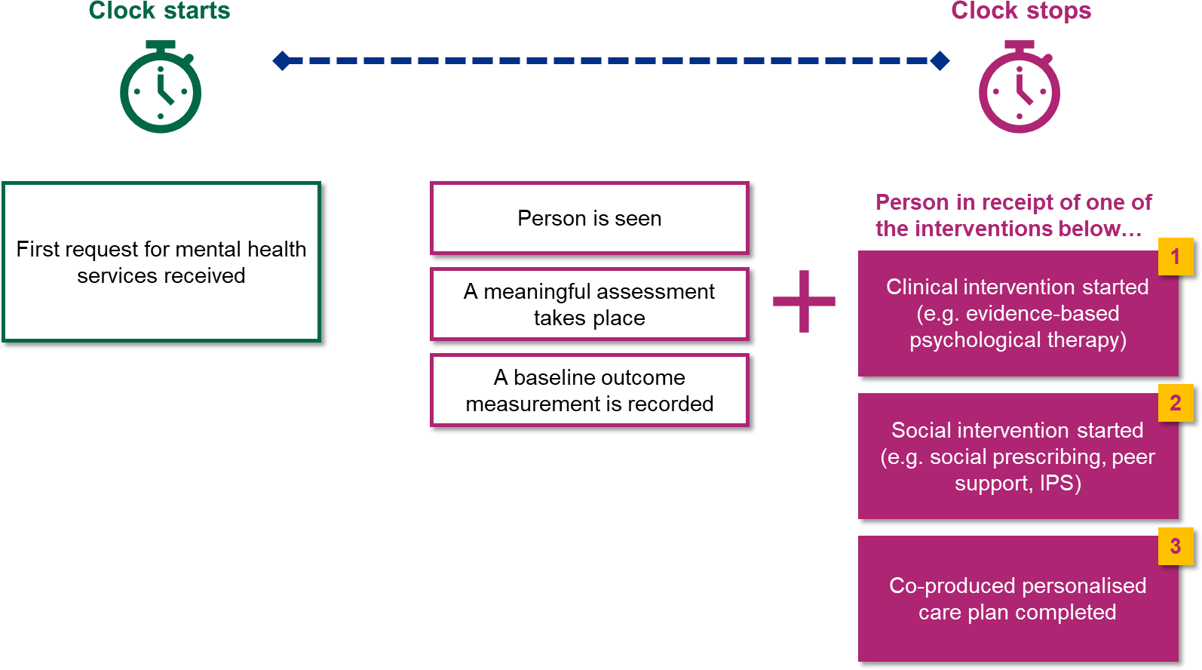
Standard Definition – Clock start/stop
 | Metric definition
Clock start | First request for mental health service received
Clock stop | Person is seen (face to face, telephone or video) AND Meaningful assessment completed AND Baseline outcome score recorded AND Clinical intervention started (e.g. evidence-based psychological therapy) OR Social intervention started (e.g. social prescribing, peer support, IPS) OR Co-produced personalised care plan completed
Clinical interventions contributing to a clock stop Clinical interventions refer to activities delivered by clinicians or allied health professionals. These should be evidence-based and NICE-concordant where applicable. Examples: Psychological therapies Medications/prescribing Occupational therapy physical health interventions Art therapy Counselling
Social interventions contributing to a clock stop Social interventions, on the other hand, refer to any non-clinical activities which are beneficial to service users. Examples:
Financial support Housing support Employment support Social services care planning Education/training Social prescribing Peer support

Slide 7
Process Flow and Tasks Required to Be Completed
Signpost/advice/other pathways
Referral closed
Referral received
Triage Decision : non-urgent 4-week wait
Yes/No
Assessment
On-going care
National Guide
Patient is seen
Record baseline outcome
Patient in receipt of intervention
Steps to be completed by staff
STEP
Record when service user is assessed via face-to-face/telephone/ video in RiO Outcome screen.
STEP
Complete DIALOG form
STEP
When booking or outcoming an appointment, tick relevant option within intervention tab in RiO
AND/OR
Develop a care plan = complete DIALOG + care plan form in RiO
See Slide 10 for image on how to record intended activities in RiO

Slide 8
New interventions list in RiO- BLMK
Mental Health | Medication and Physical Therapy Intervention | Psychological Therapies/Psychosocial Interventions | Psychosocial Interventions | Others
Mental health triage (procedure) Mental health assessment (procedure) Psychological assessment (procedure) Initial memory assessment (procedure) Assessment for dementia (procedure) Neuropsychological testing (procedure) Risk assessment (procedure) Occupational therapy assessment (procedure) Structured clinical assessment for CEN/PD Structured Clinical Management (regime/therapy) Assessment of mental capacity in accordance with Mental Capacity Act (2005) (procedure) Group consultation (procedure) | Administration of drug or medicament (procedure) Review of medication (procedure) Mental health medication review (procedure) Management of compliance with medical regimen (regime/therapy) Medication monitoring (regime/therapy) Clozapine therapy (procedure) Monitoring of clozapine therapy (regime/therapy) Lithium therapy (procedure) Lithium monitoring (finding) Valproate therapy (procedure) Monitoring of valproate therapy (regime/therapy) Valproate therapy stopped (situation) Electroconvulsive therapy (procedure) Transcranial magnetic stimulation of brain (procedure) | Psychotherapy (regime/therapy) Cognitive behavioural therapy (regime/therapy) Group cognitive behavioural therapy (regime/therapy) Cognitive behavioural therapy for psychosis (regime/therapy) Cognitive behavioural therapy for eating disorders (regime/therapy) Cognitive behavioural therapy for personality disorder (regime/therapy) Group cognitive and behavioural therapy for bipolar disorder (regime/therapy) Guided self-help cognitive behavioural therapy (regime/therapy) Mindfulness-based cognitive therapy (regime/therapy) Trauma focused cognitive behavioural therapy (regime/therapy) Group cognitive behavioural therapy for eating disorder (regime/therapy) Schema focused therapy (regime/therapy) Dialectical behaviour therapy (regime/therapy) Mentalisation based treatment (regime/therapy) Cognitive analytic therapy (regime/therapy) Integrative psychotherapy (regime/therapy) Eye movement desensitization and reprocessing therapy (regime/therapy) Psychodynamic psychotherapy (regime/therapy) Focal psychodynamic therapy (regime/therapy) Compassion-focused therapy (regime/therapy) Maudsley Model of Anorexia Nervosa Treatment for Adults (regime/therapy) Art therapy (regime/therapy) Creative therapy Dance therapy (regime/therapy) Music therapy (regime/therapy) Psychodrama (regime/therapy) Narrative therapy (regime/therapy) Psychological formulation (procedure) | Assistance with obtaining accommodation (procedure) Individual Placement and Support (regime/therapy) Employment education, guidance, and counselling (procedure) Nutrition education (procedure) Signposting (procedure) Recommendation to (procedure) Mindfulness-based therapy (regime/therapy) Smoking cessation education (procedure) Recommendation to exercise (procedure) Motivational interviewing technique (procedure) Guided self-help psychological therapy (regime/therapy) Mental health promotion (regime/therapy) Mental health caregiver support (regime/therapy) Caregiver focused education and support program (situation) Mental Health Act procedure (procedure) Safeguarding intervention (regime/therapy) Occupational therapy (regime/therapy) Care navigation (procedure) Dialectical behavioural therapy skills group intervention (regime/therapy) Daily living activity therapy (regime/therapy) Formal peer support intervention (regime/therapy) Activity care assessment (procedure) Assessment under the Mental Health Act 1983 (England and Wales) (procedure) | Official review of care under the Mental Health Act 1983 (England and Wales) (procedure) Consultation (Procedure) Care planning session (procedure) Caregiver support (regime/therapy) Safeguarding adults protection plan agreed finding)

Slide 9
New interventions list in RiO- East London
Mental Health | Medication and Physical Therapy Intervention | Psychological Therapies/Psychosocial Interventions | Psychosocial Interventions | Others
Full needs assessment ABT Initial assessment Psychology treatment | Medication administration Medication review Psychiatric/medical intervention Medical assessment Pharmacy assessment | Group psychological therapy – Psychodynamic Individual psychological therapy - CBT / integrative Group psychological therapy - CBT / integrative Cognitive behavioural therapy for eating disorders (regime/therapy) Guided self-help cognitive behavioural therapy (regime/therapy) ED hub intervention, FREED intervention, ED dietetic intervention PCN ED intervention Focal psychodynamic therapy (regime/therapy) Art therapy Psychological assessment Psychological treatment, Psychological review Interpersonal psychotherapy (regime/therapy) | Housing support Query distinctions for employment support (IPS and Non IPS) Employment support Signposting (procedure), Signposted to appropriate service (intervention) Liaison with other agencies Leisure activities input, Physical health review/observation Emergency mental health assessment (procedure) Safeguarding Care Act Assessment Occupational therapy intervention Placement review | Care Act Review Care Act Support

Slide 10
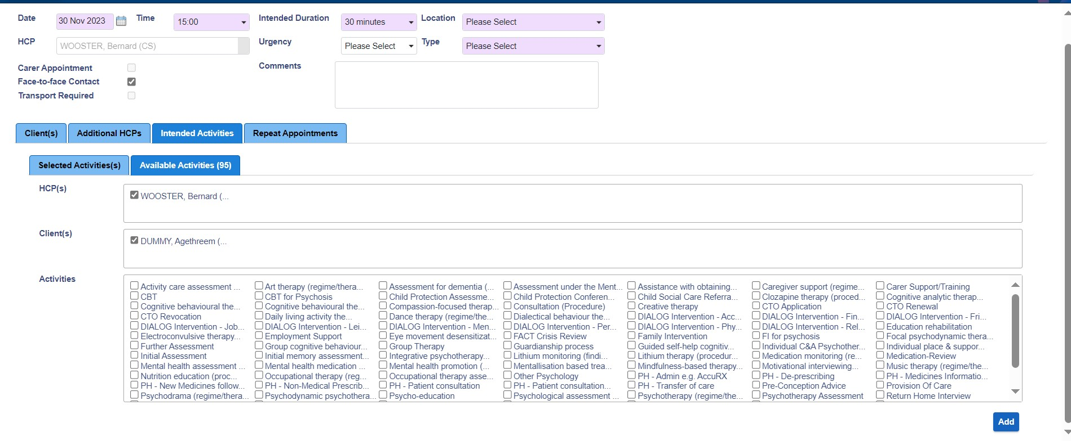
How to Record Intended Activities in RiO
When booking or outcoming an appointment, you will be able to log the intended activities used or to be used during the assessment using the “Intended Activities” tab. See arrows in the screenshot below. For further training, please click here to watch this video.
Click on all relevant activities undertaken

Slide 11
Useful Resources & Contacts
Staff are encouraged to actively engage these materials and reach out to their Operational Leads and Local Performance Teams for questions and clarifications.
Community Mental Health Framework for Adults and Older Adults https://bit.ly/cmhframework
Reporting in Power BI- Reports are being developed in the PowerBI community apps and these will be released in January 2024

