Slide 1


National Waiting Times Standard
Children and Adolescents Mental Health Services (CAMHS)

Slide 2
Background
As a result of the increasing challenges in the mental health of children and young people, the NHS has committed to approaches that can practically deliver four weeks waiting time for access to NHS support. Children, young people and their families/carers presenting to community-based mental health services should now start to receive help within four weeks from request for service (referral). This may involve immediate advice, support or a brief intervention, help to access another more appropriate service, the start of a longer-term intervention or agreement about a patient care plan, or the start of a specialist assessment that may take longer.
Please note: There are no specific targets set for this standard at this stage. However, it is expected that the data submitted by all providers will be analysed and benchmarked by NHSE over the next year to determine the most appropriate target. As a result, we recommend that the primary focus for services in ELFT over the next few months should be on embedding the necessary recording practises so that we can baseline how each service is doing, rather than focusing on achieving a specific target for the time being.

Slide 3
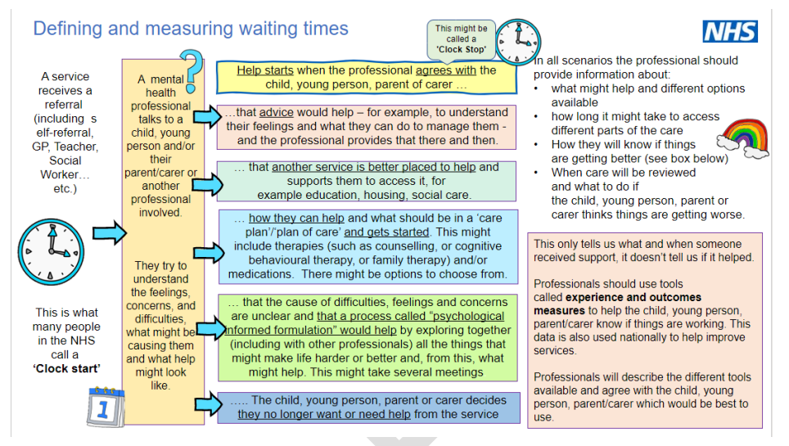
The Waiting Time Pathway

Slide 4
Key changes and steps for staff to follow
New metric measurement
3 key steps for staff to follow during the assessment process
Clock Starts | Help Starts (clock stop)
Referral received by service | First attended direct or indirect contact where: An intervention code detailing the nature of the contact for: advice, signposting, formulation or care plan (plan of care) developed and agreed with the service user, or an intervention is flowed to the Mental Health Services Data Set (MHSDS) via SNOMED5 codes; and An outcome and/or experience measure is flowed to the MHSDS
Referral Received by Service = record all direct or indirect assessment contacts by the service in RiO
Intervention Recorded = when booking or outcoming an appointment in RiO, tick relevant option within intervention tab in RiO. See Slide 6 for how to record interventions in RiO
Outcome Measure Recorded = Complete any CAMHS outcome measures in RiO (C-CGAS, CORS, ORS, SDQ, RCARD, Goal and ESQ)
Please note: Where CAMHS services operate a Single Point of Entry (SPE) to carry out assessments in partnership with other providers, locally-agreed processes for recording interventions and outcomes will need to be followed.
NHSE have confirmed that for such circumstances, they will be seeking to join up data between different providers to accurately measure waiting times. They will be sharing further guidance on this, therefore all providers are required to submit data to MHSDS.

Slide 5
Clock Stopping List
 | Stops CYP Eating Disorder waiting times clock (direct contact only)
 | Stops Core CAMHS waiting times clock (direct or indirect)
Here is a summarised list of all intended activities for CAMHS currently in RiO
for use in stopping the clock.
SERVICE | CATEGORY | CAMHS Interventions (new)
CED | CED | Cognitive behavioural therapy for eating disorders (regime/therapy)
CED | CED | Family therapy (regime/therapy)
CED | CED | Focal psychodynamic therapy (regime/therapy)
CED | CED | Interpersonal psychotherapy (regime/therapy)
CED | CED | Signposting (procedure)
CORE CAMHS & MHST | Signposting | Mental health advice and support intervention (regime/therapy)
CORE CAMHS & MHST | Advice | Assessment of needs (procedure)
CORE CAMHS & MHST | Formulation or care plan | Assessment of physical health (procedure)
CORE CAMHS & MHST | Formulation or care plan | Diagnostic assessment (procedure)
CORE CAMHS & MHST | Formulation or care plan | Emergency mental health assessment (procedure)
CORE CAMHS & MHST | Formulation or care plan | Initial child and adolescent mental health service assessment (procedure)
CORE CAMHS & MHST | Formulation or care plan | Consultation (procedure)
CORE CAMHS & MHST | Intervention | Consultation for treatment (procedure)
CORE CAMHS & MHST | Intervention | Crisis intervention (regime/therapy)
CORE CAMHS & MHST | Intervention | Mental health care and treatment planning
CORE CAMHS & MHST | Intervention | Mental health caregiver support (regime/therapy)
CORE CAMHS & MHST | Intervention | Mental health support groups- staff facilitated (procedure)
CORE CAMHS & MHST | Intervention | Mental health treatment (regime/therapy)
CORE CAMHS & MHST | Intervention | Team meeting (procedure)
CORE CAMHS & MHST | Intervention | Telephone triage encounter (procedure)

Slide 6
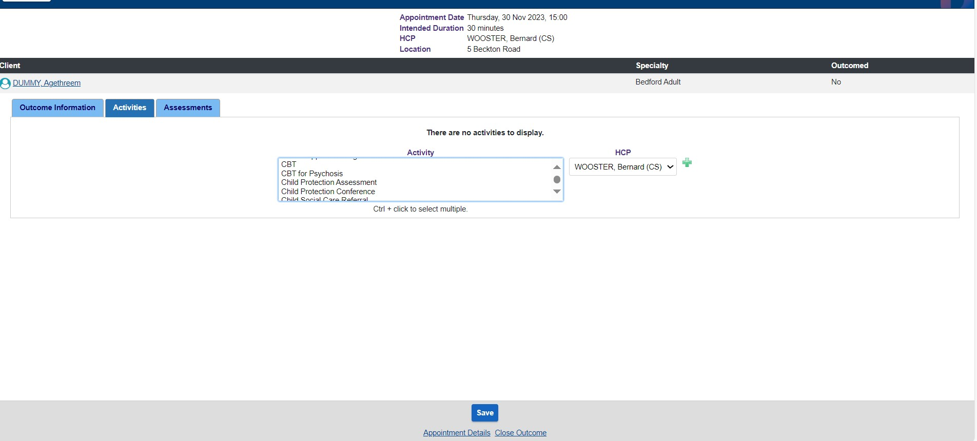
How to Record Intended Activities in RiO
When booking or outcoming an appointment, you will be able to log the intended activities used or to be used during the assessment using the “Intended Activities” tab. See arrows in the screenshot below. For further training, please click here to watch this video.
Click on all relevant activities undertaken

Slide 7
Useful Resources & Contacts
Staff are encouraged to actively engage these materials and reach out to their Operational Leads and Local Performance Teams for questions and clarifications.
Reporting in Power BI- Reports are being developed in the PowerBI community apps and these will be released in January 2024

