Slide 1
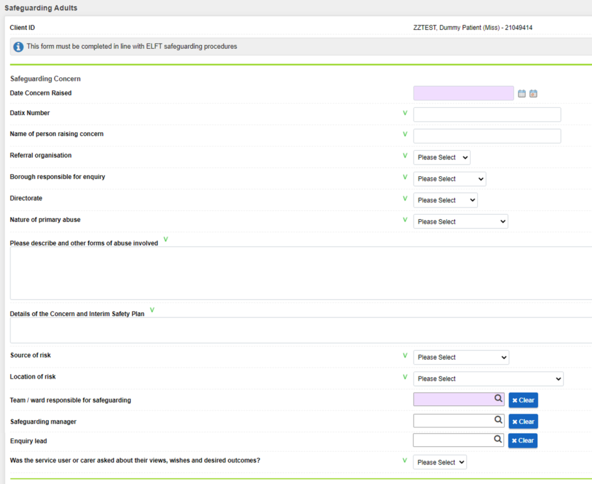
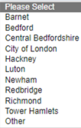
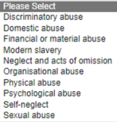
RiO Safeguarding Form

Slide 2
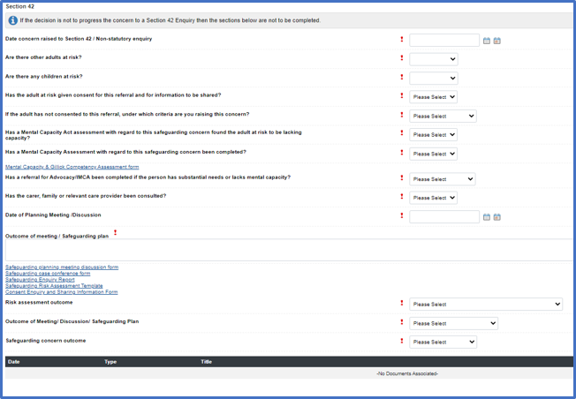
[Drop-down menu for Section 42 enquiries when you select 'yes' to 'Does this adult meet the three-stage test']

