Slide 1
Patient and Carer Race Equality Framework
Social Work Lunchtime Seminar
Patient and Carer Race Equality Framework
3/4/24
Juliana Ansah (Head of Equity, Diversity and Inclusion, PCREF Strategy Lead)
Robert Sykes (PP Lead for Equity, Diversity & Inclusion, PCREF Patient and Carer Engagement Lead)

Slide 2
Patient and Carer Race Equality Framework
What is PCREF?
The Patient and Carer Race Equality Framework (PCREF) was a key recommendation from the independent review of the Mental Health Act. The PCREF is a mandatory framework across all Mental Health Trusts.
Its core aims are to:
Improve interaction with racialised and ethnically and culturally diverse communities
Raise awareness of services’ own cultural and racial bias and provide a framework to reduce them
Improve governance, accountability, and leadership on improving experiences of care for racialised and ethnically and culturally diverse communities
PCREF is made up of three parts:
Part 1 – Leadership and Governance
Part 2 – Cultural Competencies
Part 3 – Patient and Carer Feedback Mechanism

Slide 3
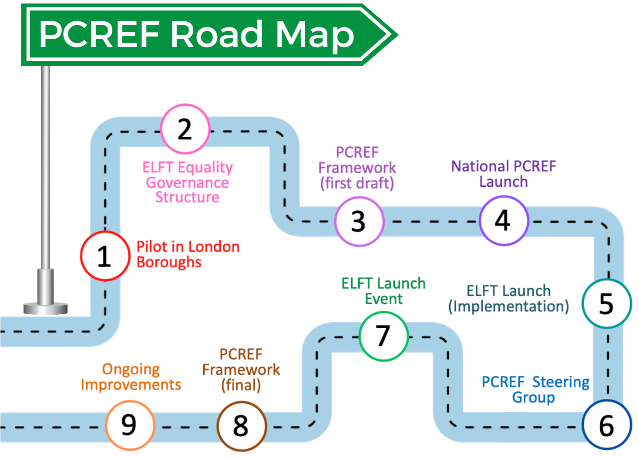
Patient and Carer Race Equality Framework
What is PCREF?
We are currently here

Slide 4
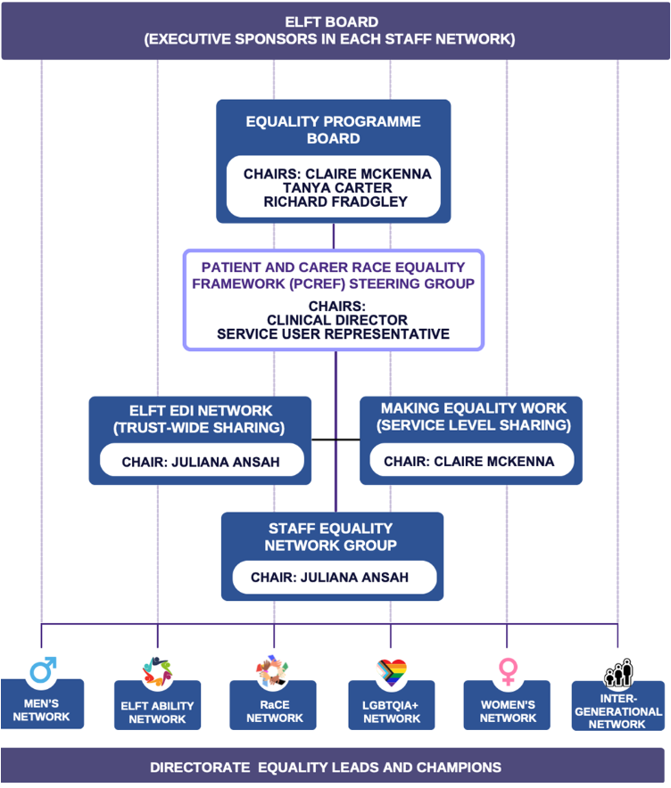
Patient and Carer Race Equality Framework
Part 1 – Leadership and Governance
PCREF Leads:
Claire McKenna (Interim Chief Nurse, PCREF Executive Lead for ELFT)
Juliana Ansah (Head of EDI, PCREF Strategy Lead)
Robert Sykes (EDI People Participation Lead, PCREF Patient and Carer Engagement Lead)
Mina Hadi (EDI Project Officer for PCREF)
Directorate level leads attend the PCREF Steering Group
Data & PCREF Metrics
Data is core to PCREF, and key metrics are reported by the Trust broken down by ethnicity.
Services use their data to identify their priority areas, e.g.
“Improve access rates for South Asian men”
“Reduce number of disciplinary referrals for African and Caribbean staff”
Notes:
The full list of PCREF metrics can be found in the PCREF reporting template

Slide 5
Patient and Carer Race Equality Framework
Part 2 – Cultural Competencies
During the pilot phase of PCREF, six national competencies were identified.
ELFT identified two additional local competencies.
National Competencies
Cultural Awareness
Partnership Working
Workforce
Staff Knowledge and Awareness
Co-Learning
Coproduction
Local Competencies
Intersectionality
Trauma Informed Care

Slide 6
Discussion: How can your team use the Cultural Competencies in your anti-racism priority areas?

Slide 7
Patient and Carer Race Equality Framework
Part 3 – Patient and Carer Feedback
NHSE is setting up task and finish group to develop a feedback mechanism which includes a racialised question.
Within ELFT, we are identifying sources for feedback data, and including a racialised question in existing feedback mechanisms.
PCREF Workshops include focus on ensuring all groups are able to provide feedback.
Discussion: How can your service users meaningfully engage with PCREF?

Slide 8
Patient and Carer Race Equality Framework
PCREF Workshops
Reviewed by staff in the PCREF Steering Group, and service users and carers in the Equity, Diversity and Inclusion Working Together Group. Piloted by the BL Anti-Racism Steering Group.
Workshops are tailored to services’ data and priority areas
Designed to give staff a clearer understanding of PCREF Parts 1, 2, and 3
Outcome-specific and goal-driven, with action plans and self-assessments based on cultural competencies
Codelivered by local service users or carers, who will be supported to share their lived experience
Codesigned by EDI team and PCREF workshop planning group (consisting of service users and carers)
We are still offering shorter explainer sessions to give an overview of PCREF!

Slide 9
Patient and Carer Race Equality Framework
Research Projects
ARIADNE
AddRessing the ImpAct of coviD-19 paNdEmic on the access to and experience of mental health care of people from Black, Asian and Minority Ethnic groups.
Focused on equitable BAME access in the community, particularly around COVID - results published in British Medical Journal and British Journal of Psychiatry.
Co-PACT
Experience based investigation and Co-design of approaches to Prevent and reduce Mental Health Act Use.
Service users from diverse ethnic backgrounds use photography to capture their experiences of compulsory admission into hospital.
New approaches to compulsory admission are co-produced by service users, carers, and staff based on the experiences captured.
Notes:
PCREF Workshops also highlight existing research and learning

Slide 10
Patient and Carer Race Equality Framework
EDI Working Together Group
Monthly meetings between service users, carers, and ELFT EDI staff
A service user co-chair for the PCREF Steering Group has been elected by the WTG
PCREF is a rolling agenda item for each EDI WTG, and the WTG feed into trustwide work on PCREF
Meetings allow for space to present and work on various equalities initiatives and projects, inviting service user and carer input
For more info contact Robert, EDI PPL robert.sykes5@nhs.net

Slide 11
Patient and Carer Race Equality Framework
PCREF Quarterly Report
Part 1: Leadership and Governance
Legislative/statutory duties (Mental Health Act, Equality Act)
Provided data (disaggregated by ethnicity/race) on:
Restraint
Patient safety incidents and near misses
Death in mental health inpatients
Complaints actioned appropriately
Part 2: Cultural Competencies
Cultural Awareness: Good
Staff Knowledge and Awareness: Good
Partnership Working: Good
Coproduction: Outstanding
Co-Learning: Good
Intersectionality: Good
Trauma-Informed Care: Good
Notes:
Restraint: Equity gap between ethnic groups across Adult & Older Adult services in restrictive practice has considerably narrowed.
Patient safety incidents and near misses: Reduced in 2023 for Asian patients by 3rd quarter; largely stayed the same for Black patients
Cultural Awareness: 1st annual population health report – coproduced with service users
Staff Knowledge and Awareness: PCREF Steering Group and workshops
Partnership Working: Anchor organisation, microgrants
Coproduction: People Participation scheme and infrastructure, EDI WTG
Co-Learning: Recovery Colleges in all directorates
Intersectionality: Embedded in PCREF workshops
Trauma-Informed Care: Work happening across directorates, Trustwide trauma-informed community of practice happens each month

Slide 12
Patient and Carers Race Equality Framework
PCREF Quarterly Report
Part 3: Feedback Mechanisms
A racialised question will be added to existing feedback mechanisms, such as:
Friends and Family Test Scores (FFTs)
Patient Recorded Experience Measures (PREMs)
Patient Recorded Outcome Measures (PROMs)
NHSE is setting up task and finish group to develop feedback mechanism.
We are currently working on identifying the best source of patient and carer feedback data – including the Carers Strategy Group and directorate/place-level groups.
Future Reports
Data and narrative was incomplete in the last quarterly report
PCREF Data Sub-Group are working to identify sources for data and narrative
A service-level reporting template has been created by the EDI team

Slide 13
Patient and Carers Race Equality Framework
Thank you for attending!
Questions?
Notes:
What can you share with us to learn?

