Slide 1
Putting first things first Being effective with Time
Notes:
Introduction
Being effective with time is really all about your own self management.
Today is a one hour, 60 minutes, 3600 seconds session and draws from some of the work by Stephen Covey’s 7 Habits.
Forgive me but I am not going to crack this for you in the hour, minutes or seconds we have together, so my offer is to share a couple of provocations that we can have a discussion about.
Being an effective person, we need to self manage. In his book he talks about one denominator all successful people share – not hard work, good luck or astute human relations – all vitally important - but the most important denominator was what Covey calls putting first things first.
However in order to put first things first, you need to know what your purpose or your mission is. (this is covey’s 2nd habit) and what sits at the foundation of your purpose and mission is being proactive about it (the 1st habit).

Slide 2
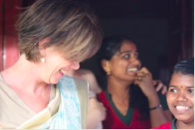
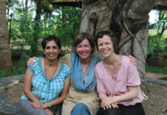
The number of breaths given to us in our lifetime is predetermined.
Hindu tradition

Slide 3
First Things First…
What one thing could you do (that you aren’t doing now) that if you did it on a regular basis, would make a tremendous positive difference in your personal life?
What one thing in your work life would bring similar things?
Notes:
Only if you have a ‘burning yes’ inside of you that captures your purpose, your sense of direction or values can you begin to say no.
“Organise and execute around your priorities”

Slide 4
Provocation #1
How to organise and execute your priorities
Time Management Matrix…
Notes:
Rather than focusing on things and time, instead we should focus on preserving relationships and accomplishing results.
Two factors that define an activity: URGENT and IMPORTANT
Urgent matters are usually visible, they press on us, insist on action and we react
Important matters, on the other hand, are about results. Something important will contribute to your mission, your values, your high-priority goals. They are usually less urgent, require more initiative and more proactivity
What happens when we live our lives in:
Q1 – Stress, burnout, crisis management, always putting out fires
Q3 – Short term focus, chameleon character, sees goals as worthless, feel victimized, out of control, shallow or broken relationships
Q4 -

Slide 5
Time Management Matrix
Q1 90%
Q4 10%
Notes:
Rather than focusing on things and time, instead we should focus on preserving relationships and accomplishing results.
Two factors that define an activity: URGENT and IMPORTANT
Urgent matters are usually visible, they press on us, insist on action and we react
Important matters, on the other hand, are about results. Something important will contribute to your mission, your values, your high-priority goals. They are usually less urgent, require more initiative and more proactivity
What happens when we live our lives in:
Q1 – Stress, burnout, crisis management, always putting out fires
Q3 – Short term focus, chameleon character, sees goals as worthless, feel victimized, out of control, shallow or broken relationships
Q4 -

Slide 6
Time Management Matrix
Notes:
Rather than focusing on things and time, instead we should focus on preserving relationships and accomplishing results.
Two factors that define an activity: URGENT and IMPORTANT
Urgent matters are usually visible, they press on us, insist on action and we react
Important matters, on the other hand, are about results. Something important will contribute to your mission, your values, your high-priority goals. They are usually less urgent, require more initiative and more proactivity
What happens when we live our lives in:
Q1 – Stress, burnout, crisis management, always putting out fires
Q3 – Short term focus, chameleon character, sees goals as worthless, feel victimized, out of control, shallow or broken relationships
Q4 -

Slide 7
Always ‘Being on’
A heavy reliance on technology and a need for rapid response has fueled an ‘always on’ culture, whereby people find it difficult to switch off.
(McDowall & Kinman, 2017)

Slide 8
Head in the sand…
“There is a degree of masochism to being 'always available' which is a significant challenge to those who wish to acknowledge the damage that does to both the individual and the organisation”.
(McDowall & Kinman, 2017)

Slide 9
Get your ‘stuff’ together
Night before. Spend last 15-minutes organizing yourself for most important things for tomorrow.
First thing in the morning. List the 3 or 4 most urgent and important matters that need to be addressed today and work on those when you’re most productive.

Slide 10
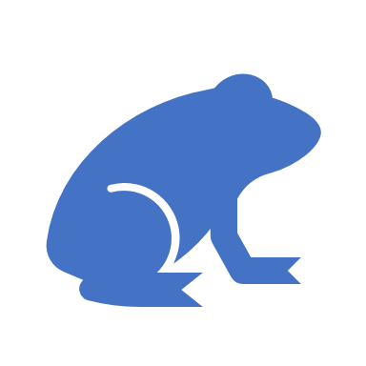
First frog first…
"If it's your job to eat a frog, it's best to do it first thing in the morning. And If it's your job to eat two frogs, it's best to eat the biggest one first.”
Mark Twain

Slide 11
Get organised…
A place for everything and keep everything in its place.
Clean your workplace at the end of the day
Make a document management system on your one drive.
Do one thing at a time.
Notes:
The average person spends 2.5 days each year looking for misplaced items.
There is a cost attached to this too by wasting both your time and your money.

Slide 12
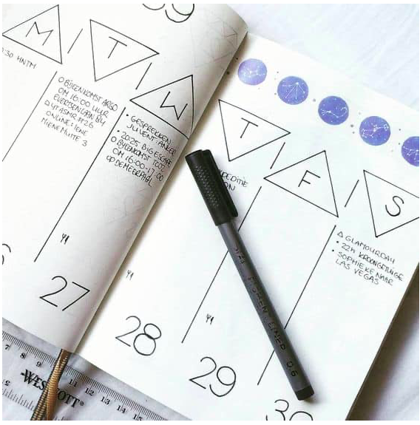
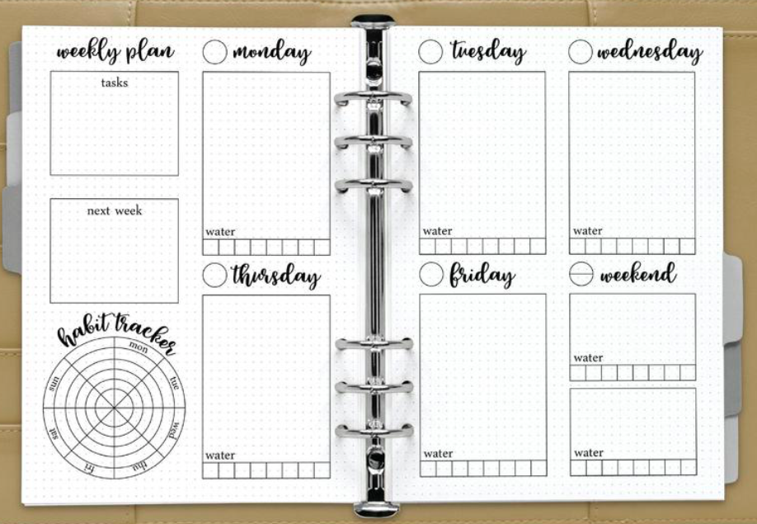
Bullet Journal – Weekly Plan
Notes:
What roles do you play in your life? Key relationships including yourself.
What are the ‘big rocks’ for the week – those that have the greatest contribution. Ask yourself ‘what is the most important thing I can do to in this role this week?’
Block out time for the ‘big rocks’ before the week fills up.
“What is the one thing that you could do, that you know would have a positive impact on ….”

Slide 13
Organise your e-mails
Start by purging everything you don’t need!
Archive what you’re not yet ready to delete
Set up Folders and file your emails (you need to keep) into the folders
Carve out time in your diary to manage your emails eg., 30 mins daily, deeper dive weekly
Use the flag system to remind you about the emails you can’t get to immediately
Identify a buddy who can help you

Slide 14
Organise your calendar
Schedule time in your calendar to do the Q2 activities.
Book holidays and birthdays and special days as leave
Get a balance when it comes to early mornings and late nights
Leave a buffer-time between tasks and meetings.
Eat, drink, take regular 5 min breaks

Slide 15
Final Thoughts
Stop trying to be perfect
Live the life you love

