Slide 1
Addressing Staff Burnout
What is burnout?
Burnout isn’t technically a diagnosis in itself, but instead it refers to a collection of symptoms.
If you are experiencing burnout you may feel completely exhausted, have little motivation for your job, feel irritable, or anxious and you may see a dip in your work performance.
Some people also experience physical symptoms like headaches or stomach aches, or have trouble sleeping
In 2019, ‘burnout’ was recognised by the World Health Organisation (WHO) as an ‘occupational phenomenon’. As lockdowns have drastically affected our work-life balance and working environments, research was undertaken by WHO to ascertain the public’s perceptions of burnout and the contributing factors, considering the pandemic.
(www.mind.org.uk)

Slide 2
What is Burnout
Burnout is a state of physical and emotional exhaustion. It can occur when you experience long-term stress in your job, or when you have worked in a physically or emotionally draining role for a long time.
Common signs of burnout:
Feeling tired or drained most of the time
Feeling helpless, trapped and/or defeated
Feeling detached/alone in the world
Having a cynical/negative outlook
Self-doubt
Procrastinating and taking longer to get things done
Feeling overwhelmed
(www.mentalhealth.org.uk)

Slide 3
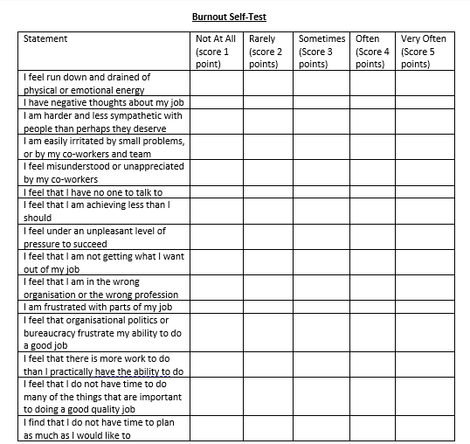
Lets check ourselves for Burnout

Slide 4
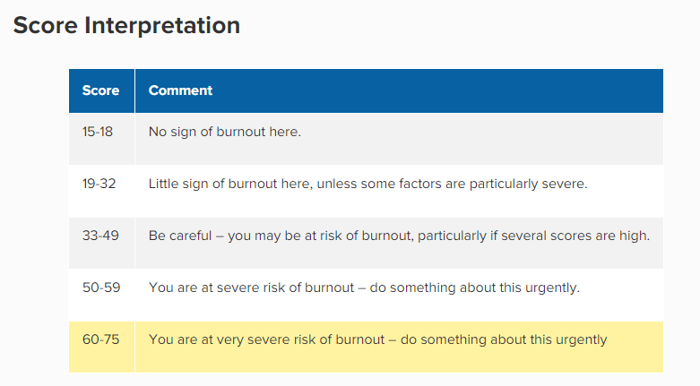
Our burnout scores

Slide 5
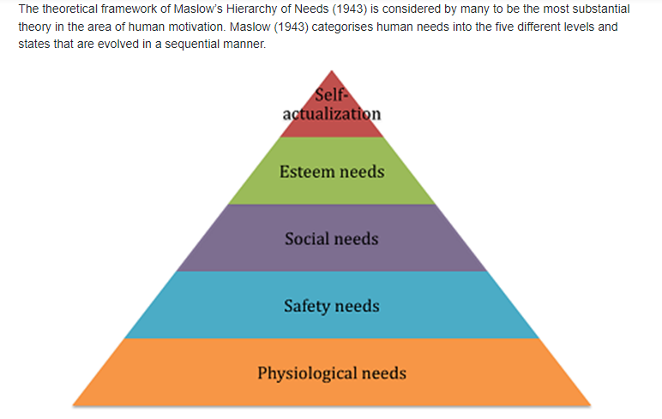
Maslow’s Hierarchy of Needs

Slide 6
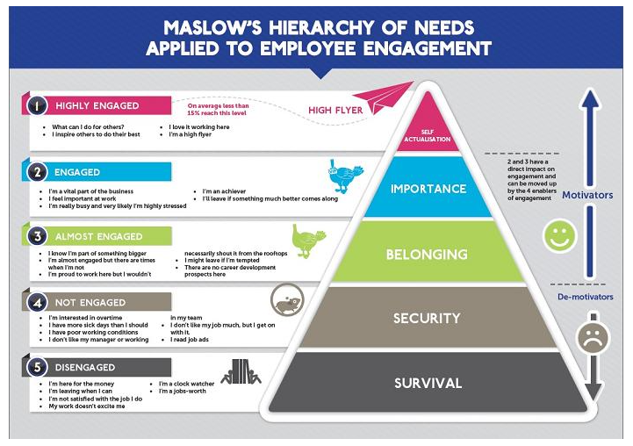
Maslow’s Hierarchy of Needs – Employee Engagement

Slide 7
Maslow’s Hierarchy of Needs – Employee Engagement
In pairs/small groups, look at this model and discuss:
Q1 - Where are you on the pyramid?
Q2 - What would enable you to move up the pyramid?
Only share what you are comfortable with

Slide 8
Finding our Equilibrium
In small groups, look at this model and discuss:
Q1 – What are our stressors?
Q2 - What are our motivators?
Let’s discuss our stressors and motivators
What does this tell us?

Slide 9
Finding our Equilibrium
There is evidence to support the idea if people can:
re- connect with the values that brought them into the work
feel they make a difference
have the opportunity to be creative at work and; are able to change and develop
Then they are able to deal with their stress better and feel more positive about their work

Slide 10
How can we cope with burnout at work?
Thinking about the motivators and stressors identified in the previous activities, in small groups discuss:
What actions can we take to help us cope with burnout at work?
What support do we need to help us cope with burnout?

Slide 11
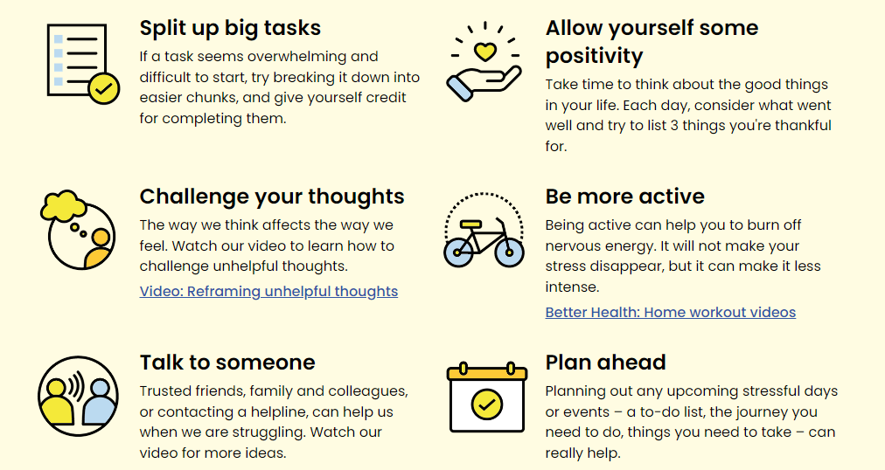
Tips for burnout/stress on an individual level

Slide 12
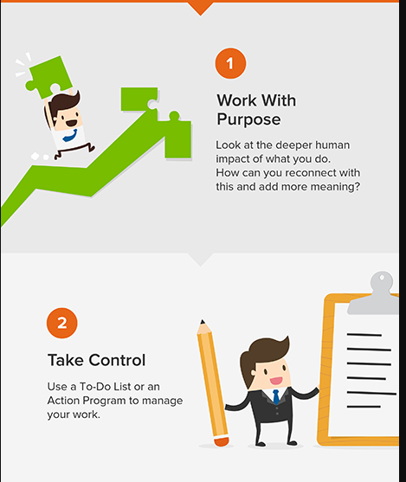
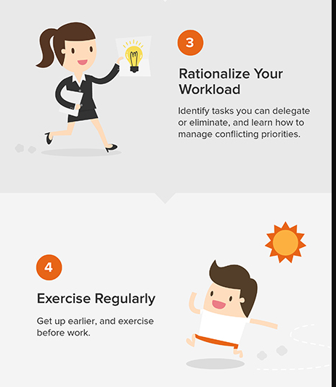
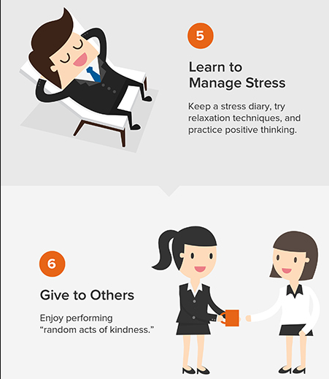
Tips for burnout/stress on an individual level

Slide 13
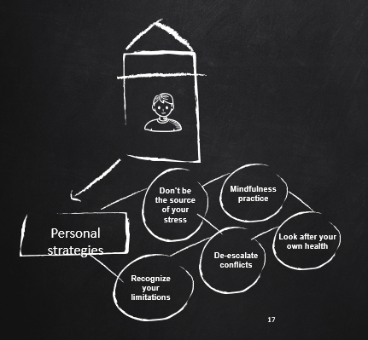
Personal strategies to cope with burnout at work

Slide 14
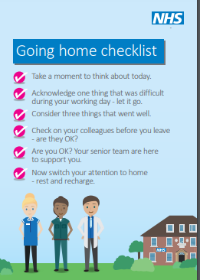
The NHS Going Home Checklist
The ‘Going Home Checklist’ is a poster which can be used to encourage reflection and mindfulness at the end of a working day
NHS-Staff-wellbeing-poster1.pdf (dbth.nhs.uk)

Slide 15
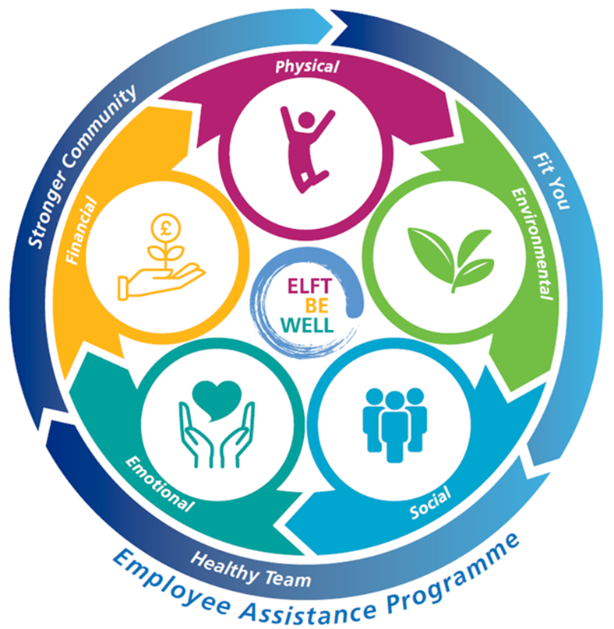
ELFT Wellbeing Wheel

Slide 16
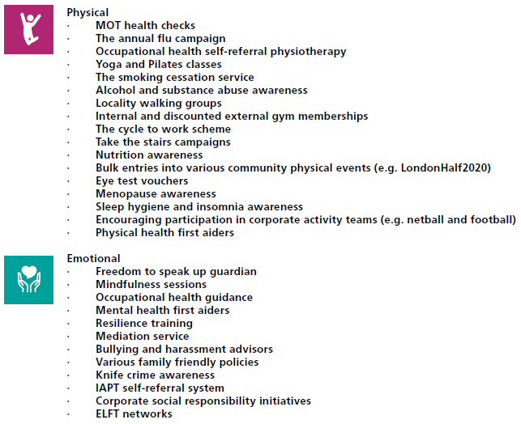
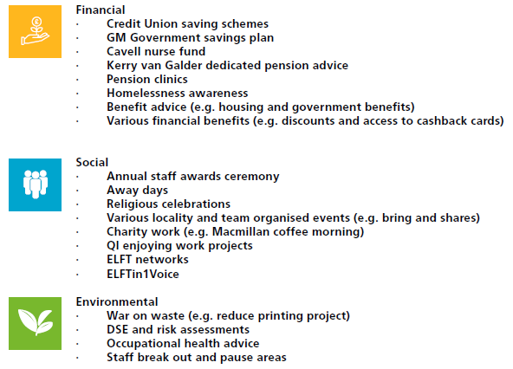
ELFT Wellbeing Wheel

Slide 17
Other Support Offers
Headspace app free for NHS staff: https://www.headspace.com/nhs
Support available for NHS staff to support their wellbeing i.e. yoga videos, habits, managing stress etc. https://healthservicediscounts.com/nhs-wellbeing-plan/wellbeing
ELFT’s Employee Assistance Programme on 0800 174 319 or by logging in online www.carefirst-lifestyle.co.uk : Username: ELFT; Password: employee
KeepingwellNEL & Keepingwell BLMK – London staff can visit - https://keepingwellnel.nhs.uk wellbeing platform for real-time support, signposting and fast-tracked referral where requested, to other support services. Luton and Beds Staff can visit - https://keepingwellblmk.nhs.uk or call 01908 724227
Silver Cloud is free to access for all staff to a CBT online platform by using the access code: NHS2020 https://www.silvercloudhealth.com/uk
Sleepio - is a personalised sleep improvement programme. Free for NHS staff https://www.nhs.uk/apps-library/sleepio/
NHS in Mind - is a free platform containing interventions to help combat high anxiety, panic and fatigue https://www.nhsinmind.co.uk/
Ten Percent Happier - is free for six-months and offers meditation and mindfulness guidance https://www.tenpercent.com/care

