Slide 1
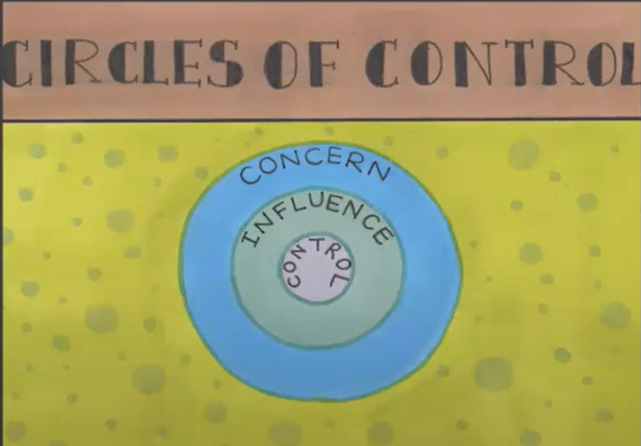
Circles of Control Model
Concern
Weather
Traffic
Others moods
Others decisions
The economy
Others opinions of us (may be able to influence)
Control
Our mood
Our decisions
Our reactions
What we say
Who we spend time with
What we learn
Influence
Those around us e.g. in a meeting we can influence the mood
from the work of Stephen Covey
Notes:
Circle of Concern
The simple graphical representation explains that your Circle of Concern includes everything external such as war, politics, pandemics, weather, etc. It depicts everything important to a certain person. This comprises factors that a person may affect and control.
The Circle of Concern will always contain numerous things outside of a person’s influence or control by its very nature. ^{[1]} For example, most people are concerned about the news/weather and how it affects their everyday lives, yet they have little control over it.
Circle of Influence
Since humans are social creatures, an individual’s Circle of Concern may be influenced by others. This is their Circle of Influence, and it has to do with the quality of their connections and their dialogues with others. The behavior of your team, your company’s work culture, your promotion prospects, etc. are all examples of the Circle of Influence. You may be concerned about the long working hours, but thinking through how can you reduce these falls into the Circle of Influence.
The Circle of Influence is an excellent tool for effectively directing your time and energy. It has the potential to improve your performance, personal growth, and overall enjoyment in life.
Circle of Control
A circle of control entails how you respond to these external situations. Your thoughts, your attitude, and your enthusiasm are what form the circle of control. These are the things that you have the power to control. ‘Control,’ refers to what we can directly cause to happen due to our decisions, regardless of whether or not others agree. Our Circle of Control can only relate to ourselves in this way, and even then, only to our conscious self. What is the reason behind this?
‘Control,’ as per ontological perspective,^{[2]} is inextricably tied to conscious decision. ‘Control = Awareness + Choice,’ as the adage goes. As a result, a person can only exercise control over parts of their own way of being that they are aware of.
We typically behave without conscious deliberation about how we will act and play out well-worn behavior patterns since much of what we do is habitual, or what we call “transparent” in the ontological perspective.
Acting in this manner implies that we are acting outside of our immediate control. It’s important to remember that habits are more than simply physical behaviors; they also encompass how we view and interpret our surroundings.
As a result, the more our capacity for self-awareness, the greater our ability to command our state of being.

Slide 2
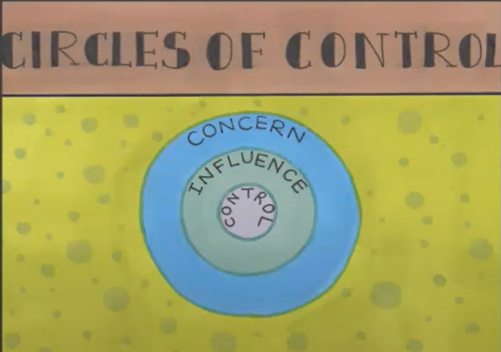
Your Circles
What is my concern?
Of my concern what is in my control?
What is out of my control?
What am I currently trying to control?
Where can I have influence?
What can I control that I am not presently controlling?

Slide 3
Suggestions on Circle of Control
When you feel anxious or start getting worried over external events, you can simply change your mindset to focus on things within your control. You have already learned that things beyond your control are not worth brooding or worrying over.
When you feel overwhelmed is you can start identifying your focus and priorities in life. It will allow you to stay focused on what’s important to you and remind you why you should maintain a mental balance.
When anything unplanned or uncontrollable happens such as the pandemic, simply focus on what you can influence and control.

