Slide 1
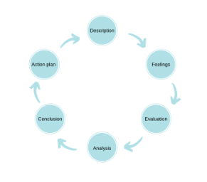
Gibb’s Reflective Cycle
Gibb's cycle contains six stages:
Description
Feelings
Evaluation
Analysis
Conclusion
Action plan
Gibb's begins with an outline of the experience being reflected on. It then encourages us to focus on our feelings about the experience, both during it an after. The next step involves evaluating the experience - what was good or bad about it from our point of view? We can then use this evaluation to analyse the situation and try to make sense of it. This analysis will result in a conclusion about what other actions (if any) we could have taken to reach a different outcome. The final stage involves building an action plan of steps which we can take the next time we find ourselves in a similar situation.
Notes:
Gibb's Reflective Cycle
The final model builds on the other three and adds more stages. It is one of the more complex models of reflection but it may be that you find having multiple stages of the process to guide you reassuring. Gibb's cycle contains six stages:
Description
Feelings
Evaluation
Analysis
Conclusion
Action plan
As with other models, Gibb's begins with an outline of the experience being reflected on. It then encourages us to focus on our feelings about the experience, both during it an after. The next step involves evaluating the experience - what was good or bad about it from our point of view? We can then use this evaluation to analyse the situation and try to make sense of it. This analysis will result in a conclusion about what other actions (if any) we could have taken to reach a different outcome. The final stage involves building an action plan of steps which we can take the next time we find ourselves in a similar situation.

