Slide 1
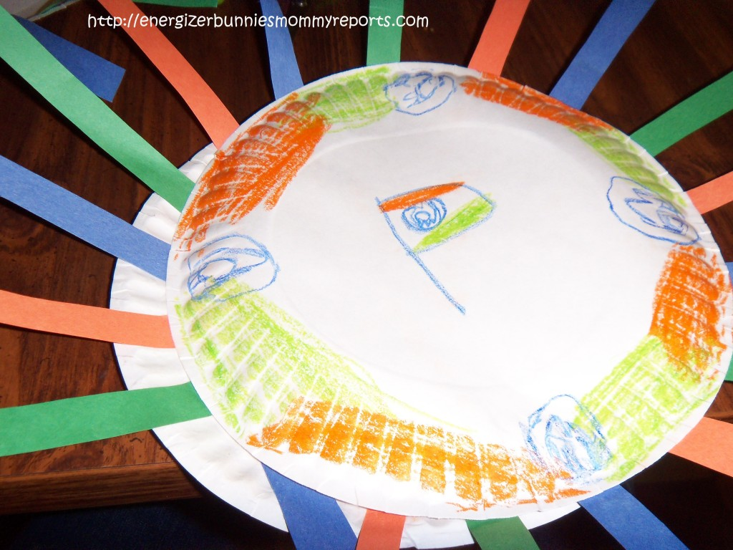
What's on your plate?
Take a paper plate and some pens
Write down all the things that are on your plate – good and bad, what you are responsible for, where are your pressures/stresses etc.
Share your plate with the group
This Photo by Unknown Author is licensed under CC BY-NC-ND
Notes:
"What's on your plate?" is an activity that helps participants identify and manage their stressors¹²³. To do this activity, you need to:Hand out a paper plate to each participant¹.
Ask participants to write down all the things they are thinking about, responsible for, or stressed about on the front side of the paper plate¹.
Categorize each item into different categories using different colors².
Share "what's on your plate" with the small group³.
If time permits, allow group members to tell the large group interesting things they learned about each other as a small group³.

