Slide 1
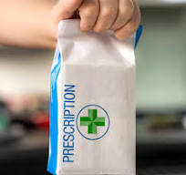
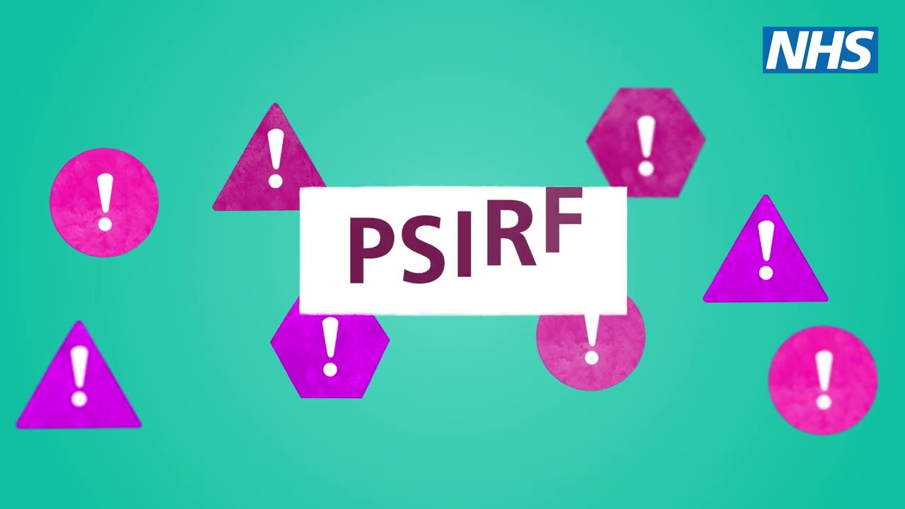
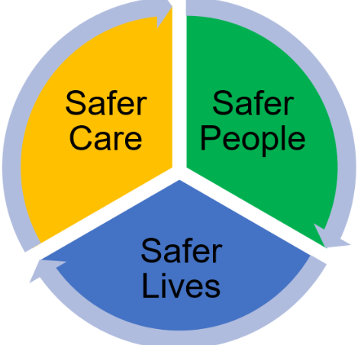
MIST
MIST
Medication Information and Safety Tips
Medication Information and Safety Tips
ELFT Medicines Safety Group
Making patient safety matter
August 2024
Reporting Incidents
Medication incidents reported via the Trust’s incident reporting system (INPHASE) are vital in identifying trends and areas for improvement. It is important for teams to focus on HOW incidents have happened and to share the learning in order to improve, rather than attributing blame or liability.
PSIRF – what is it?
The Patient Safety Incident Response Framework - PSIRF sets out the NHS’s approach to developing and maintaining effective systems and processes for responding to patient safety incidents for the purpose of learning and improving patient safety.
The key aims of PSIRF include:
Compassionate engagement and involvement
Use of system-based approached to learning
Considered and proportionate responses
Supportive oversight focused on strengthening response system functioning and improvement
PSIRF – Learning Methods
You teams can try new learning methods, such as After Action Review (AAR) –click here to learn more. To learn about other leaning methods – link here (Patient safety learning response toolkit NHS).:
Example After Action Review
A health care assistant (HCA) was allocated a task to administer enoxaparin to a patient at home. She administered the dose, without realising that a nurse had administered the dose earlier that day and signed the MAR chart to reflect this. The patient received a double dose. An AAR was conducted to include all staff who were involved in the incident; colleagues collectively reflected on the incident to learn and implement actions/change to improve future processes.
See full AAR in the linked document below
Nurse Discharge Medication Checklist (NDMC)
FINAL NURSE CHECK OF DISCHARGE MEDICINES: complete a final check of the medicines bag content in conjunction with the Trust’s Nurse Discharge Medication Checklist (mandatory as per Trust Medicines Policy) before the patient is discharged including Short Term Leave. Incidents continue to be reported on INPHASE which could have been avoidable had this mandatory checklist been completed and a final check of the medicines taken place.
Learning from Incidents
Allergy Status Reconciliation on admission
A patient was admitted to the ward and the allergy status from her previous admission of ‘NKDA’ was automatically pulled across to her current electronic drug chart. However, since the patient's last admission a new allergy/reaction had been documented in her medical record. At the beginning of every admission the allergy status MUST be confirmed by the clinician and the drug chart/patient record updated. Unfortunately, in this case, this didn’t happen. The patient had an allergy to haloperidol causing Neuroleptic Malignant Syndrome (a life threatening reaction). The patient’s allergy status on the drug chart wasn’t updated and she was prescribed haloperidol; she was administered a haloperidol depot injection twice as an inpatient. At the 72 hour discharge follow up, the patient reported serious side effects. An ambulance was called and the patient was admitted to general hospital.
Learning and Practice Points
The allergy status must be confirmed by the doctor for every new admission as part of the medicines reconciliation process.
The ward pharmacy team will undertake a secondary check and should follow up any discrepancies.
There is an EPMA prompt on the system to confirm the allergy which should not be ignored.

Slide 2
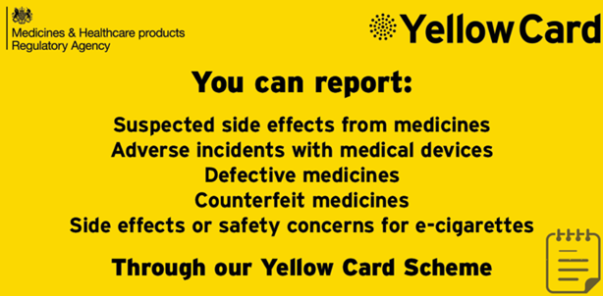
MIST
MIST
Medication Information and Safety Tips
Depot Injection Administration Errors
Example 1: Depot injection administered in accordance with the details on the team white board, which did not correlate with the actual drug chart resulting in an administration error.
Example 2: The prescribed depot administration date on the electronic drug chart was missed. It was administered a week later but could not be signed for as administered, as there was not a legally valid prescription to sign against i.e. no legal record of administration.
Learning and Practice Points
Legal requirement to administer in accordance with what has been prescribed on the drug chart
If you notice an issue with the prescription please escalate to the prescriber before administering any medication.
It is not acceptable to ask the doctor to re-prescribe retrospectively after administering a medication without a legal prescription.
For a missed depot dose, please escalate to the clinician for review; the treatment plan and ongoing prescription(s) may need altering.
CLOZAPINE: Pre-requisite prescribing checks
Clozapine prescribing: it is a requirement for patient registration with the correct monitoring service dependent on the brand prescribed. A newly admitted inpatient was prescribed clozapine for re-titration. The prescriber assumed the patient was already registered, as she was on clozapine in the community. However, she was prescribed a different brand of clozapine; consequently was not registered with the relevant monitoring service. The nurses sourced Clozapine medication from the emergency drug cupboard out of hours without checking with the on-call pharmacist and so the error was not detected immediately.
Learning and Practice Points
Clozapine prescribing should be communicated with the pharmacy team and confirmation obtained from pharmacy that the pre-requisite checks have been undertaken e.g. patient registration and valid blood test results, correct titration plan.
Out of hours, this confirmation and advice can be obtained via the on-call pharmacist.
Clozapine is a high risk medication with greater potential for harm. Access the clozapine policy via the intranet.
MHRA Drug Safety Updates (DSUs):
Topiramate: Pregnancy Prevention Programme
Topiramate is now contraindicated in
pregnancy and in women
childbearing potential unless the conditions of a PPP - Pregnancy
Prevention Programme are fulfilled. Topiramate during pregnancy is associated with significant harm to the unborn; higher risk of congenital malformation, low birth weight and a potential increased risk of intellectual disability, autistic spectrum disorder and attention deficit hyperactivity disorder in children of mothers taking topiramate during pregnancy.
General advice for healthcare professionals:
topiramate should not be used in pregnancy for:
- prophylaxis of migraine
- epilepsy unless there is no suitable alternative
topiramate should not be used in women of childbearing potential unless the conditions of the PPP are fulfilled. This aims to ensure that all women of childbearing potential:
are using highly effective contraception
have a pregnancy test to exclude pregnancy before starting topiramate
are aware of the risks of topiramate
see specific advice for prescribers and dispensers in the full MHRA drug safety update
ensure women of childbearing potential sign the Risk Awareness Form
report suspected adverse drug reactions with topiramate to the Yellow Card scheme.
Mental Health Setting:
Female inpatients of childbearing potential on topirimate for a neurological indication, please ensure conditions of the PPP are fulfilled and there is a completed Risk Awareness Form – refer to their neurologist if needed.
In the rare circumstance you prescribe topirimate in a female of childbearing potential for an unlicensed mental health indication then:
Ensure conditions of the PPP are fulfilled
Complete a Risk Awareness Form
Comply with the ‘Unlicensed and Off-Label Medicines Policy’
.
ELFT Medicines Safety Group

