Slide 1
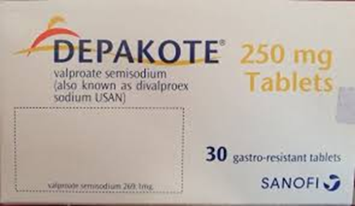
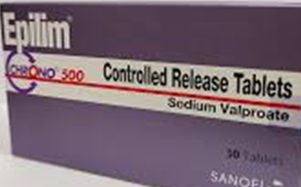
MIST
MIST
Medication Information and Safety Tips
Medication Information and Safety Tips
ELFT Medicines Safety Group
Making patient safety matter
June 2024
Valproate Trust Policy Updated
New Regulatory Changes ​
A​. Valproate must not be started in new
patients (male or female) younger than
55 years, unless two specialists independently consider and document that there is no other effective or tolerated treatment, or there are compelling reasons that the reproductive risks do not apply. This must be documented on the revised valproate Risk Acknowledgement Form.
B. At their next annual specialist review, women of childbearing potential and girls should be reviewed using a revised valproate Risk Acknowledgement Form, which will include the need for a second specialist signature if the patient is to continue with valproate and subsequent annual reviews with one specialist unless the patient’s situation changes.
Advice for healthcare professionals (HCPs):​
​Read the new Policy; available on the Trust website in the Medicines section of the Policies webpage.
Read Key Resources: Valproate Safety Measures accessed via the MHRA website
Critical medicine omissions:
Timely prescribing, supply and
administration of critical medicines is
essential. Critical medicine omissions
increase risk of patient harm. There is guidance within the Trust’s ‘Medicines Policy’ on what medicines are considered ‘critical’. If you don’t have access to the correct medication, please contact your relevant pharmacy team. During out of hours, wards can contact the DSN (Duty Senior Nurse), who can then contact the on-call pharmacist if needed. If medication is not available please contact your local pharmacy team.
Learning from Incidents
1) Patient Self Administration (Trust Policy)
There have been a few incidents relating to inappropriate self administration of medication.
Example:
Patient was given his Tacrolimus cream (a POM prescription only medicine) to keep in his room. The patient had applied this unsupervised four times a day instead of four times a week. There was no documentation on JAC EPMA, so it’s not clear what had been applied and when. Such medicines are subject to SAFE and SECURE STORAGE as per Medicines Policy.
Learning and Practice Points
Please follow the Trust Self Administration Policy. This includes undertaking a patient assessment before the patient is able to self administer.
Please don’t assume based on the type of medication e.g. cream that it is okay for the patient to keep in their room. In this case the cream was mistakenly handed directly to the patient for safe keeping and self application.
2) Secondary Dispensing in advance
A number of incident reports indicate medicines are being prepared in advance of drug administration rounds; dispensed into paper pots with patient initial/names being written on the pots. This HIGH RISK practice is not in line with the Trust Medicines Policy. As a result, patients have been given the wrong medication meant for another patient.
Learning and Practice Points
Always administer against the drug chart from original medication packs; confirm patient name, allergies and medication being administered.
Know your 10Rs (10 Rights of Administration) - refer to the ELFT Medicines Policy
RIGHT: patient, medicine, dose, time, route, expiry, effect ,consent, documentation, education

Slide 2
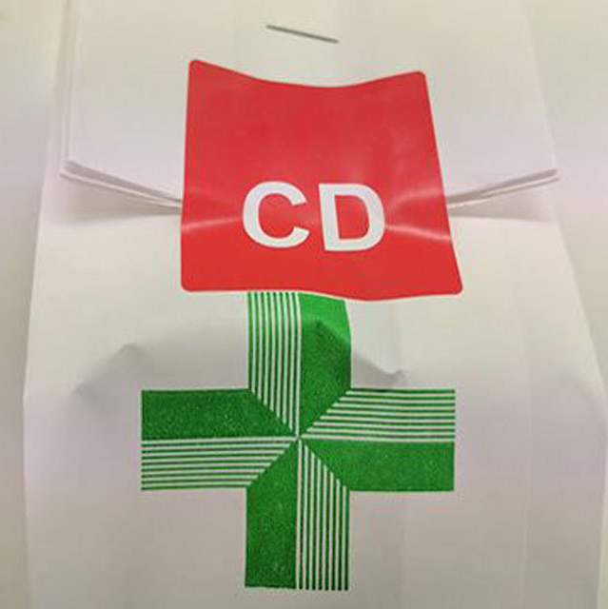
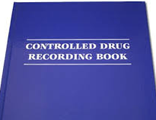
MIST
MIST
Medication Information and Safety Tips
3. Clozapine break– RE-TITRATION
A patient was admitted to the ward due to non-compliance with their Clozapine medication in community; leading to a relapse in mental state. If there is >48 hour treatment break, Clozapine must be re-titrated. On this occasion, this didn’t happen and the patient was prescribed his regular full maintenance dose. Fortunately, this was detected by nursing staff and administration did not take place.
Learning and Practice Points
Clozapine is a high risk medication associated with serious adverse effects and strict protocols in relation to blood test monitoring and dose titration on initiation and after treatment breaks e.g. non compliance.
It is essential that all staff involved in prescribing, administering and supplying Clozapine are familiar with the medication, monitoring requirements and the Clozapine Policy.
Controlled Drug (CD) procedures:
Key Practice Points
CD audits are undertaken every
Quarter. Results are shared with
directorate teams to address areas
of non compliance.
CD balance checks against the register are to be undertaken at least ONCE every 24 hours.
Two nurse signature entries are required in the in the register to confirm each CD administration.
When CD stock is received on the ward, please ensure 2 members of staff (at least one registered nurse) sign it into the register.
When a CD has been transferred from another ward/team, or to another page in the same CD register – there are specific recording requirements as per CD policy
CD stationery; CD register and returns books to be kept inside a locked cupboard.
CD keys are to be kept separate to general medication keys and should only be accessible by authorised persons, e.g. registered nurse or pharmacist?
MHRA Drug Safety Updates (DSUs):
Finasteride: psychiatric and sexual side effects
A patient alert card is
being introduced for
men taking finasteride
to help raise awareness
of the risk of psychiatric side effects and sexual dysfunction, including the potential for sexual dysfunction to persist after treatment has stopped.
Healthcare professionals are reminded to:
Monitor patients for both psychiatric and sexual side effects.
Prior to starting treatment, counsel patients on the risk of psychiatric effects (e.g. depressed mood, suicidal thoughts) and sexual dysfunction and request they report these immediately to a healthcare professional.
Montelukast: risk of neuropsychiatric reactions
Healthcare professionals
prescribing montelukast
should be alert to the
Risk of neuropsychiatric
reactions in all patients
including children and
adolescents. Reported neuropsychiatric reactions include sleep disorders, hallucinations, anxiety and depression, and changes in behaviour and mood.
Healthcare professionals should:
Advise patients and their caregivers to be alert to these risks and seek medical advice as soon as possible if neuropsychiatric reactions occur.
Counsel patients and caregivers about new or worsening changes in mood e.g. sleep or behaviour (nightmares), aggression, anxiety or thoughts about self-injury. Seek immediate medical attention if experiencing these symptoms
For both drugs, if any of the listed symptoms occur, report them via the Yellow Card Scheme.
.
ELFT Medicines Safety Group June 2024

