Slide 1
AHP Quality and Safety ELFT, Rise up Steve Tolan Deputy Chief AHP Officer NHS England
Notes:
Standard title slide

Slide 2
Allied Health Professions Community Thank you
AHP Students: 41,564
AHP Support workers: 41,000
Registered AHPs: 200,750
#AHPsDeliver
#StrongerTogether
Notes:
.

Slide 3
AHP visibility in quality and safety
Organisation quality and safety forums / risk registers
CQC
FTSU
National inquiries
Nationally collected datasets
Quality and safety research

Slide 4
“At the start of this analysis, we had hoped to document the change in the quality of AHP care and, in particular, how changes in the health system were impacting on this. However, we found that there were very limited information and data to do this. Instead, we have highlighted the need to develop information systems that adequately capture consistent and comparable information on all aspects of the quality of AHP care.”
(Nuffield Trust, 2014)

Slide 5
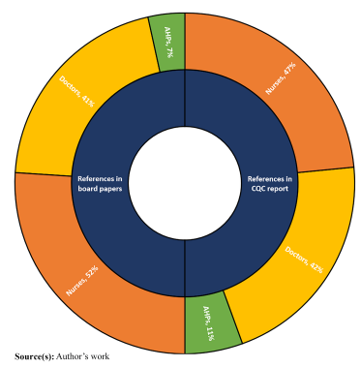
CQC & Board representation
Notes:
Public board minutes - 7% AHP, 41% for doctors, 52% nurses
CQC - 11% AHP, 42% doctors, 47% nurses

Slide 6
Safer staffing

Slide 7
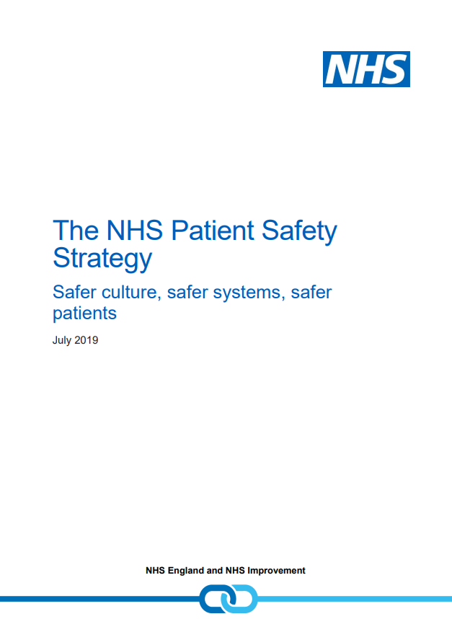
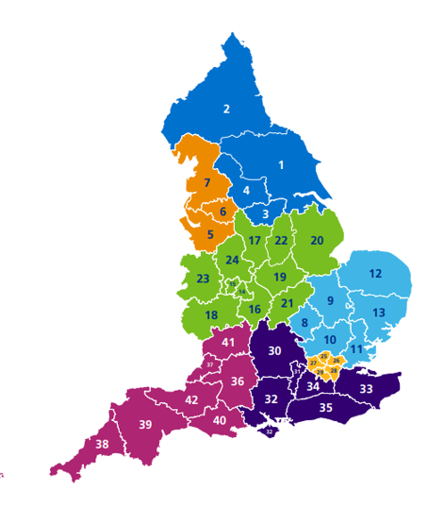
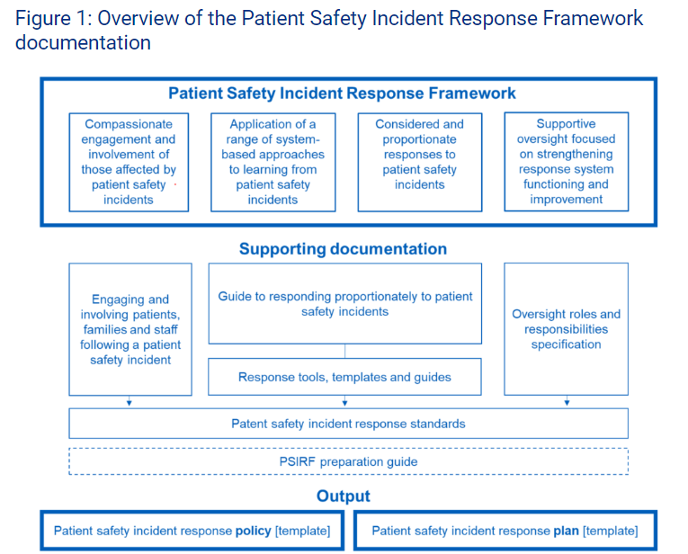
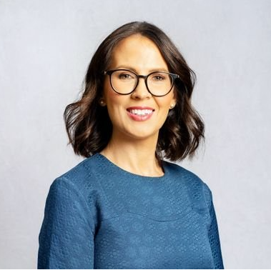
Opportunities
EARLY DRAFT

