Slide 1

Welcome!
#ELFTAHPCONFERENCE2024 #AHPsDay

Slide 2
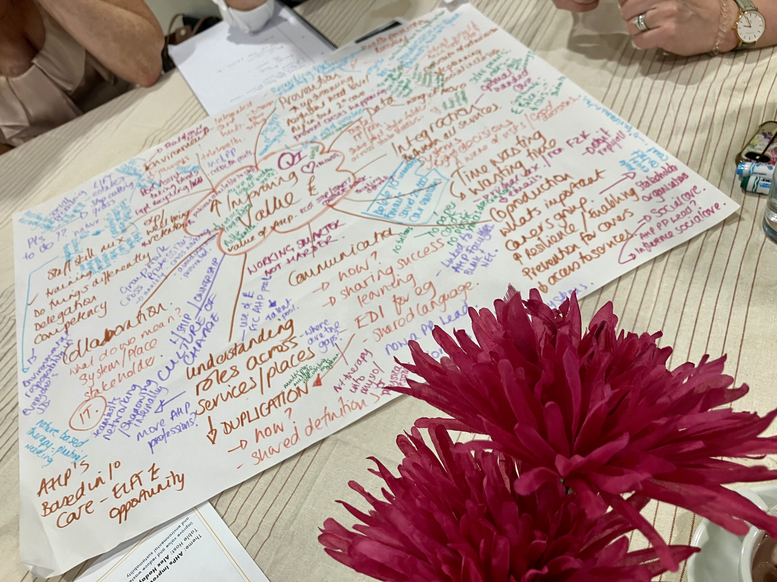
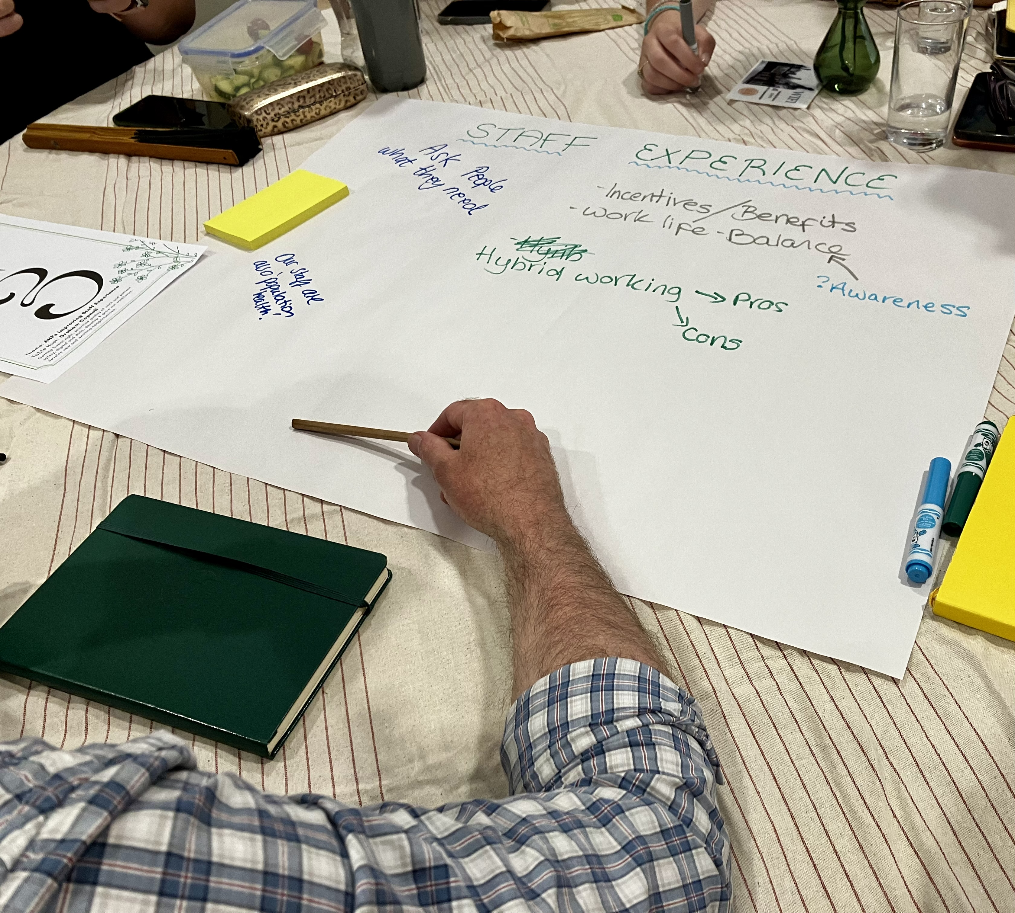
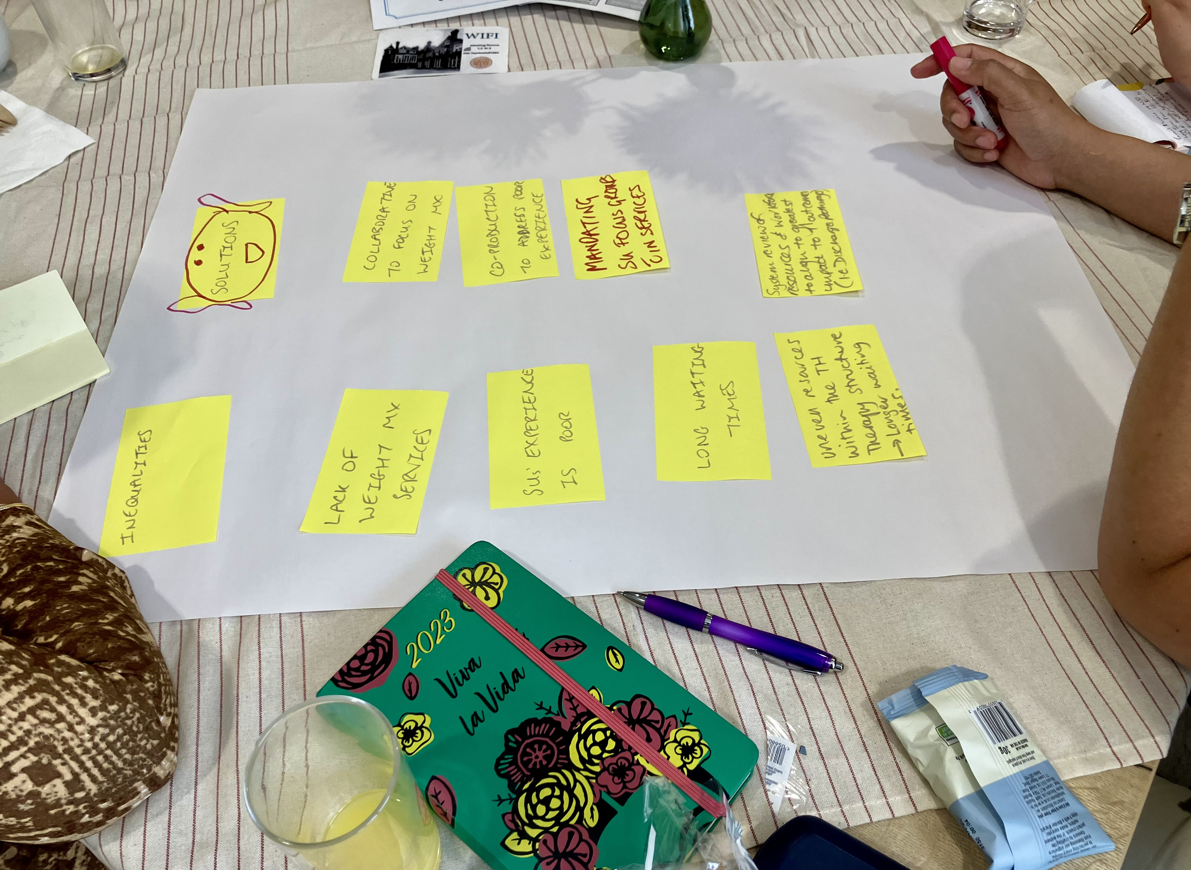
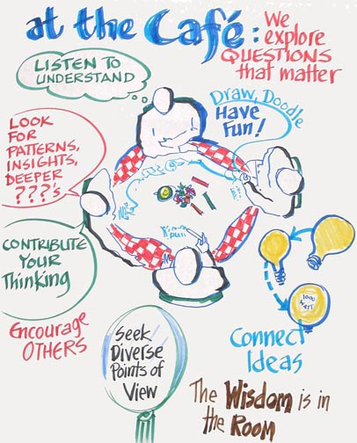

Our vision to
“Grow and Develop AHPs at ELFT to Reflect and Meet the Needs of Our Service Users”
Fiona Kelly ELFT Director of AHPs

Slide 3

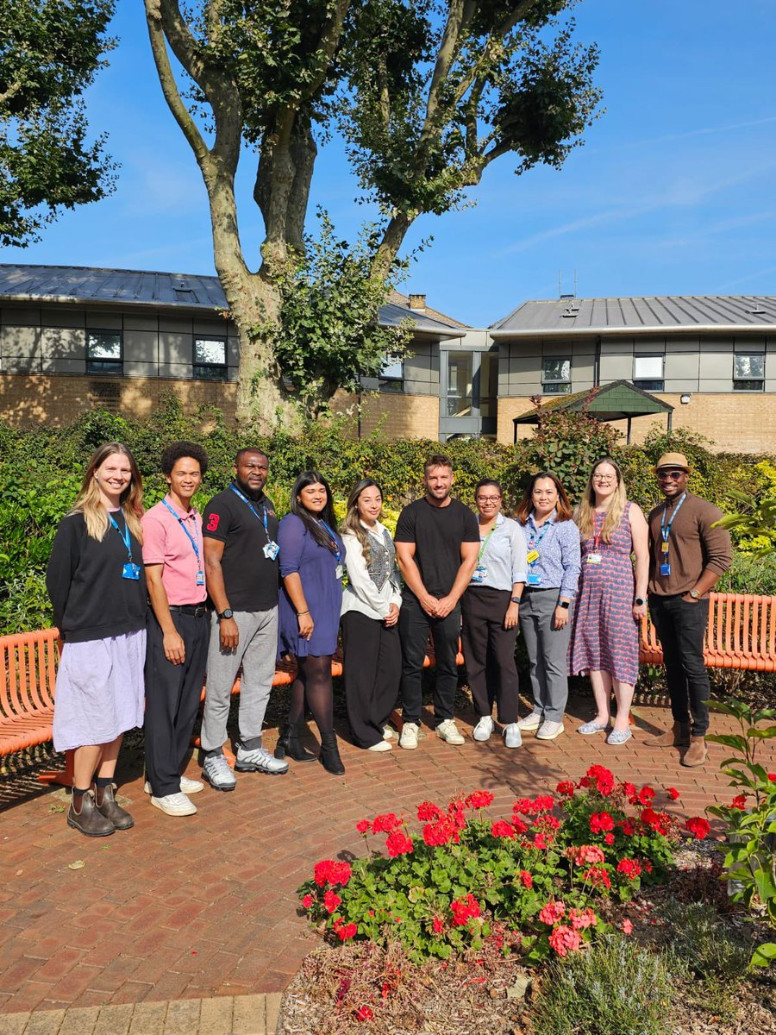
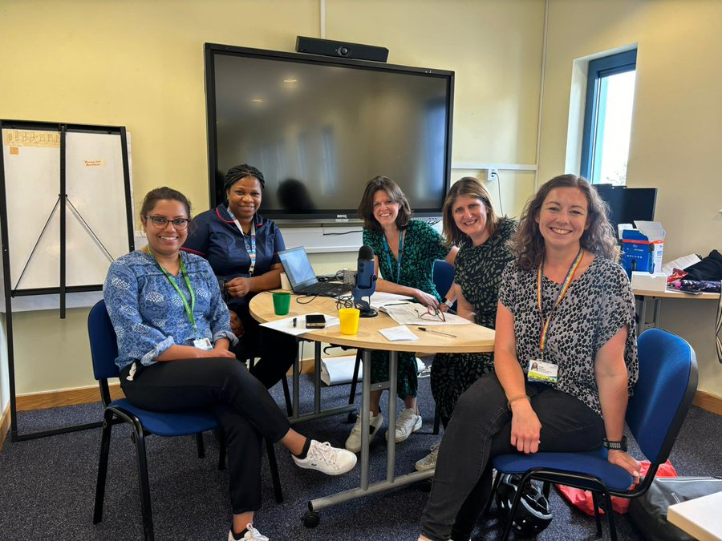

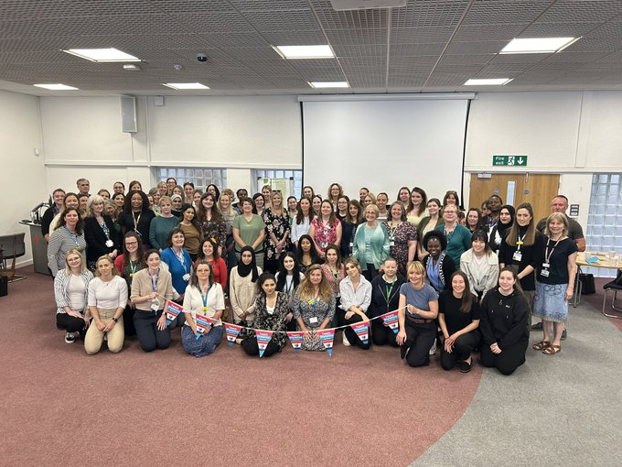
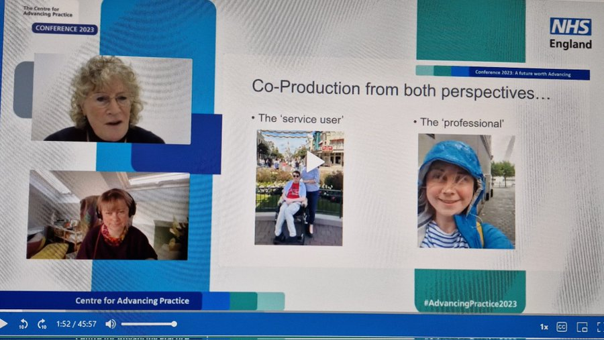
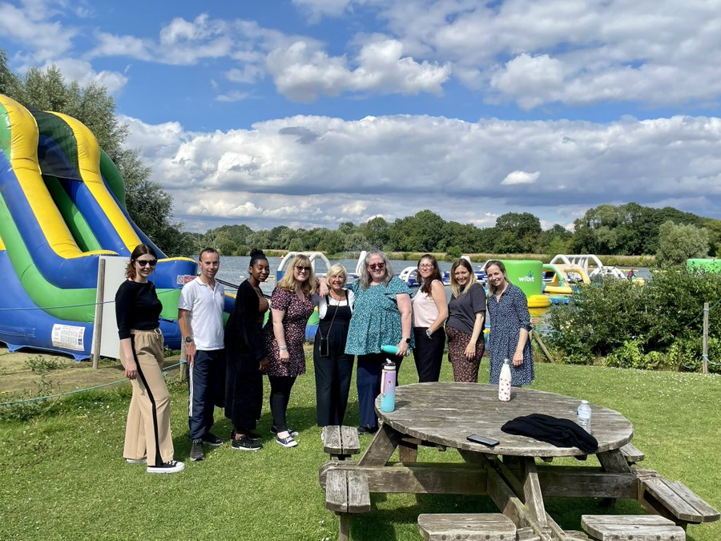
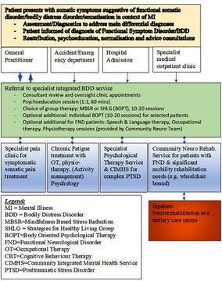
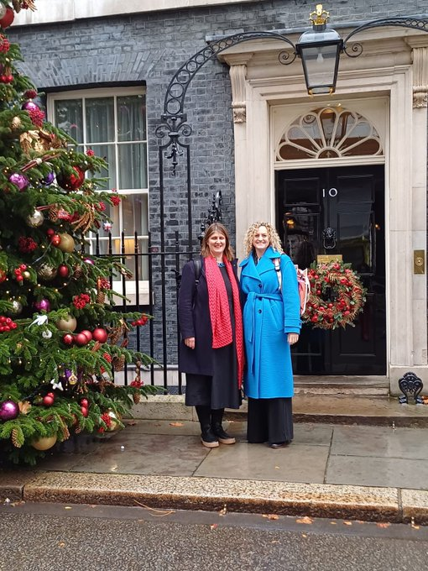

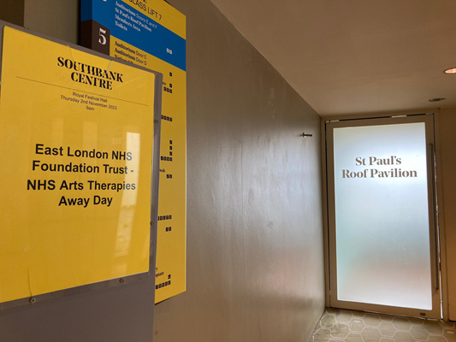
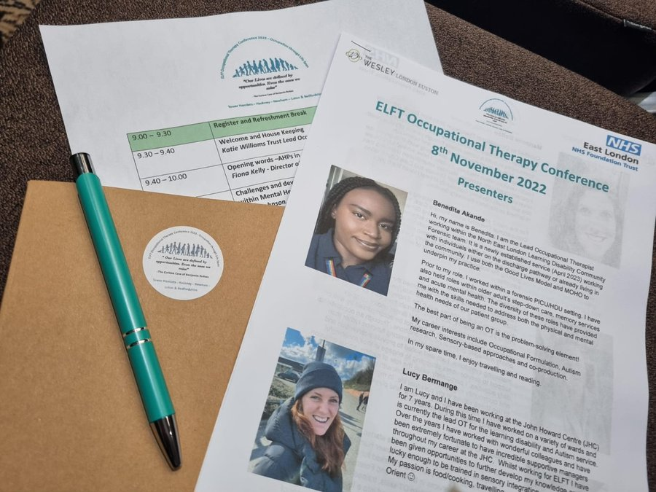
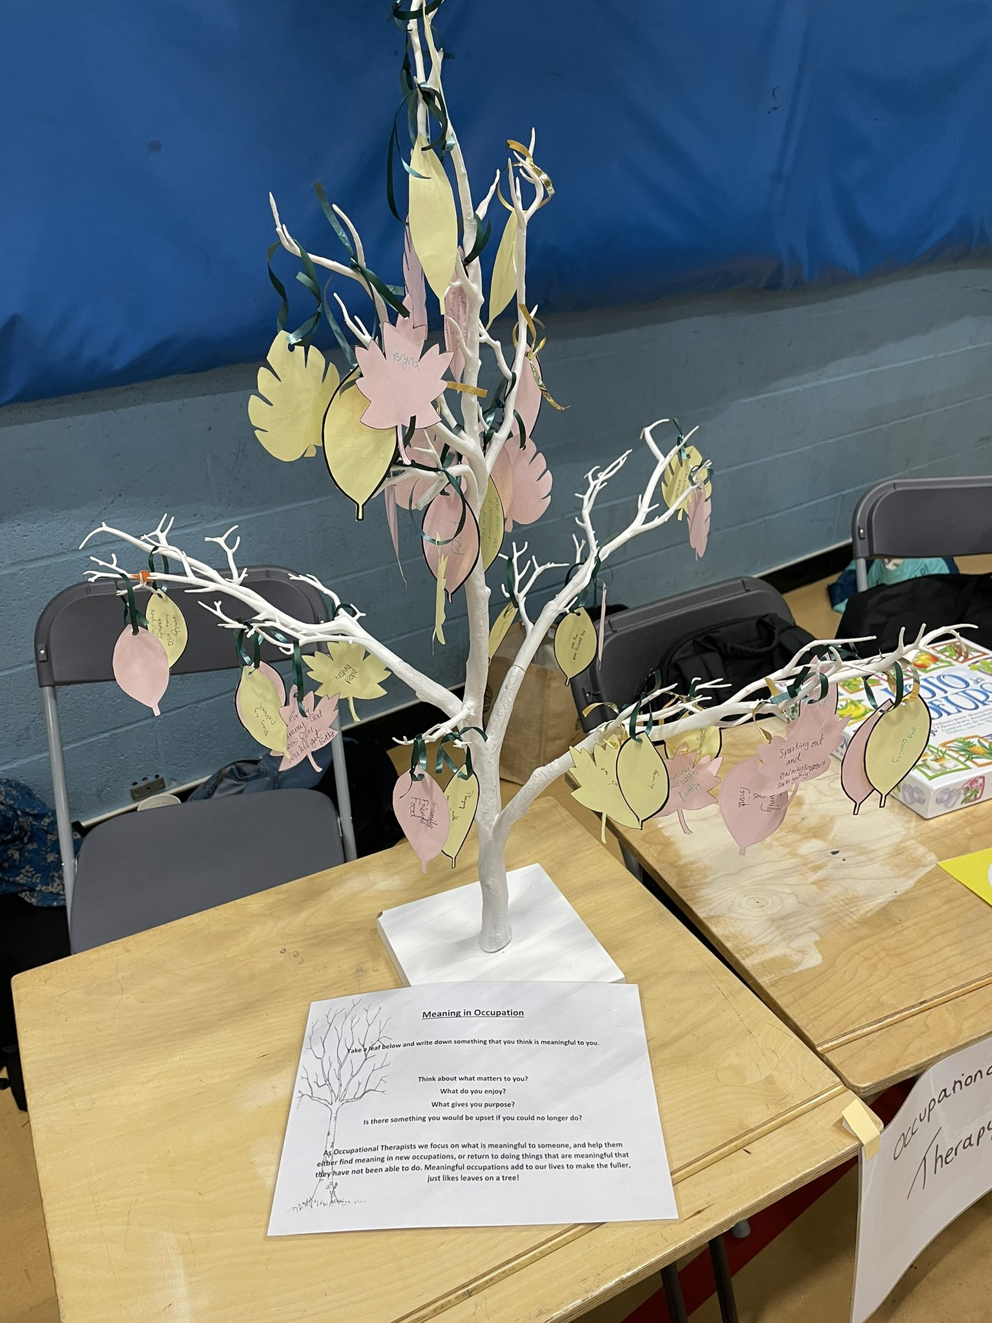
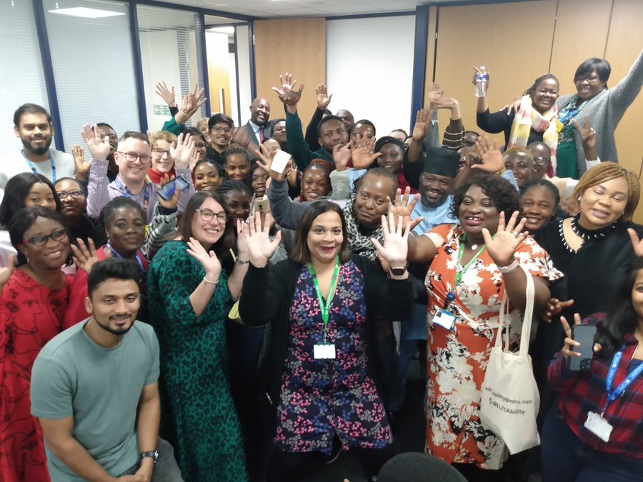
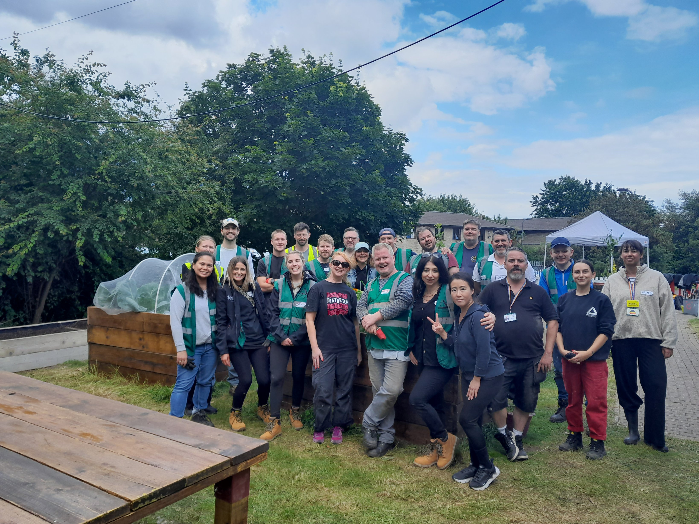

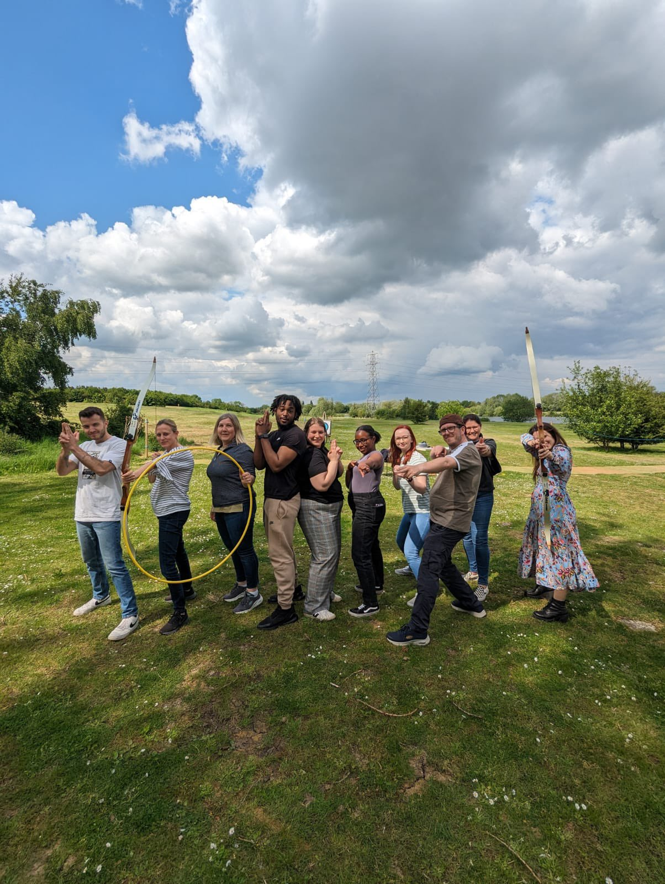
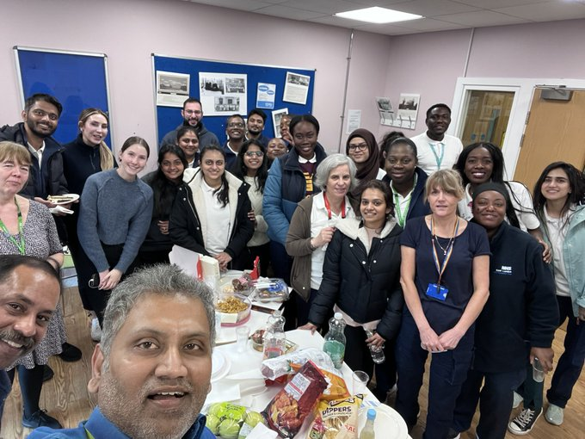
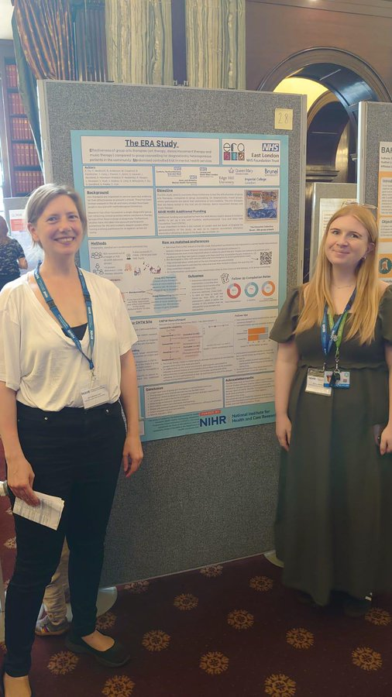
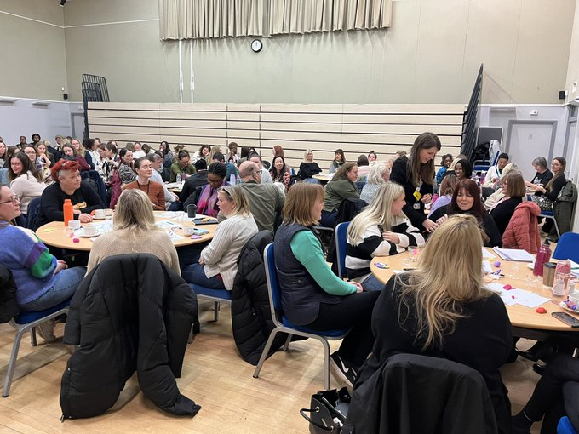
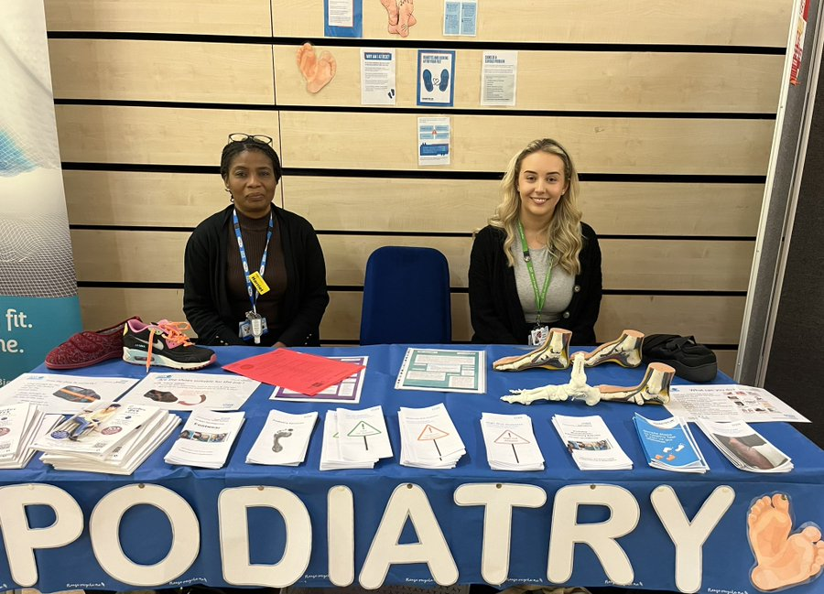
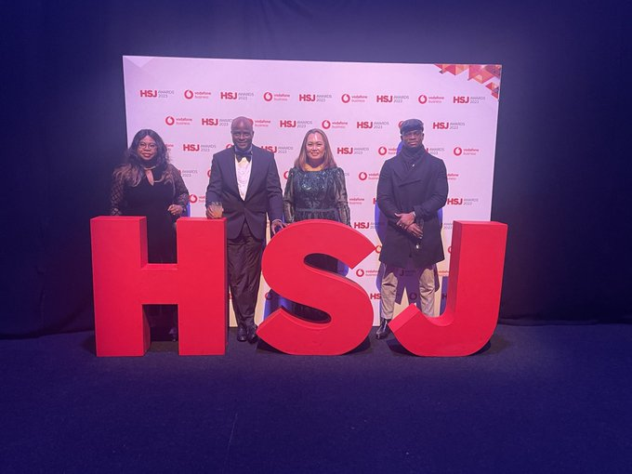
Our ELFT AHP Community
Supporting, Developing & Growing our Workforce
Research & Innovation
Innovation, Collaboration & Partnership
Annual Conferences & Away Days
Paper co-authored @NHS_ELFT
with partners across #BLMK & #ArtsTherapies defining a #Codesigned #ServiceModel 4 ppl with #BodilyDistressDisorders
Overjoyed to share our new #systematicreview on #forensicdramatherapy for adult #mentalhealth.

Slide 4
NHS staff are profoundly passionate and motivated to raise the quality of care for patients. Their talents must be harnessed to make positive change. The best change empowers patients to take as much control of their care as possible (Lord Darzi 2024)
Shift in Focus:
1/ Prevention & Admission avoidance
2/ Integrated Community Based Care & Long Term Conditions
3/ Digital & Technology
How?
Integration: Focus on place based, integrated, person centred holistic pathways: prevention, rehabilitation, and community based care, closer to home.
Workforce: Optimising, supporting, growing and developing variety of AHP and AHP support worker careers.
Leadership: Enable visibility & connection
Digital & Data: Enabling care & supporting workforce planning, quality & impact evaluation.
COVID Impact & System pressures
Rising Demand & Complexity: LTC, Ageing & growing population.
Impact of socioeconomic, climate, wider determinants of health and health inequalities
Climate Emergency
Staff experience and inequalities (WRES)
Workforce recruitment & Retention
Financial Viability Programme

Slide 5
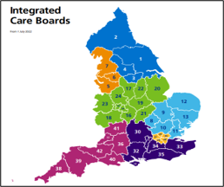


Chief AHP Officer NHSE
Suzanne Rastrick
NHSE Regional Chief AHP
Rachel Wakefield (EofE)
Phillipa Wright (London)
Regional AHP Boards
NHSE Regional AHP Workforce training and Education Lead (London & EofE)
BLMK/NEL AHP Councils
(Hannah Harniess Chief AHP NEL ICB) BLMK Chief AHP TBC)
BLMK & NEL AHP Faculty Leads
BLMK and NEL AHP Faculty Worksteams

Slide 6
Developing our ELFT AHP Vision and
Priorities
Listening and Connecting
Time with AHPs, Directorates, PPL, place based and wider system partners
Refreshing:
AHP Board
AHP workforce and Education Committee
AHP Plan 2021-2025
Engaging and Celebrating:
Greener AHPs Jamboard April 2023
AHP Research and Innovation Webinars
AHP Senior Leadership away workshops July 2023 & Feb 2024
Visiting Teams
AHP Week October 2023
24/25 Delivering our AHP Priorities
1/ Data & Informatics
2/ AHP Wide Projects
3/ Connecting and Collaborating
Feb 2023 to March 2024

Slide 7

Trust Strategic Objective
Priority areas for the service
Defined workstreams / projects / programmes for 24-25
Living Well
Working with our communities to enable equitable health promotion, prevention and living well.
Projects working with service users and communities to support prevention, self-management and patient activation.
AHPs involved within community place-based models of care and clinical pathway innovation e.g. Trieste, Intermediate Care and Integrated Neighborhood Teams
AHP Primary Care roles development and support
Improved Population Health
AHP Leadership
Raising visibility, diversity, reach & influence within clinical pathways & system transformation.
Project to develop and support diverse AHP Leaders who are able to be authentic, bring whole selves to work & reflect the communities we serve.
Review AHP leadership structures, support and development opportunities
Develop AHP communities of practice and/or professional networks
Celebrating and share AHP innovation and success through conferences, website and newsletters
AHP 2024/25
Annual Plan Priorities
To Grow and develop AHPs at ELFT to reflect and meet the needs of our service users
Improved Experience of Care
AHP Workforce Development
Growing and developing diverse AHP careers with equity of opportunities
Recruitment and Retention Project with focus on AHP Development Band 5-7
Scope AHP Workforce dashboard
AHP Support worker development project
Apprenticeship and undergraduate placement expansion
AHP Advanced clinical and consultant practice expansion
Improved Staff Experience
High quality, safe, effective and sustainable healthcare
Enabling right care, right time and right place to improve health outcomes.
Increase AHP use of digital tools and enabling technology to improve access and pathway efficiencies
Implement AHP job planning
AHP Annual safe staffing reviews
Widening access to AHPs to meet physical health needs in mental health
Scoping AHP Quality Dashboard
Develop AHP Clinical effectiveness champions/forum (Education/QI/Research)
Develop ELFT AHP champions/networks within Sustainability, Digital and EDI
Improved Value

Slide 8


We will work with our communities to enable equitable health promotion, prevention and living well.
Lead: Marion Levine & Sponsor: Fiona Kelly
Activities so Far:
What’s Next?
X11 projects
MHLDA, CHS & BCYP
Primary Care/Community/Vol Partnership
  1st July AHP Living Well Workshop with Population Health and Working Together Group colleagues.
  AHPs supporting physical healthcare in mental health & Population Health groups
  AHPs Making Every Contact Count (MECC) workshop Jan 2025
  AHPs build on supporting ELFT, Place based, System & Regional improvement networks and collaborative.

Slide 9
AHP Leadership
We will raise the visibility, diversity, reach and influence of AHPS within clinical pathways and system transformation
Leads: Graham Copnell, Rushmi Kanjee and Fiona Kelly
Activities so Far:
What’s Next?
New! AHP Intranet page and AHP email circulation
✓ELFT AHP Conference
✓ELFT AHP Day and AHP Research and Innovation Webinars
✓AHPs leading service and clinical pathway
transformation
✓Review of AHP WRES and Career Progression Data
AHP Career Progression Focus Groups in partnership with RaCE Network
Further develop AHP Intranet resources
Build on connections to Trust/System/Regional and National work-streams
Explore AHP Learning Forums/Professional Networks and Communities of Practice
Develop AHP Leadership support and development opportunities

Slide 10
AHP Workforce Development
We will Grow and Develop diverse AHP careers with equity of opportunities
Leads: Graham Copnell/Julie Archer/Nicola Larter
Activities so Far:
What’s Next?
AHP Support Worker Project:
Identified 145 AHP support staff
Support Worker Survey (over 80 Reponses
Draft AHP Workforce Information Dashboard
Internationally recruited AHPs pastoral support and resources
X23 AHP Apprentices graduating 2024.
ELFT AHP Preceptorship Programme award.
X9 AHP Trainee Advanced roles
B7 Practice Education Facilitator (FTC)
Support recruitment and retention Projects
Connect to Trust Workforce Steering groups
Advanced roles AHP Network & expansion
AHP Workforce Research project

Slide 11
High Quality, Safe, Effective & Sustainable Healthcare
We will deliver High Quality, Safe, Effective and Sustainable Healthcare
Leads: Julie Archer, Graham Copnell and AHP Leads
Activities so Far:
What’s Next?
AHP Job
planning Project
Business case e-job planning software
x8 early adopter pilot sites co-design, test and learn
Share & build on learning from AHP Time In Motion & Job Planning Pilots
Grow and establish AHP Digital and Greener Champions
✓AHPs supporting physical healthcare in mental health & Population Health groups
✓Exploring AHP Quality Dashboard Framework
✓Digital pathway innovations (MSK/CAHMS/Forensic)
✓AHPs linked to Trust Climate Network

Slide 12
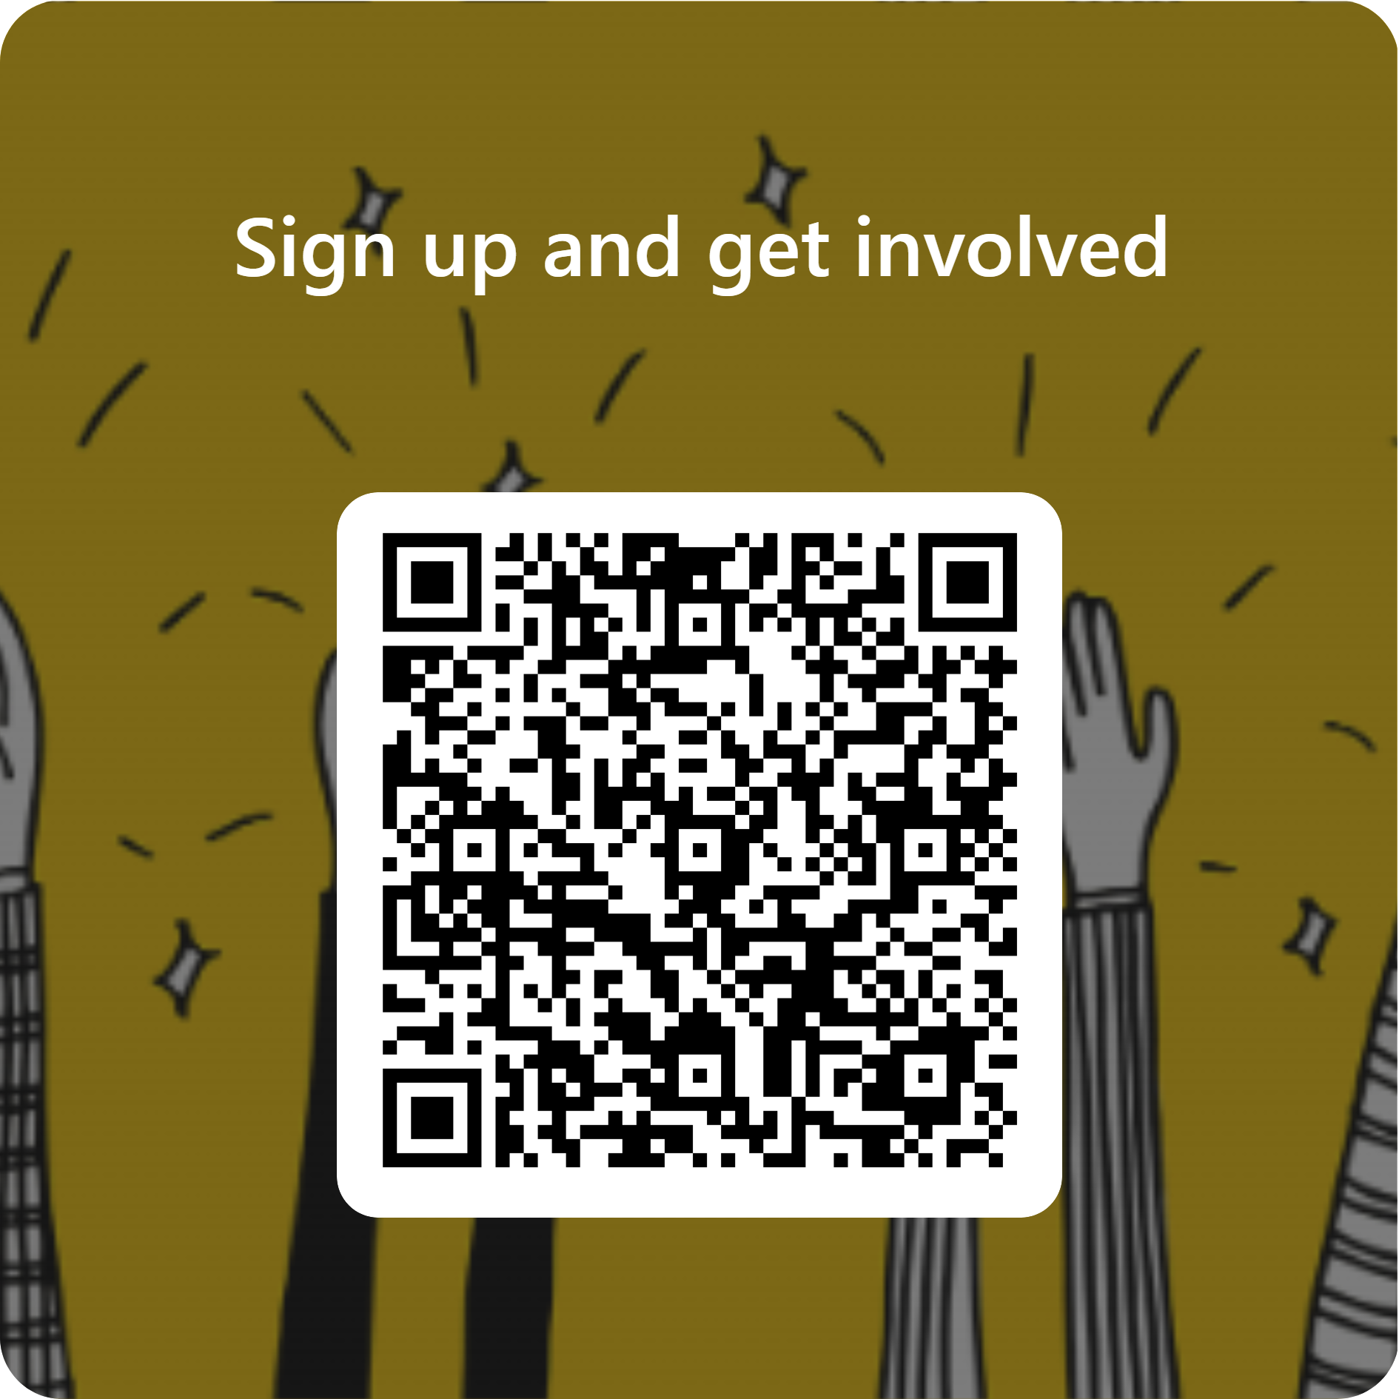
Invitation to Sign Up and Get Involved:
Who can get involved?
Any member of the ELFT AHP Community Registered and Support staff
What is the commitment?
You will receive invitations to get involved in work within area of interest
Time limited workshops/task and finish/QI groups
Why get involved?
You are passionate about the area and keen to contribute existing work or new ideas
It aligns with work you are doing within your team/service/directorate/professional group
Development opportunity:
  Work with colleagues across the organisation
  Build on your experience, develop your CPD and CV

Slide 13
Thank you
Fionakelly2@nhs.net
Linkedin
AHP Hub:
https://www.elft.nhs.uk/intranet/things-support-me-do-my-job/allied-health-professionals-ahp-elft
AHP Corporate Team:
Graham Copnell AHP Professional Development Lead
Emily Matthews AHP Professional Development Lead (Beds and Luton)
Nicola Larter AHP Support Worker Project Lead

