Slide 1
Research and academic careers

Slide 2
Notes:
The amin theme of the conference is to bring us together as an AHP community to share best practice, celebrate our achievements and identify opportunities for further developments.
This seminar is going to focus on the latter and explore opportunities to develop in the research and academic spaces.

Slide 3
Notes:
Thinking back to the AHP annual plan that Fiona introduced this morning, this seminar addresses in part, the areas of AHP leadership and workforce development.

Slide 4
Aims and learning outcomes
Provide information about funded opportunities to develop research skills
Explore AHP research journeys
Discuss ways of moving AHP research in ELFT forward
Notes:
Over the next 30 minutes or so we would like to provide some information about opportunities to be involved in research in NEL, listen to two of our colleagues talk about their research journies and experience and finally here from you about how you think we could support research opportunities for AHPs

Slide 5
Where to start?
Video Project 2.mp4
Nicki Power Doctoral Research Fellow supported by Barts Charity | Art Therapist Unit for Social and Community Psychiatry WHO Collaborating Centre for Mental Health Service Development Queen Mary University of London 🚩Newham Centre for Mental Health | London | E13 8SP | United Kingdom
Dr Catherine Carr
Music Therapist, Mental Health Care for Older People Leadenhall ward, Tower Hamlets Centre for Mental Health Senior Clinical Lecturer in Music Therapy, Unit for Social and Community Psychiatry, Newham Centre for Mental Health Chief Investigator, ERA study - Effectiveness of group arts therapies for diagnostically heterogeneous patients in community mental health care: Randomised Controlled Trial East London NHS Foundation Trust
Notes:
Getting involved in research and academia can be a daunting thing and it is often difficult knowing where to start.
We thought it might be useful to hear from two colleagues currently involved in research in ELFT to find out about their experiences

Slide 6
HCPs Clinical Academic Careers
Local opportunities
Jamila Kassam Academic Strategic Lead

Slide 7
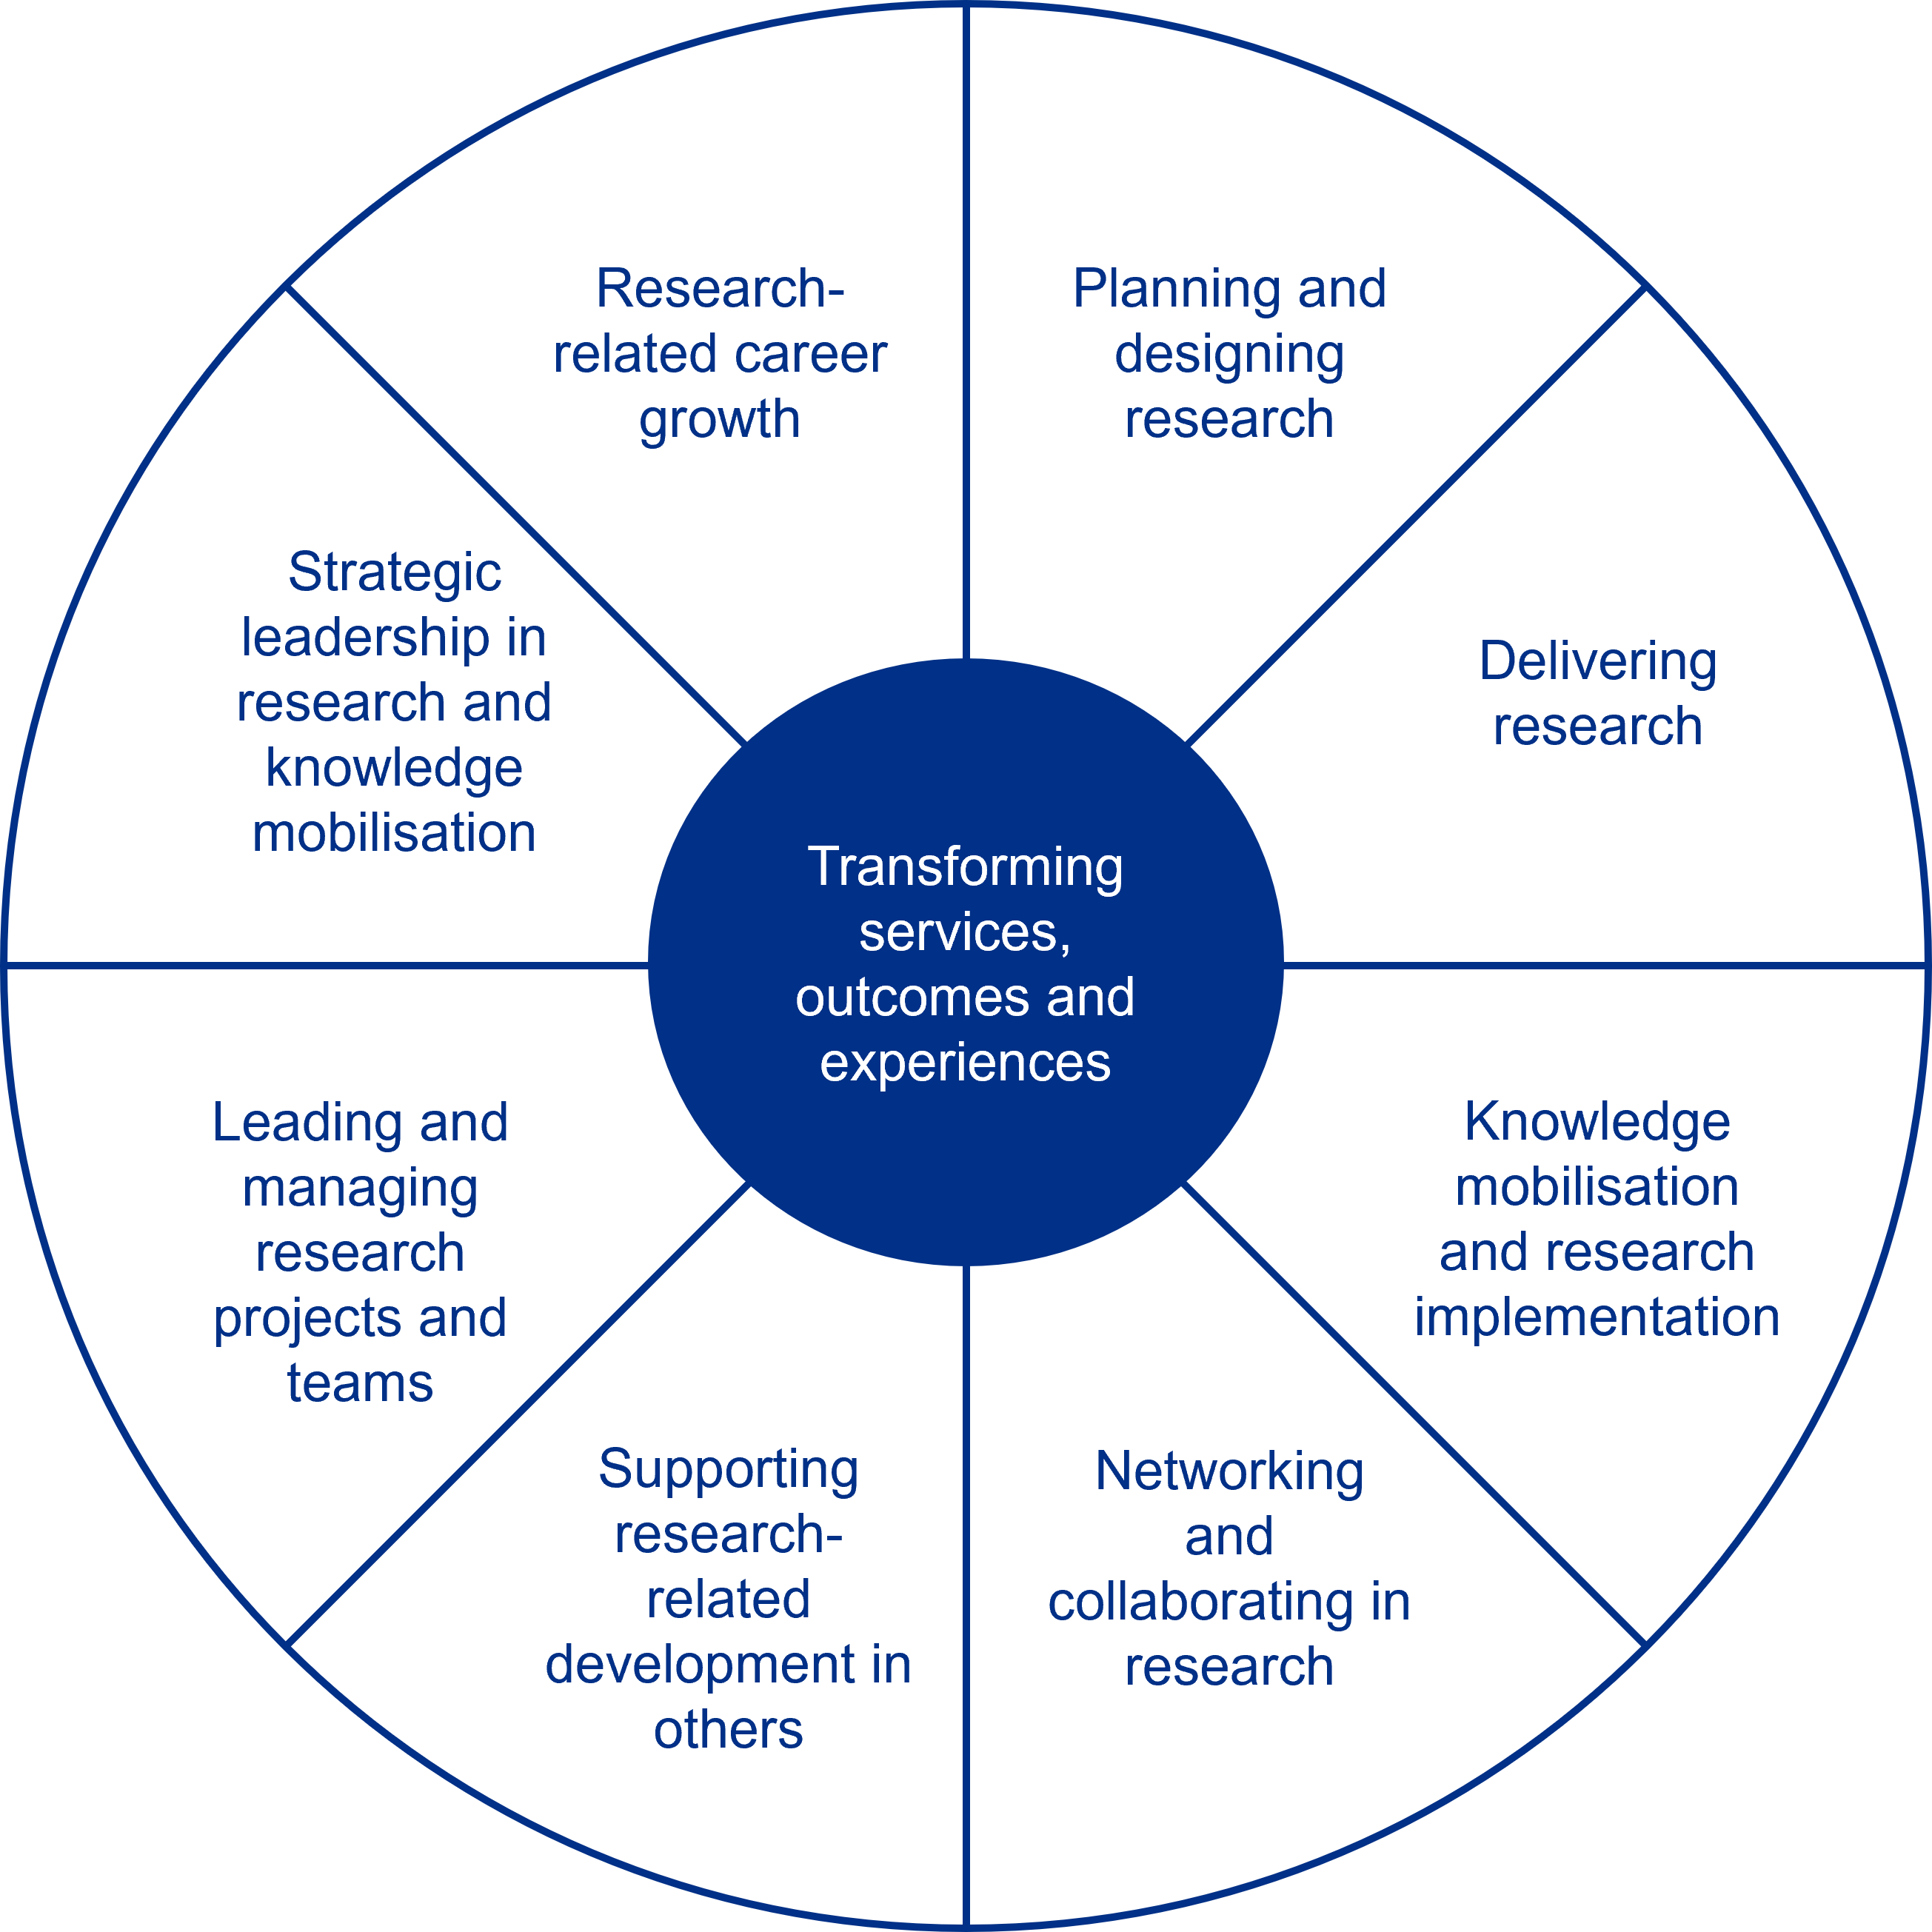
Research Capabilities Framework
NHS long term plan and NHS people plan to serve community and develop people
Entry
Enhanced
Advanced
Consultant
Detail HERE

Slide 8
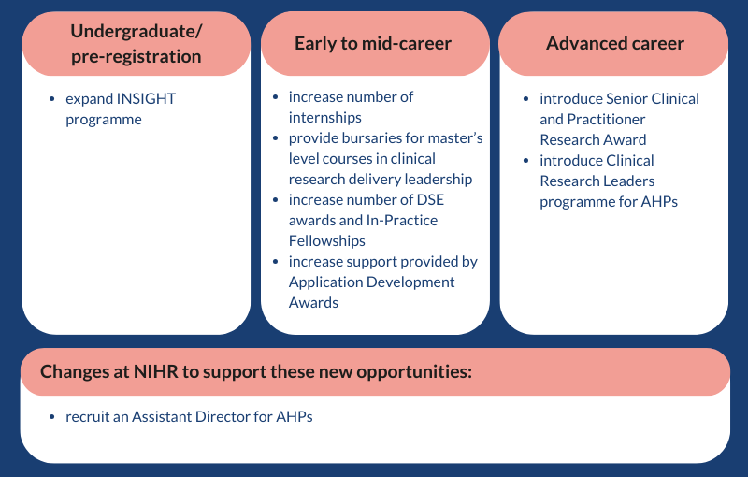
NIHR Opportunities
Significant investment from NIHR for HCP academic careers

Slide 9
NIHR Insight
Early Career opportunities including internships, events, research cafes and workshops across NEL.
Funded masters studentships (x30 annually)
MSc Global public health and policy QMUL
MSc Public mental health QMUL
MSc Healthcare research QMUL
MRes Clinical research City St Georges
Student stipend provided
Mres or MSc can cost £15K
Band 5 clinicians will take home after tax £29,784.72 , if they were to self fund they’d have £14,284.72 left.
This award gives £20,266 tax free and the fees are paid
Key Dates
Application deadline End of Feb 2025
Interviews 2nd week March, offers 3rd week of March 2025
Course start October 2024

Slide 10
Applied Health and Care Research PGDip Apprenticeship – Fees £9000
Institute for Apprentices and Technical Education, Academic Professional, Level 7, Research Specialist
Semester 1, year 1 - 30credits
Semester 2, year 1 -30 credits
Semester 3, year 2 30 credits
Introduction to Research
Choosing and using research
Developing new research questions
Semester 4, year 2 - 30credits
End Point Assessment
Level 7 Apprentice Award IFATE
PGDip Award QMUL
Semester 5 & 6, year 3 –
60 credits
Research in Practice
Dissertation
Module Lead TBC Blizard
MSc Award QMUL
Optional top up to MSc
- £4500
- Academic year 3

Slide 11
BRC
NIHR award to Barts Health NHS Trust to develop research capacity and infrastructure
MSK, Cancer, Cardiac themes
BRC Precision medicine training academy
4 NAP posts post doctoral level (up to top of band 8a)
Funded by NIHR / BTLC with training costs provided annually
Matched local funding
50:50 research:clinical

Slide 12
The Detail..
Recruitment windows will be in 2024 and 2025 with ACLs typically being recruited Q2/Q3 allowing a start in October 2024 or 2025).
ACLs postholders will be expected to Undertake the clinical responsibilities and:
Development required by the role as instructed by the trust
Develop a post-doctoral fellowship application aligned to the area of their ACL for submission by the end of the post •
Contribute to the academic work of the BRC theme, as appropriate
Actively contribute to the research capacity building work of the BRC and hospital
clinical academic departments Time-period of ACL role The likely

Slide 14
A little bit of Menti
https://www.mentimeter.com/app/presentation/n/algpwenyt2z4p5wtqrsnppfh6ev7eni2/present?question=recy9afqoyau
https://www.mentimeter.com/app/presentation/n/algpwenyt2z4p5wtqrsnppfh6ev7eni2/present?question=thdbnaiehiqq
https://www.mentimeter.com/app/presentation/n/algpwenyt2z4p5wtqrsnppfh6ev7eni2/present?question=zinbuqu7frb1

Slide 15
Scan here for all the seminar presentations

