Slide 1
Pathways App
AHP Conference.
Brenda Abrah
Specialist Occupational Therapist
Phoebe Swinburn
Senior Occupational Therapist
Jess Bolton
Occupational Therapist
Francesca Kamil
Occupational Therapy Assistant
Notes:
Add logos - CS

Slide 2
Introduction
A web app designed by OT/SU team
Co - Produced
Originally an OT-specific project - now MDT
Closed-testing & Pilot Stage
Notes:
Sean

Slide 3
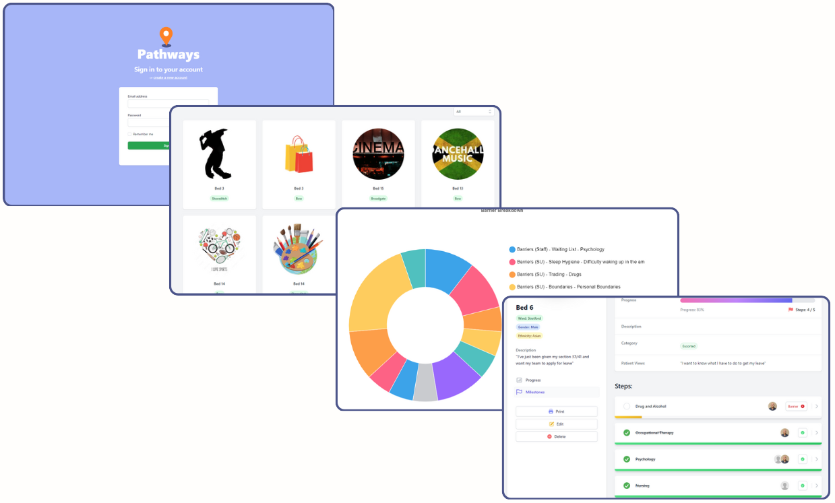
Project Methodology
Co-Production
2 years in development
Over 50 Staff & Service Users input
10 + Focus Groups
Common themes:
“Stuckness”
Understanding of hospital pathway
Service-User Confidence
Feeling decisions are being made for them
Lack of clarity around goals
Co-Production
Quality Improvement
QI Reps
Driver Diagram
Measurement Plan
> 20 active PDSA cycles on QI Life
35 + Staff Champions
Questionnaires > 80 service user responses across 10 wards
Notes:
Claire
Questionnaires
Asked things like do you understand your hospital pathway over 50% dont
Do you feel stuck in hospital? 66% yes
Do you feel decisions are made for you in hospital? 81% yes or sometimes

Slide 4
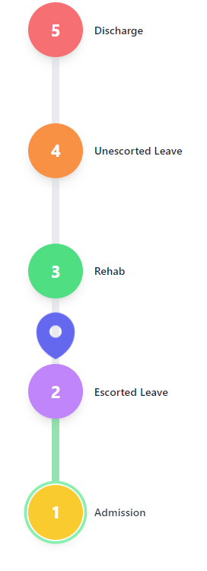
The Pathway
The Pathway: Showing progress
Provides a clear visual overview of a patient's projected recovery journey through the service. The Pathway’s line turns green according to progress.
Developed based on feedback from service users that they felt unclear on their planned journey through hospital.
Example Pathways: discharge, escorted leave, unescorted Leave, transfer to low-secure hospital.
Each Pathway is agreed by the MDT, and can be easily edited at any time.
Printability function – service users and staff can keep a copy of current progress.

Slide 5
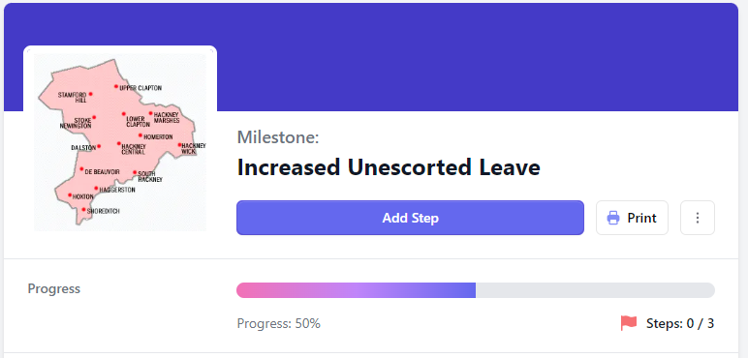
Milestones
Clear and Shared Goal-Setting
Milestones are overarching goals that are important to the service user.
Each Milestone is individualised to the patient - capturing their views on what is really important.
Examples of Milestone categories are: Escorted leave, Discharge and Weight-loss
Notes:
Sean to do
Include dashboard

Slide 6
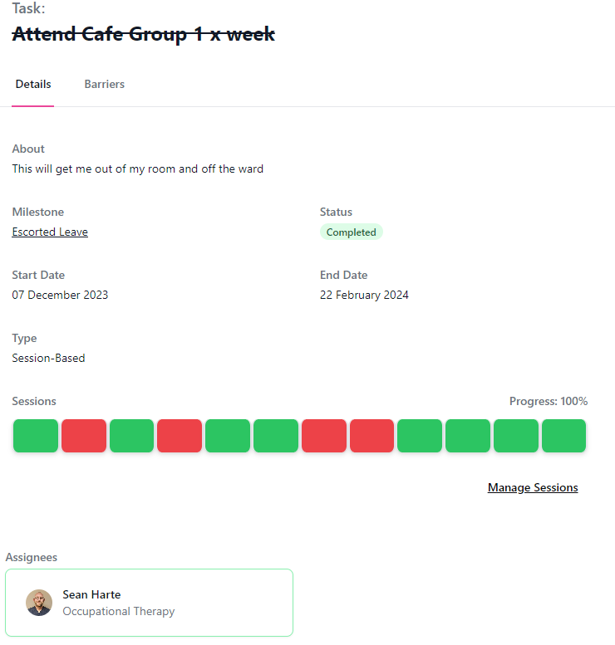
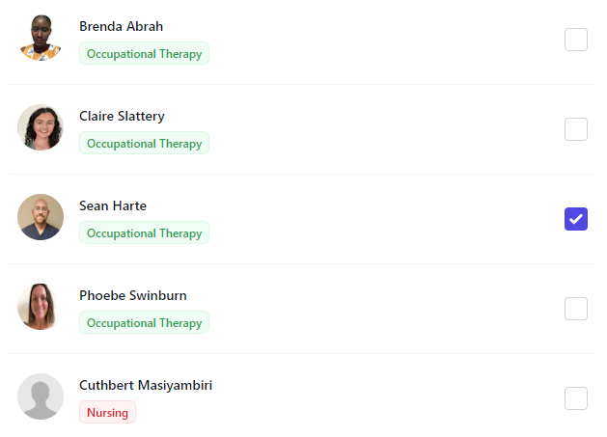
Milestone breakdown
Steps
Tasks
Accountability
Milestones are broken down into steps, categorised by MDT discipline.
Provides a clear overview of what steps need to take place, and by whom.
Creates an interactive, streamlined shared list of actions.
These tasks are allocatable to specific team members or the patient.
Each task can be assigned a due by date, with email reminders sent regularly.
Steps are broken down into smaller, time specific tasks.
Notes:
Sean to do
Include dashboard
Phoebe
SMART goal methodology
Steps and tasks can allocated to individual staff or teams to enhance accountability
Each MDT can see each others steps and tasks
Run through the app, how we decided with the service users was to break down into three elements when setting goals
Put in a screenshot of the app for barriers and allocating a tasks.

Slide 7
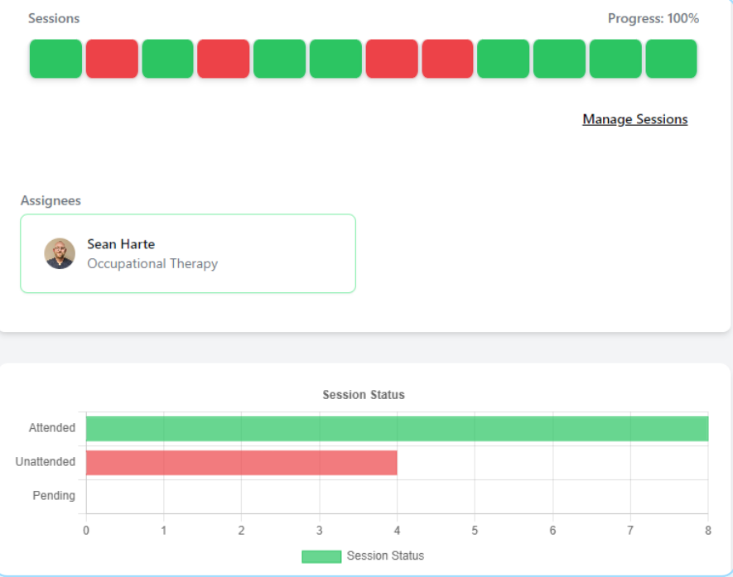
Engagement monitoring
Keeping track of progress
Attendance and engagement can be continually reviewed with the option to set sessions as one-off, weekly, or monthly reviews
Green boxes indicated sessions attended
Amber reflects the need for the session to be reviewed
Red boxes equate to a missed session
When you mark a session as red, it allows you to capture the reason the session did not take place via a dropdown selection box
Notes:
Sean to do
Include dashboard

Slide 8
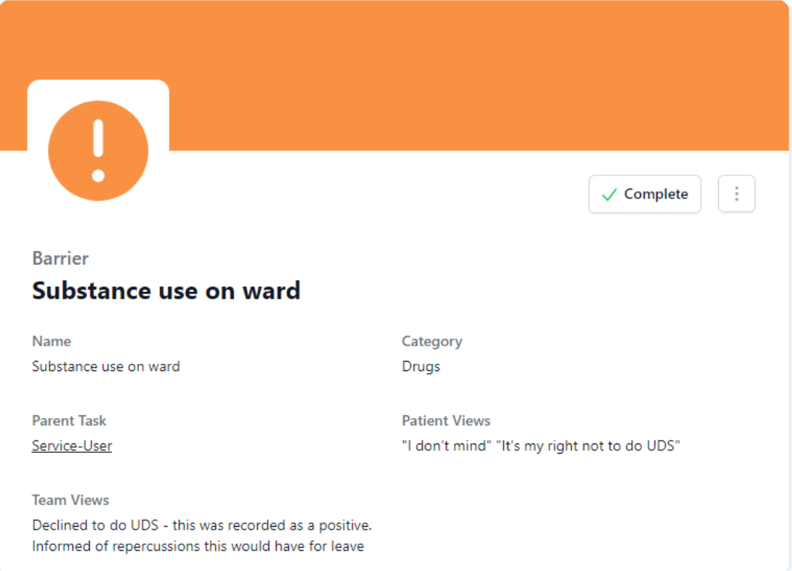
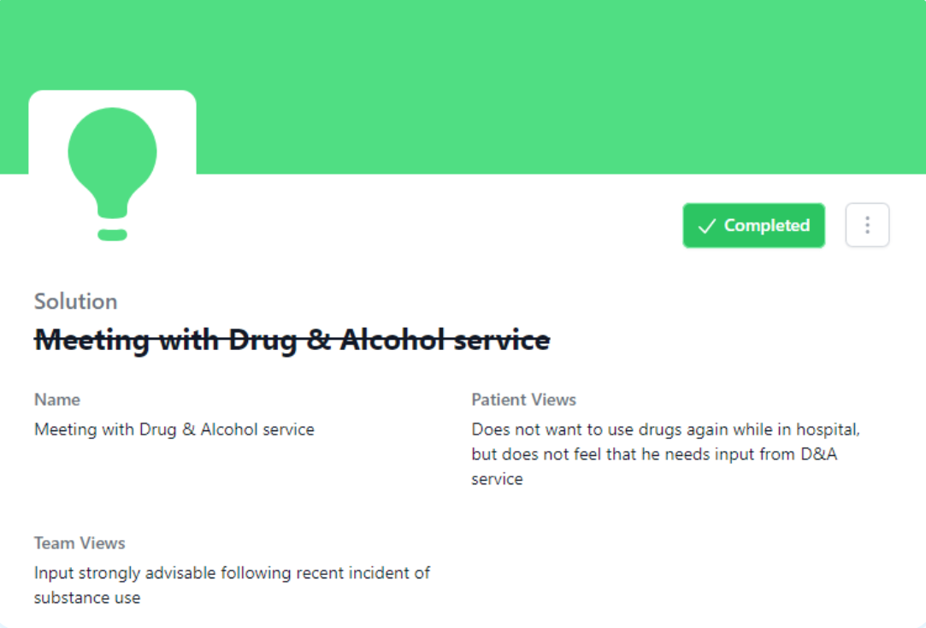
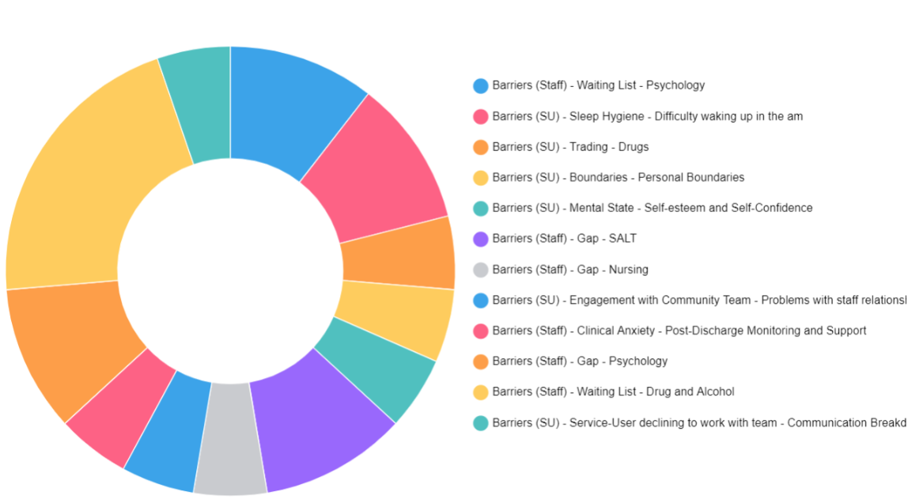
Overcoming challenges & capturing data
Barriers
Solutions
Analytics
If a task is unable to be completed, the reason why can be logged as a 'barrier'
Highlights challenges to be addressed by the team and patient
A solution is a shared response from the team to action and solve the barrier.
Pathways gathers insights from user interactions, allowing continuous improvements and informed decision-making.
Users can sort by MDT, ward or by individual patient to get a detailed overview of barriers to recovery, why sessions are DNA’d, etc.
Notes:
Sean to do
Include dashboard

Slide 9
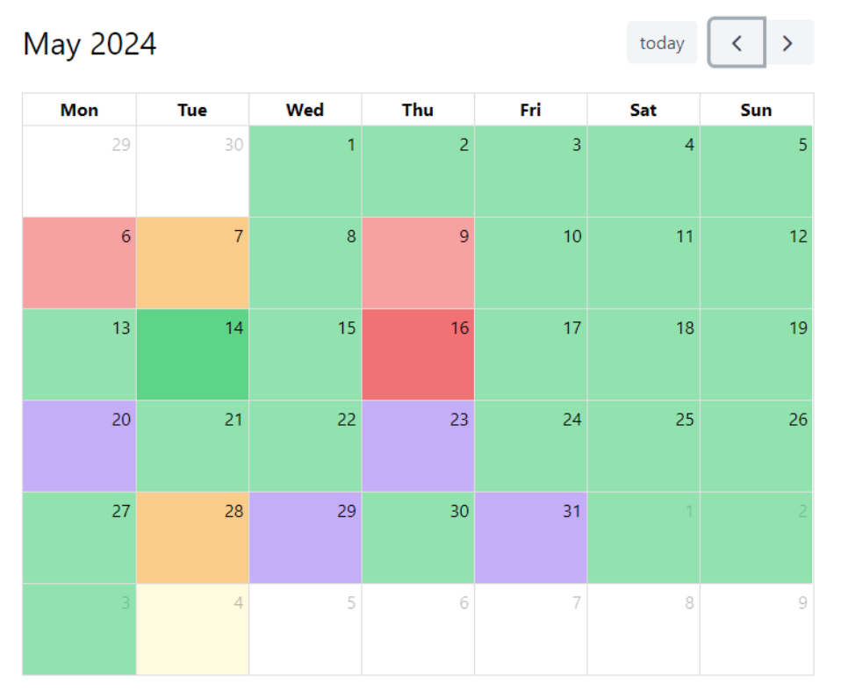
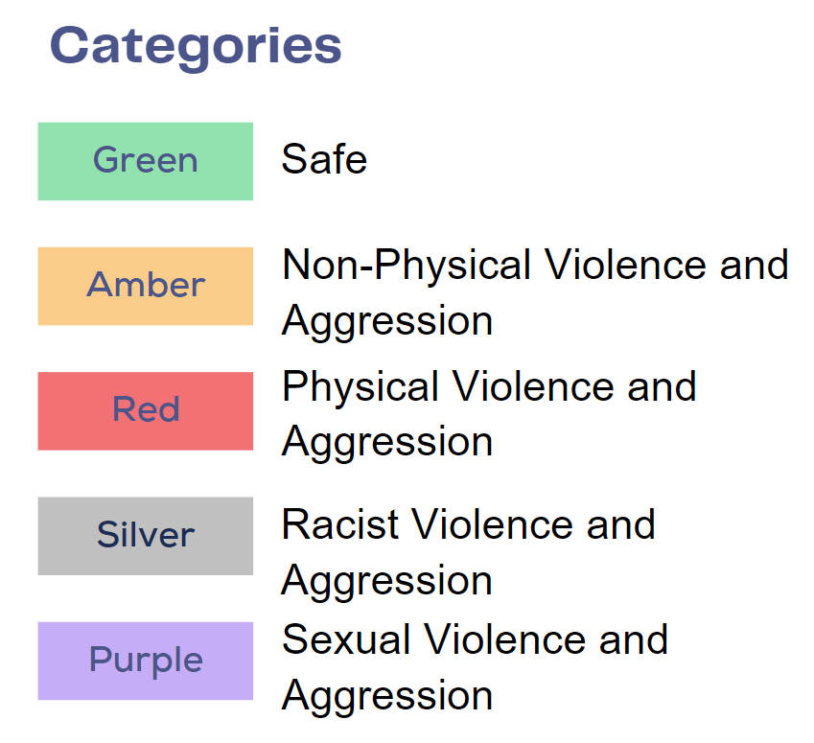
Promoting a safe environment
Safety Tracker
If required, patients can be set up with a Safety Tracker.
This tool helps you to log behaviours and interactions that impact the safety of the ward.
Notes:
Sean to do
Include dashboard

Slide 11
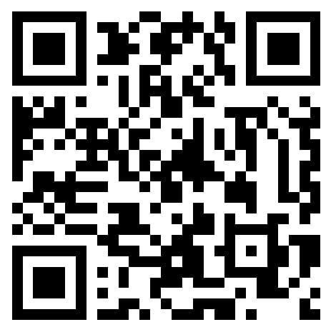
Thank you, any questions?

