Slide 1
Network Overview
There are 6 networks at ELFT. Each network fulfils various functions including providing opportunities for social interaction, peer support, and personal development.
Staff Equalities Networks can also contribute to the development of Trust policies and practices and have a pivotal role in channeling staff voices, building actions plans for organisation development, and improving working conditions of our workforce.
ELFT
Men’s Network

Slide 3
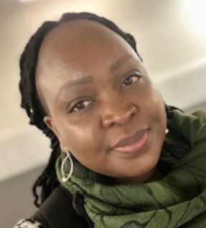
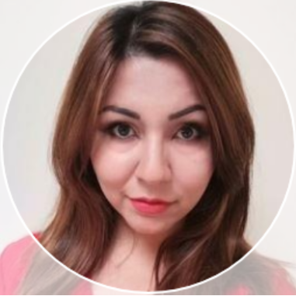
Meet the team
Edwin Ndlovu
Edwin Ndlovu
Executive Sponsor
Executive Sponsor
Vacant Post
Network Lead
(Luton & Bedfordshire)
Seconded Role
Annabelle Lambourn
Network Lead
(London)
Seconded Role
Sahar Kariz
Network Coordinator
Seconded Role

Slide 4
What does the network mean to its members?
“A safe place, a place of belonging where there is respect and understanding”
“Working to look at the needs of non-white staff members”
“A place for people of colour to get together and talk about issues concerning race”
“Supports, empowers and gives a voice to staff from different ethnic groups”
“A safe place to discuss challenges and barriers but to also celebrate diversity”
“Gives us a voice”
“It makes me feel acknowledged”
“Education, information, understanding”
“Representation of global majority”
“The coming together of like-minded individuals from diverse backgrounds”
“A place I can be part of a wider community and celebrate my ethnicity and learning about others”

