Slide 1
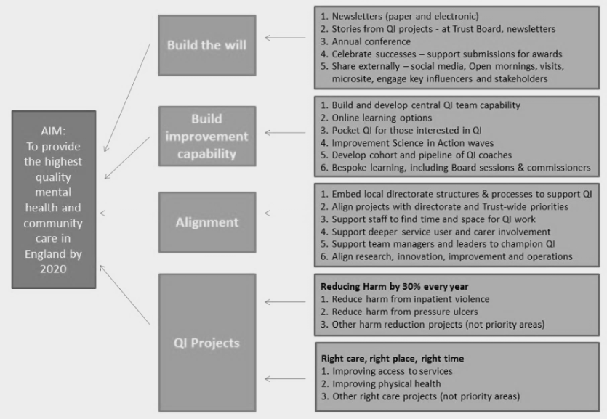
INSERT High quality Team photo
INSERT PROJECT TITLE
INSERT PROJECT TEAM MEMBERS, QI COACH & SPONSOR
Life QI Code:
What is your main achievement with this project Think of a newspaper headline!
Aim
How did you involve service users and carers in this work?
Tests of Change
What was your aim, and why was this important to work on
Also, how have you involved Service Users and carers in the project; Big I or Little i
These are the ideas that your team tested and implemented.
Driver diagram
Data
Share your data and stories
EXAMPLE
Learning and what next?
What have you learnt from this Project? Did you see an improvement in your system? How has this impacted your work individually and as a service? Will you use QI to tackle another issue?

Slide 2
Tell us your story in a nutshell
In no more than 100 words, roughly equal to the text that will fit in this box. Tell us what you have achieved with your quality improvement work.
Not everyone is familiar with driver diagrams, control charts and PDSA cycles. So to make your story as accessible as possible, use this space to tell us very simply:
What you have achieved
What you and your team have gained from the experience
What this means for staff, service users and carers
What is next for you and the team
Any additional team or project photos?
Paste them into a slide and we will share them with your project story!
Please return your completed poster to elft.qi@nhs.net

